Slide 1
Team Teaching Bringing Theory and Practice Together
Dr Vicky Nagy, Senior Lecturer in Criminology, University of Tasmania
Katherine Ibbott, Learning & Development Manager, Community Corrections, Department of Justice Tasmania

Slide 2
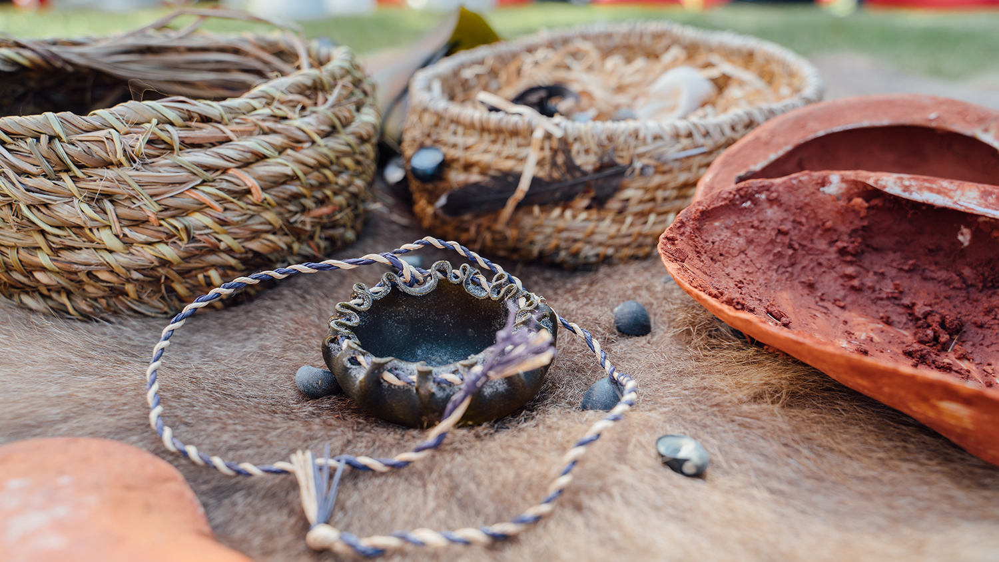
Acknowledgement of Country
We acknowledge the palawa/pakana of lutruwita, the traditional owners of the land upon which we live and work.
We acknowledge the Gadigal people, the traditional owners of the land upon which we meet today.
We pay respects to Elders past and present as the knowledge holders and sharers. We honour their strong culture and knowledges as vital to the self-determination, wellbeing and resilience of their communities.
We stand for a future that profoundly respects and acknowledges Aboriginal perspectives, culture, language and history.

Slide 3
Who We Are

Slide 4
Why Team Teaching?
Working With Offenders started in 2005
On hiatus from 2016-2019
2019: Vicky takes over, Kate is guest presenter
2020: Kate on board as tutor
2021: Let’s boogie! Winter school, intensive 5 days
Wide variety of students: social work, criminology, psychology, law, as well as police officers and corrections staff
2022: extended to 6 days, 30 hours of engagement, facilitating 15 hours each

Slide 5
Team Teaching
What is it?
Finkel and Arney (1995) put forward five criteria of true collaborative and collegial teaching:
the teachers respect each other as intellectual equals and behave this way in front of students;
the teachers are different (as to gender, age, culture, experience, world views, priorities) and are interested in their differences;
the teachers interact meaningfully with each other and the students, not just divide content to deliver;
the course is inquiry-centred with an interest in conversation rather than just delivering set content; and,
the teachers conceive of the students as auditors then full participants in the construction of knowledge.

Slide 6
Team Teaching (Cont’d)
What it normally looks like
“Sage on the stage”
Guest lecturers on topics of expertise
Disjointed, sequential lectures
“Relay Teaching”
What it should be
Respectful & friendly
Dynamic
Collaborative
Differences of opinion bridged
Co-created
Why this model
Can learn from each other (content & style)
Exchange of ideas about curriculum, development & assessments
Ongoing planning
Intellectual environment becomes about stimulating education

Slide 7
Teaching Philosophies
Vicky’s teaching philosophy | Kate’s teaching philosophy
Creating curious and engaged learners Assessments are spaces for students to be creative, stimulated and apply their knowledge Skill acquisition in the digital space crucial Lifelong learning unlocked (of students, staff & myself!) Challenging preconceptions Pushing boundaries to develop student confidence Respect the experiences of professionals & people within the CJS | Learning through doing – a taster of what skills are needed Understanding of how to apply learning in a workplace Encouraging students to form evidence based ideas, rather than just popular opinion Promoting solutions-focused, creative thinking to big problems Providing varied perspectives so students base their views on all angles Fun! Bringing humour to help with engagement around some challenging topics
Getting the students engaged, involved, and confident requires set up!

Slide 8
Working together
Trust
Humour
Filling the gaps – identifying what we’re each good at
Great chemistry
Genuine energy and passion for corrections and criminology

Slide 9
Bringing Theory and Practice Together
Students have this as their applied unit:
Chance to practice what they’ve learned, see where the research is and isn’t being applied correctly in the field
Chance to hear from those in the field, to decide their future occupations
Chance to see where they can fit in, what sort of practitioner they want to be
For those already working in the field:
Bringing research to the job, professionalisation, and importance of research
Developing or updating skills e.g., LS/CMI assessments, case notes for court
Sharing their own experiences with other students, a chance to increase confidence

Slide 10
Day 1 | Day 2 | Day 3 | Day 4 | Day 5 | Day 6
Introduction | Specific offender/prisoner groups | Court Mandated Diversion | Professional Conduct | Case Notes | External stakeholders and support services
International Perspectives on crime & prison | Aging Offenders | Community Corrections | Professional Boundaries | Management of clients (RNR, GLM) | Returned citizens
Penal Populism | Female Offenders | Prisons and Safety | Professional Development | Motivational Interviewing | Political willpower for change
Human Rights of prisoners | Indigenous Offenders | Prisoner Voices | Vicarious Trauma/ Resillience | Experience working in criminal justice
 | Families of Prisoners
 | Complex Needs of Offenders

Slide 11
In Practice
Guidelines and Values slide from HGA232/332 2022

Slide 12
Activities
Participation
Respectful communication
Expressing opinions
Communicating with vulnerable populations
Networking
Reflection (pre and post)
What biases they are coming in with?
What have they learned?
Have they changed what they think about offenders/offending?
Case notes
Writing for co-workers and courts
Supporting opinions and actions with evidence
Neutral language
Policy Report/ Presentation
Using evidence to back up recommendations for change

Slide 13
What did students think?
‘The best unit I have taken so far at uni. I love the way students are treated as peers’
‘The helpful aspects [of the unit] are numerous… the commitment to the learning process by Vicky and Kate and the preparation of the teaching materials and their delivery’.
‘The lectures were very interesting. The choice of speakers really helped bring things to life, rather than it feeling like just another theoretical unit.’

Slide 14
What did students think?
Collaborative form of teaching
‘I found it beneficial to have two teachers who could offer different perspectives. It was great having one teacher guiding us through the theory and then one talking more about the application and what working in the field involves’.
‘They [Nagy and Ibbott] are enthusiastic, have a wealth of knowledge which they are keen to share. They encourage analytical thinking and challenge your perspectives.’
Respect for each other
‘Kate and Vicky are absolutely incredible! I have never loved a lecturer more than these two - their banter is amazing and they make the content so fun!’.

Slide 15
Future Plans
Continue partnering in delivering WWO
Delivery extending to rest of Tasmania (Launceston in-person delivery from 2024)
Plans to expand offerings for prison and Community Corrections staff at various levels of higher education
WWO on Open Universities Australia- so feel free to sign up!!

Slide 16
Thank you
Vicky.Nagy@utas.edu.au
Katherine.Ibbott@justice.tas.gov.au

