Slide 1
Human Aspect of Technology in the Remote Service Delivery Team
Corrective Services NSW
Presenters
Susan Walton
Grace Wong
Aaron Lutter-Wood
2023

Slide 2
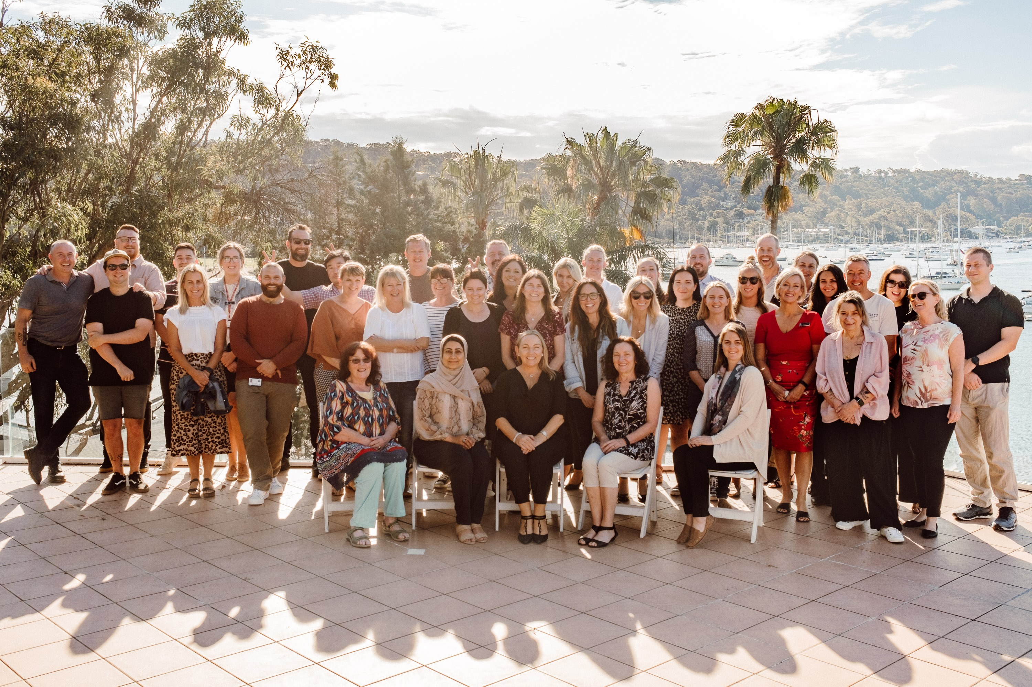
Remote Service Delivery Team
Change Agents

Slide 3
Huh what do you do????

Slide 4
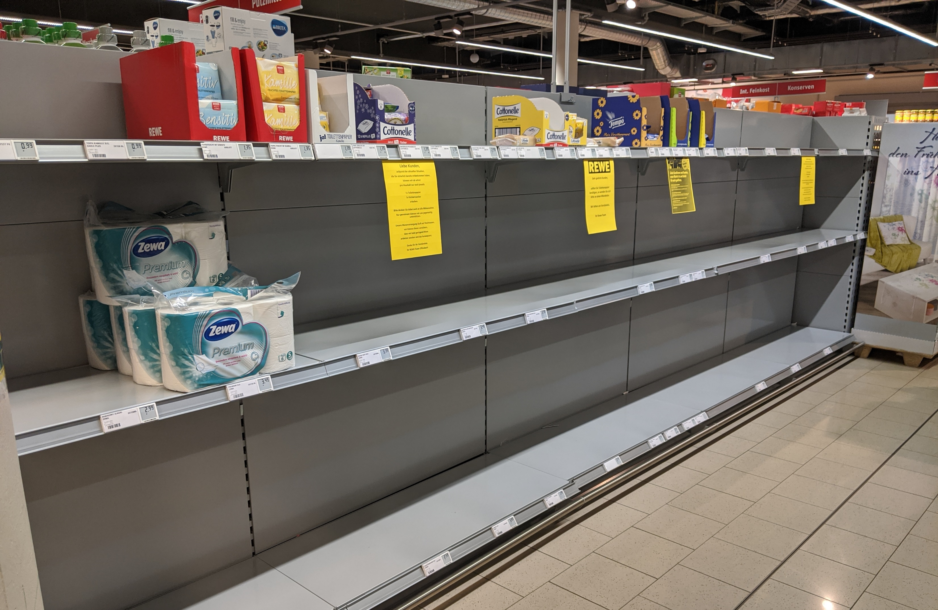
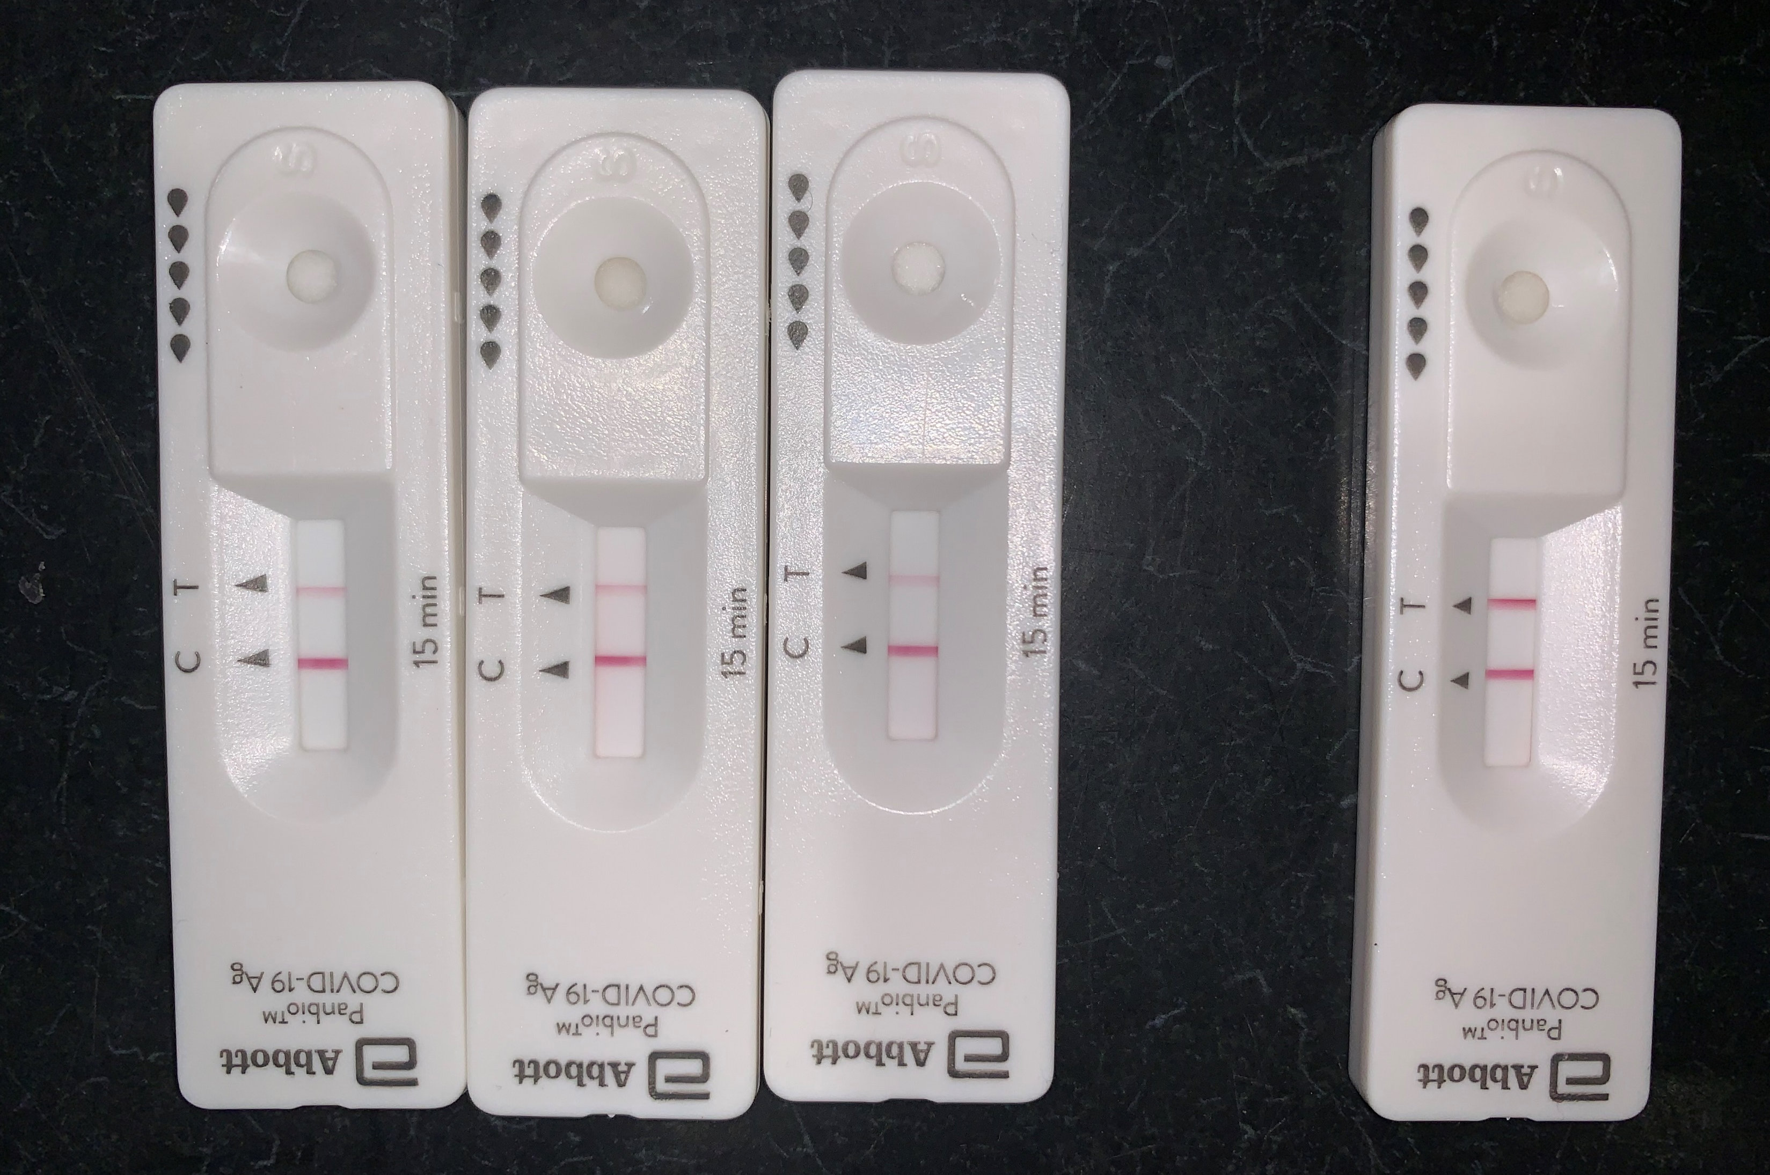
Pandemic Times

Slide 5
CSNSW First Remote Team

Slide 6
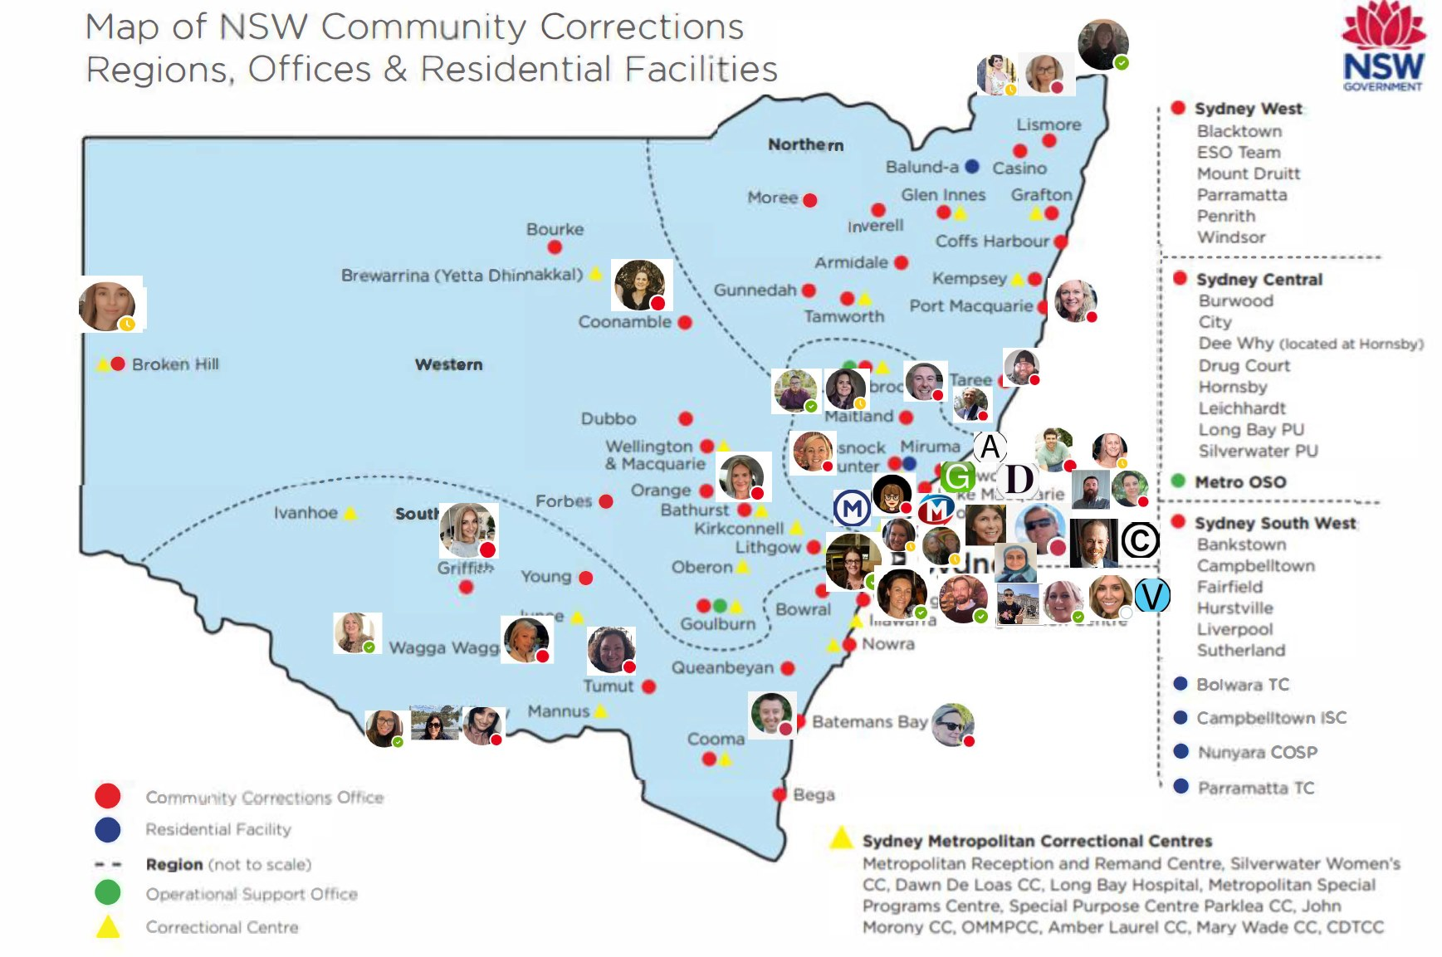

Slide 7
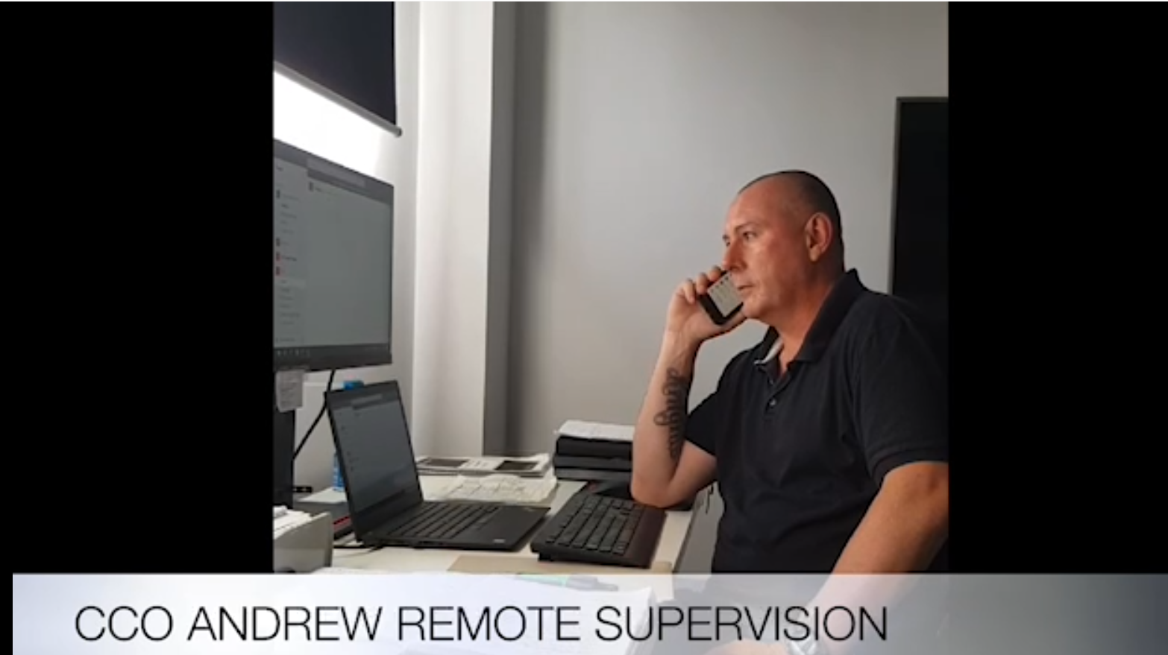
What kind of technologies do you use, or do you avoid?

Slide 8
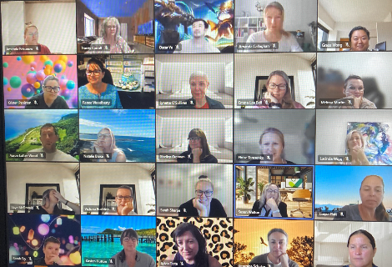
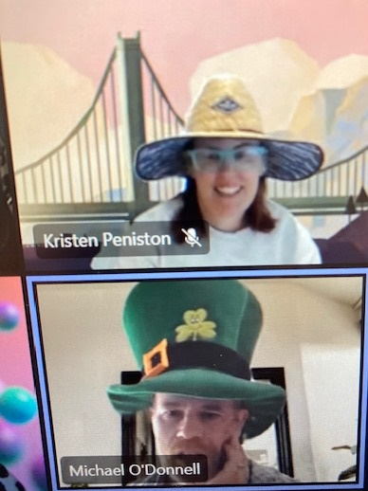
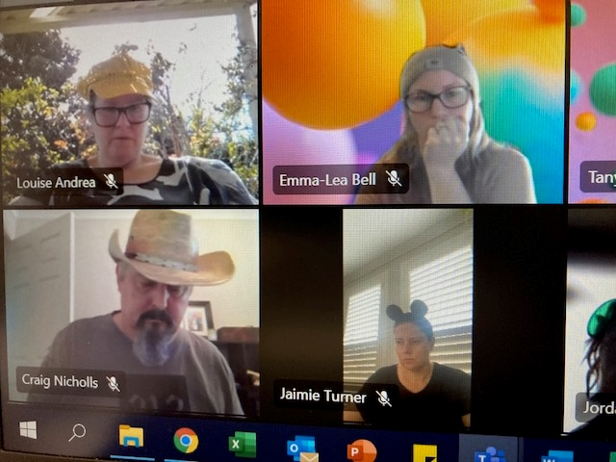
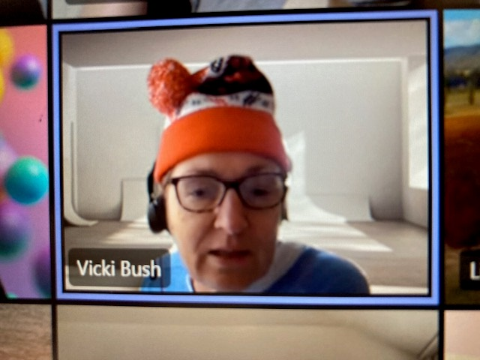
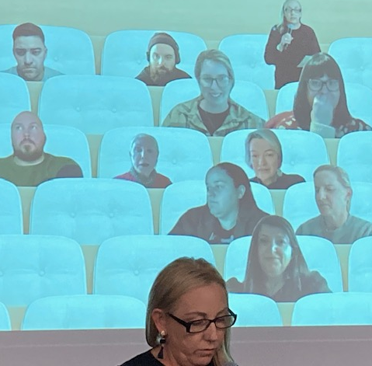
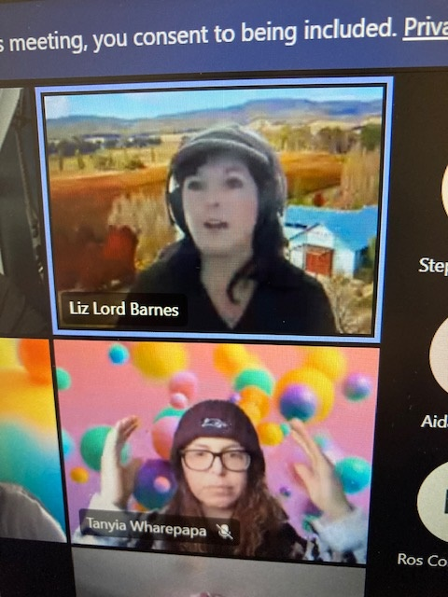
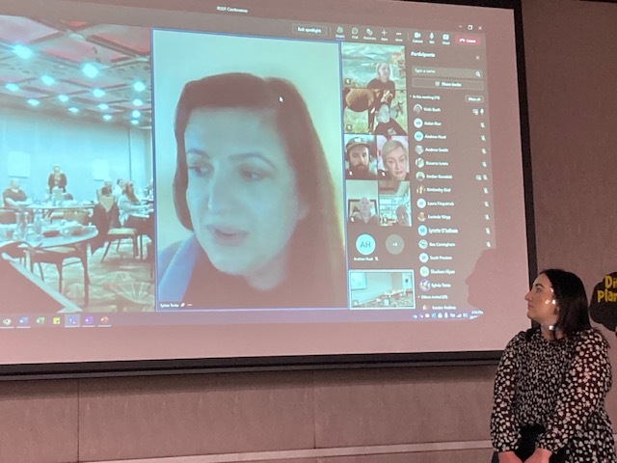
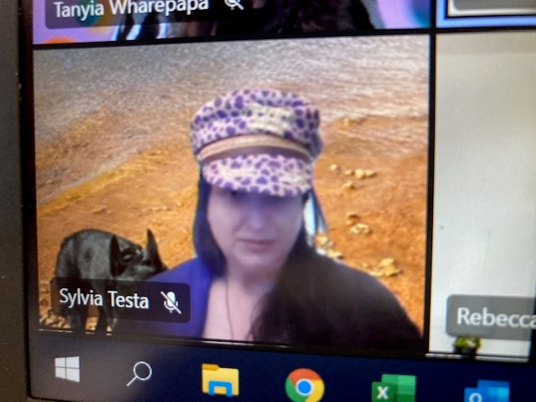
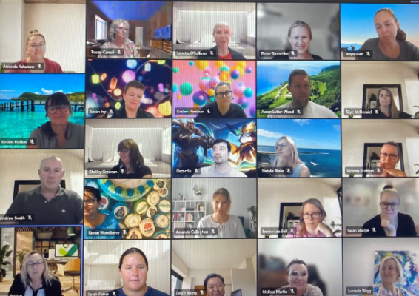
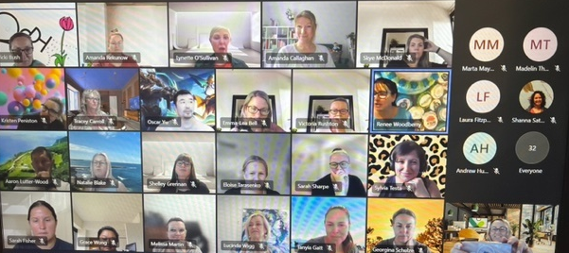

Slide 9
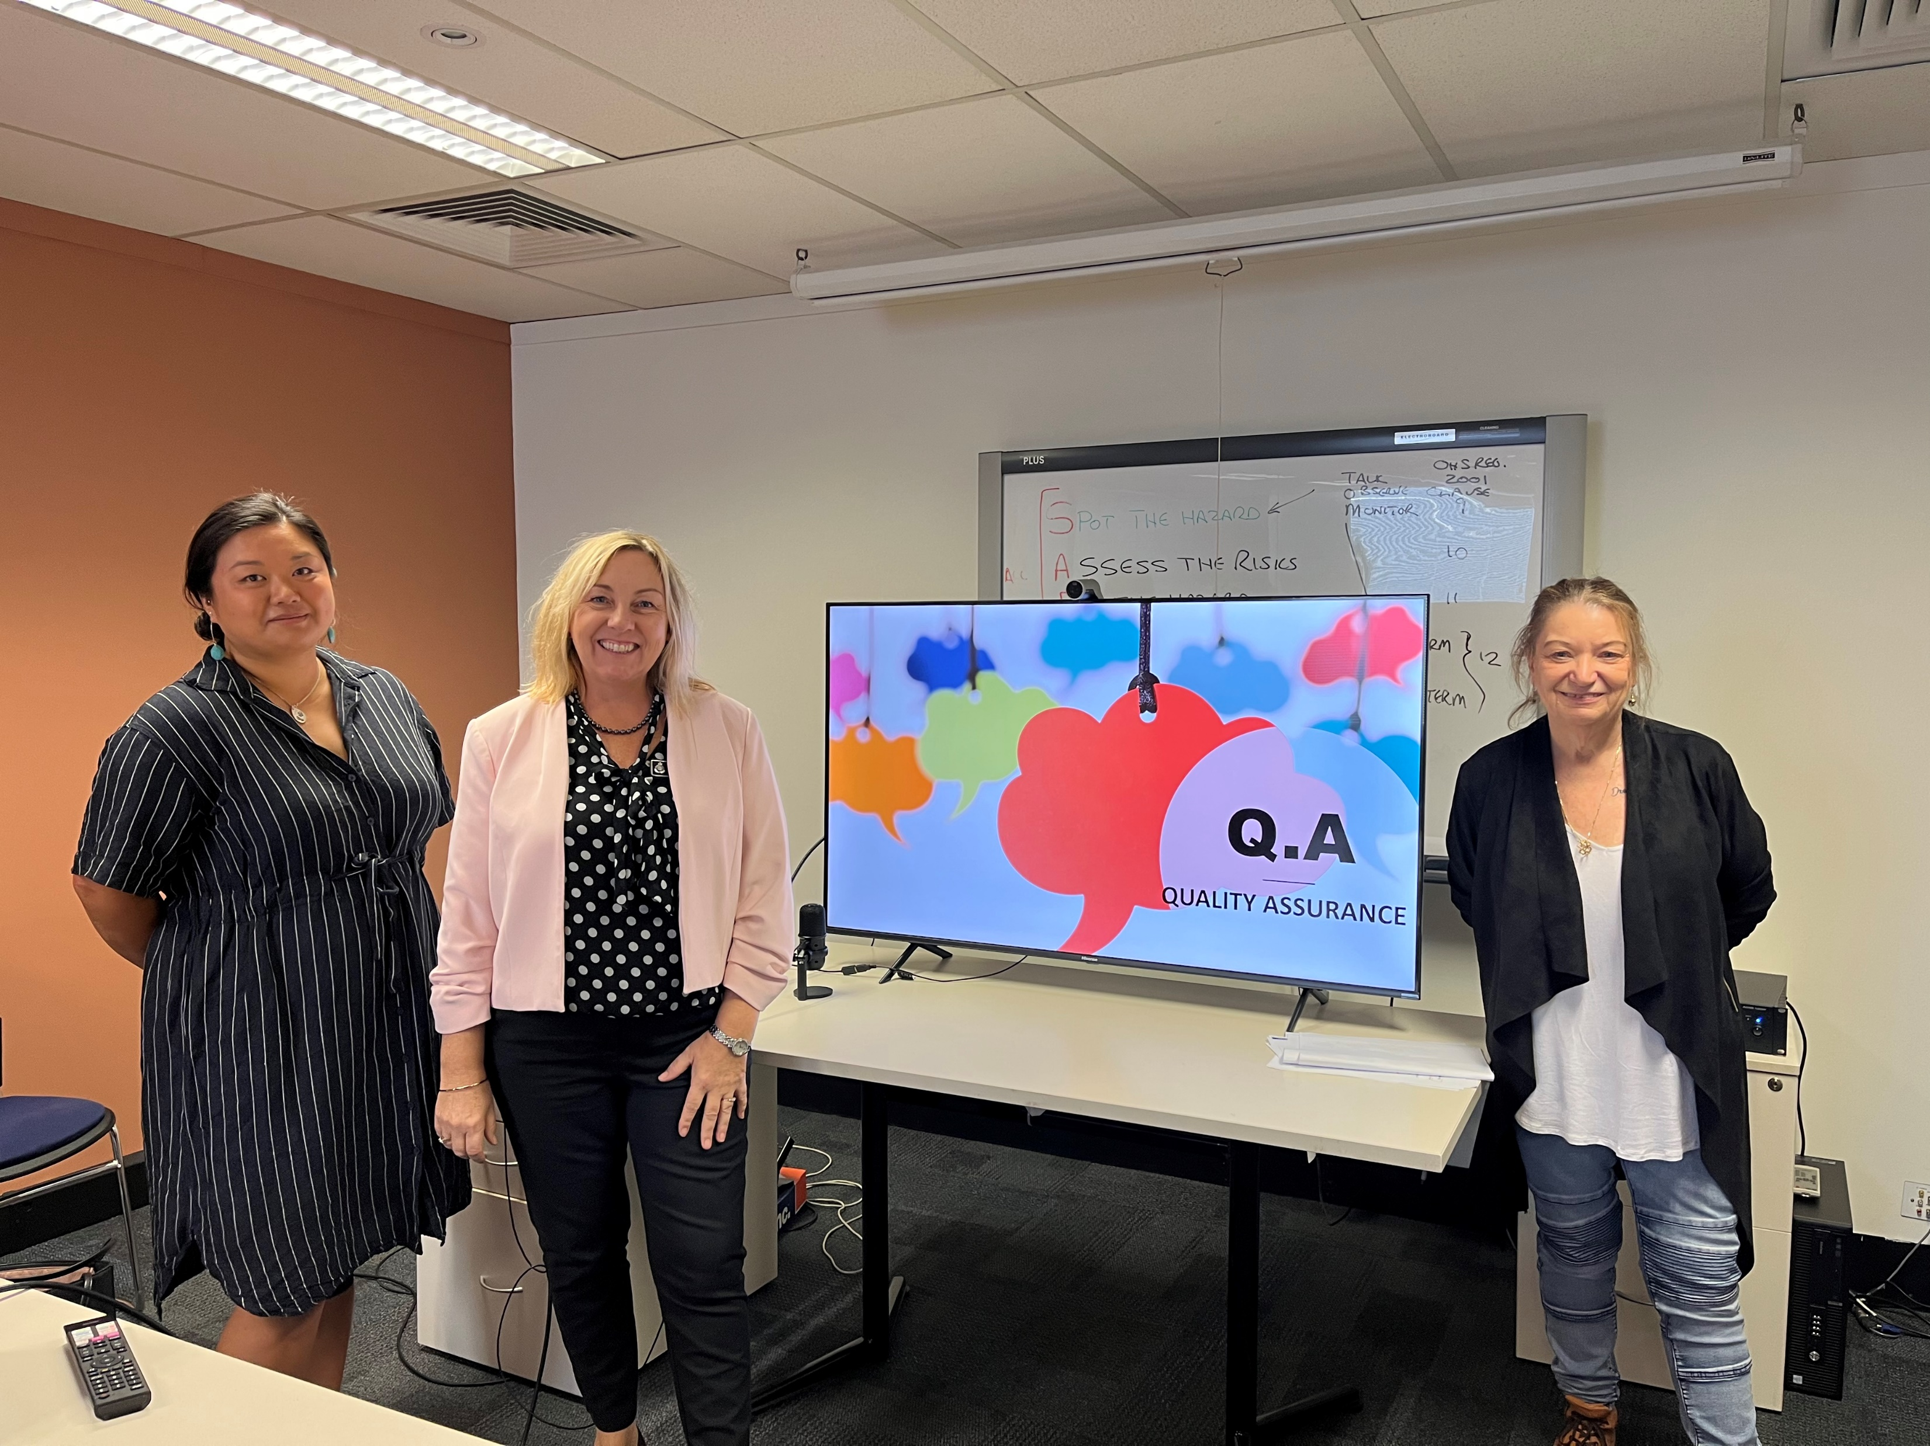
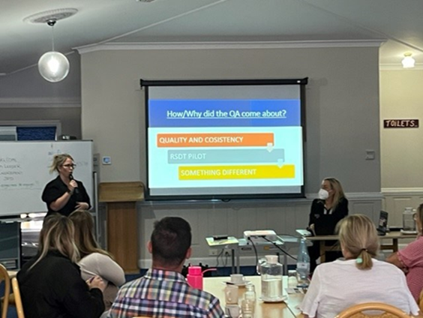
Quality Assurance

Slide 10
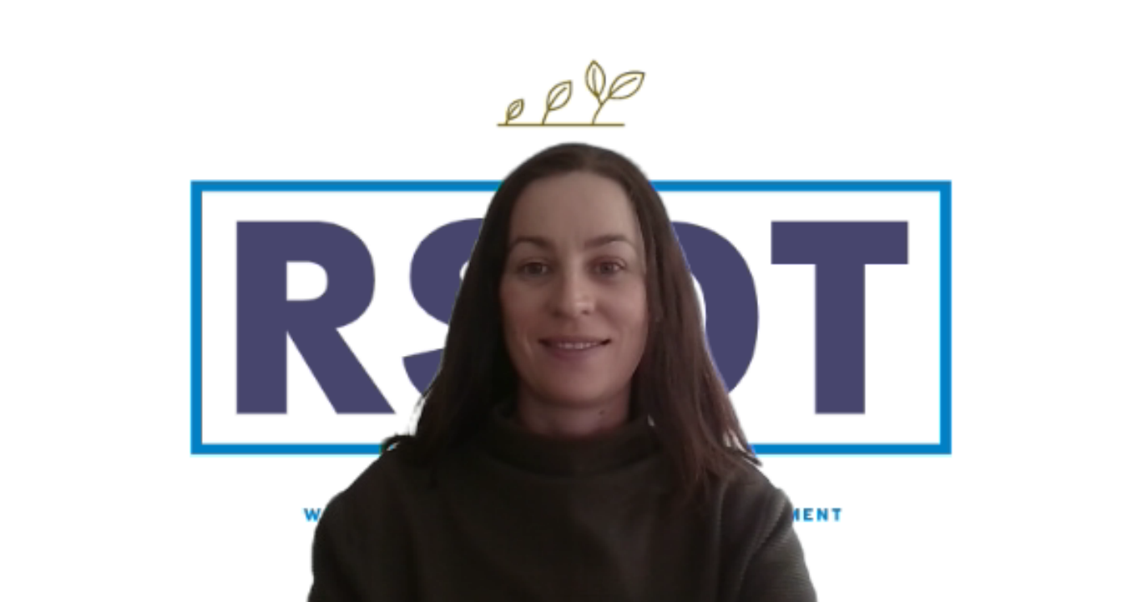
Remote administration through technology
Immediate support
Reaching remote locations
Share best practice and systems State-wide

Slide 11
How can technology allow us to be more efficient in the administration of budgets and corporate services like HR management?

Slide 12
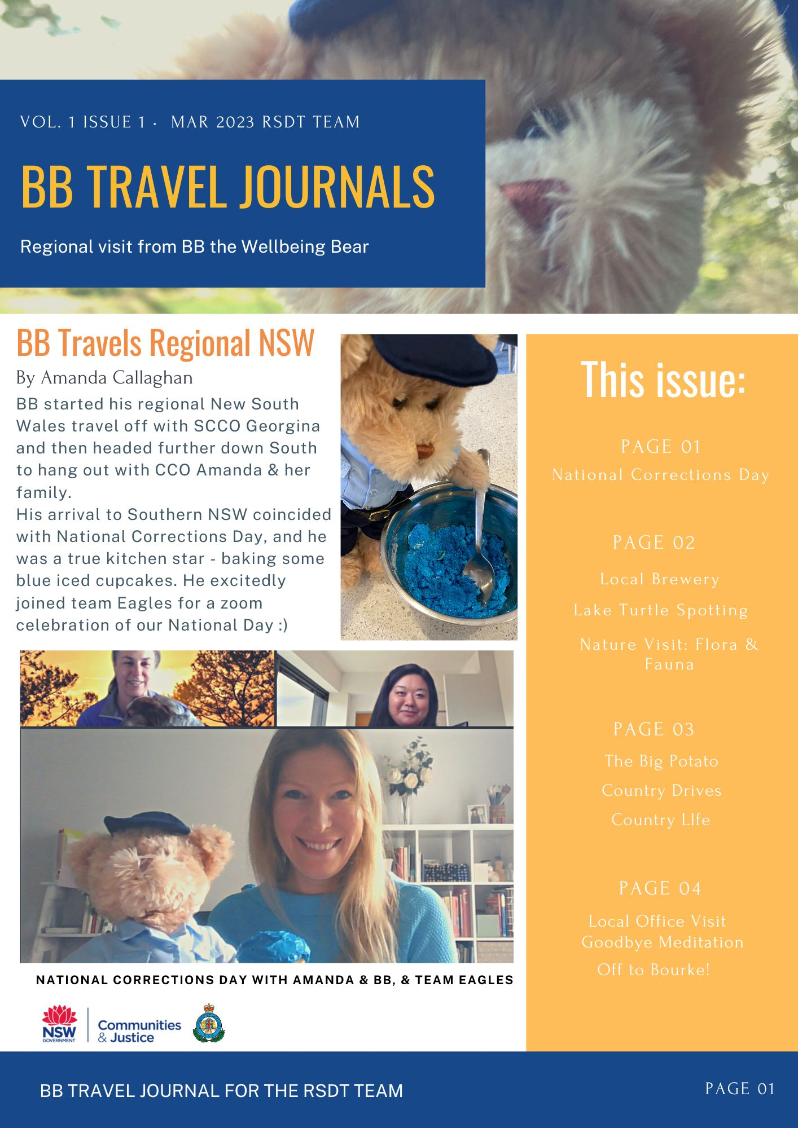
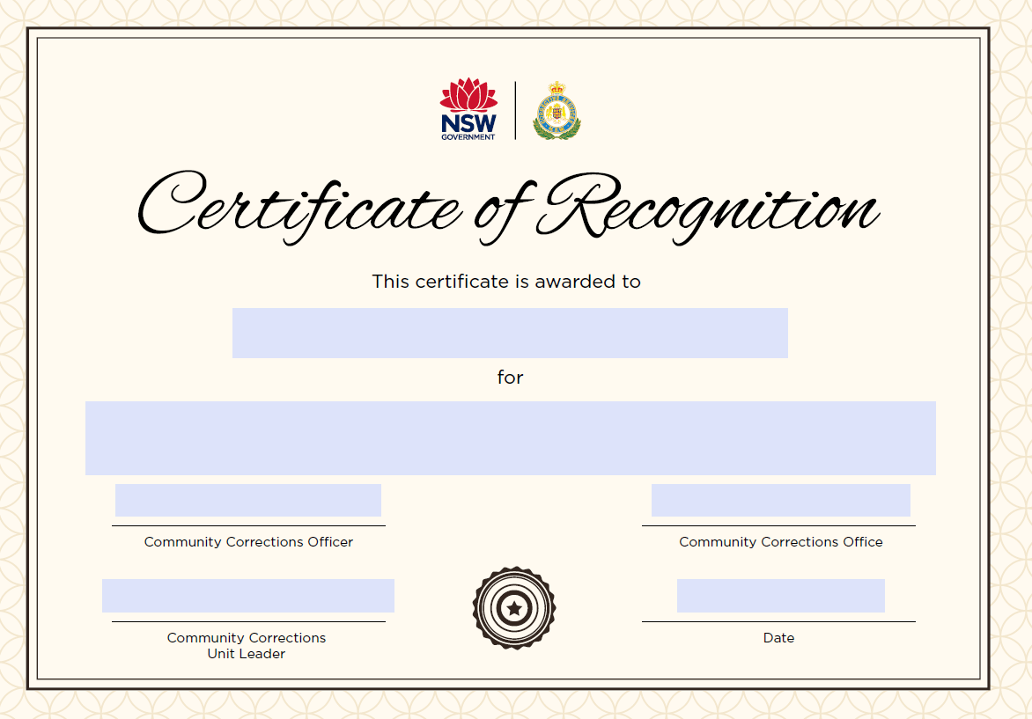
How can technology contribute to improved mental health of our staff and offenders?

Slide 14
Technology assisting people with cognitive and mobility limitations to engage in supervision

Slide 15
What are the risks of technology on our staff, offenders or other stakeholders

Slide 16
What are the technological skillsets we will need in the future?

Slide 17
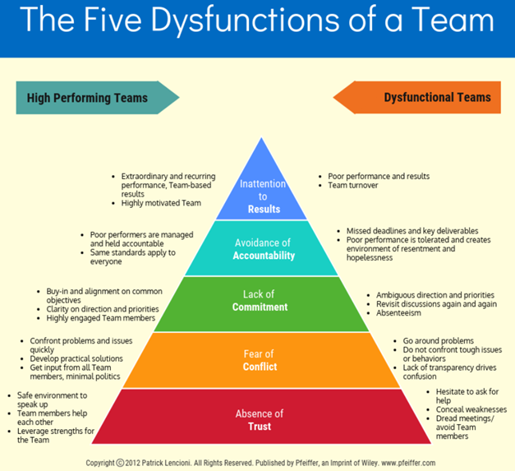
Patrick Lencioni
How do you create and maintain a high performing and engaged team in a remote environment?

Slide 18
“Phone and video reporting is easier for me as I do not have a license and work around the state, I can report in my lunch break and not have to take time off work”.

Slide 19
Q
Susan Walton Manager RSDT 0427249756 Grace Wong Team leader 0438805071 Aaron Lutter-Wood Team leader 0460293470 Central Ph: (02) 86880333 rsdt_cos@justice.nsw.gov.au
Questions

