Slide 1
2023
Advancing Community Corrections: Vision and Innovation.
One PO’s 35 year evolution
From Okeechobee to Sydney
Notes:
G'day everyone! Now, I hope I did justice to that Aussie greeting. I've been practicing! I find myself in this extraordinary country, a land of immense beauty, rich history, and incredible cultural diversity. A nation of sunburnt lands, sweeping beaches, and bustling cities. And as I stand here, in the vibrant heart of Sydney, I'm reminded of the iconic Australian films and stories that have painted vivid pictures for us foreigners - be it the gritty outback tales of 'Mad Max', the warmth of 'Strictly Ballroom', or the heartwarming journey in 'Red Dog'."
And yet, the movies and songs, as captivating as they are, merely offer glimpses.
To truly understand Australia, one has to experience it firsthand – the pulsating energy of its cities, the ageless wisdom of its indigenous cultures, the undeniable spirit of mateship, and of course, the allure of Vegemite!"
As I come from America, it's both an honor and a learning experience to be amongst you all. Our countries, though oceans apart, have shared stories, collaborations, and mutual admiration. While I might occasionally reminisce about the tunes of INXS or the stellar performances of Nicole Kidman, I'm here to connect on a deeper level, to discuss our shared mission in the probation sector, and to collaboratively envision a future brimming with innovation."
While I aim to share insights and experiences, I'm equally eager to learn from each of you, to understand the Australian perspective, and to see how, together, we can shape the future of probation services, not just in our respective nations, but globally.“
2:20

Slide 2
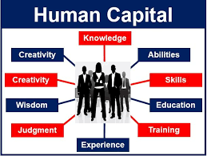
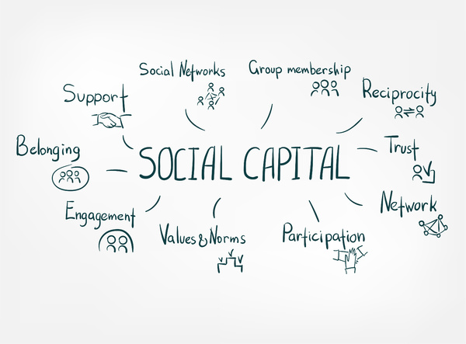
Bridging Continents, Unveiling Journeys
Notes:
After sharing these reflections on our shared cultural tapestry, I want to draw a parallel from a concept many of you might be familiar with — the triumvirate of desistance from crime: human capital, social capital, and identity transformation.
These principles are not just crucial in understanding the journey of those reintegrating into society post-offense but have personally resonated with me on another level.
Just as these are the keys for individuals to turn their lives around, I realized that they mirrored my own professional path.
Throughout my career, I've harnessed the power of augmenting my human capital through continuous learning, leveraging my social capital by forging meaningful relationships, and constantly undergoing identity transformation to adapt and lead.
Today, I'll be sharing this intertwined journey with you all — illustrating how the same principles guiding reform in our sector have been the cornerstone of my professional evolution."

Slide 3
Pathways in…..Pathways out
Notes:
Today, we embark on a journey to understand desistance from crime.
To understand why someone stops committing crimes, we first need to understand why they start.
The Risk-Need-Responsivity framework or RNR - a model we owe to the groundbreaking work of Bonta and Andrews - helps us understand the risk factors, needs, and interventions that work best for our clients.
But, as we look into the future of community corrections, we must also understand desistance.
- *SC* stands for Social Capital, which is the sum of resources one can access thanks to personal and professional networks.
- *HC* denotes Human Capital, signifying skills, knowledge, and experiences that an individual possesses.
- *ID* is about Identity, and how one perceives oneself, can play a pivotal role in determining behavior.
Our work, our interventions, play a role in influencing these factors.
And here's where the parallel process enters.
We, as individuals, undergo growth…….change………………..and evolution…………much like our clients.
Our institutions, from management to frontline staff, also experience these transformations.
3:55

Slide 4
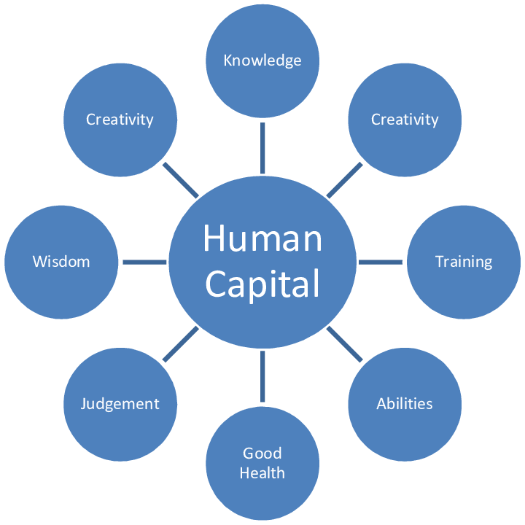
Notes:
As we delve deeper into the nuances of Human Capital, it's important to acknowledge the foundational theories of desistance.
The eminent criminologists, Fergus McNeil and Shadd Maruna, have consistently underscored the importance of the personal and societal factors that influence an individual's journey away from crime.
Maruna, in his groundbreaking study, "Making Good," emphasized the transformative power of "redemption scripts."
These are personal narratives that individuals construct, reflecting a changed and prosocial identity.
Bonta and Andrews, in "The Psychology of Criminal Conduct", further stressed that an individual's skills, knowledge, and experiences—components of their human capital—are instrumental in crafting these positive narratives.
They believed that by augmenting an individual's human capital through avenues like education, vocational training, and personal development, we set them on a path where they can rewrite their stories.
McNeil often highlights the significance of social connections, relationships, and opportunities in the desistance process. This interplay between personal change and societal opportunity converges beautifully with the idea of human capital.
For, when an individual possesses the necessary skills and knowledge, they are better positioned to seize opportunities and foster positive relationships, reinforcing their journey away from crime.
So, as we discuss human capital, remember: it's not just about imparting skills, but also about nurturing the potential within, allowing individuals to craft their own narratives of change and transformation.
5:47

Slide 5
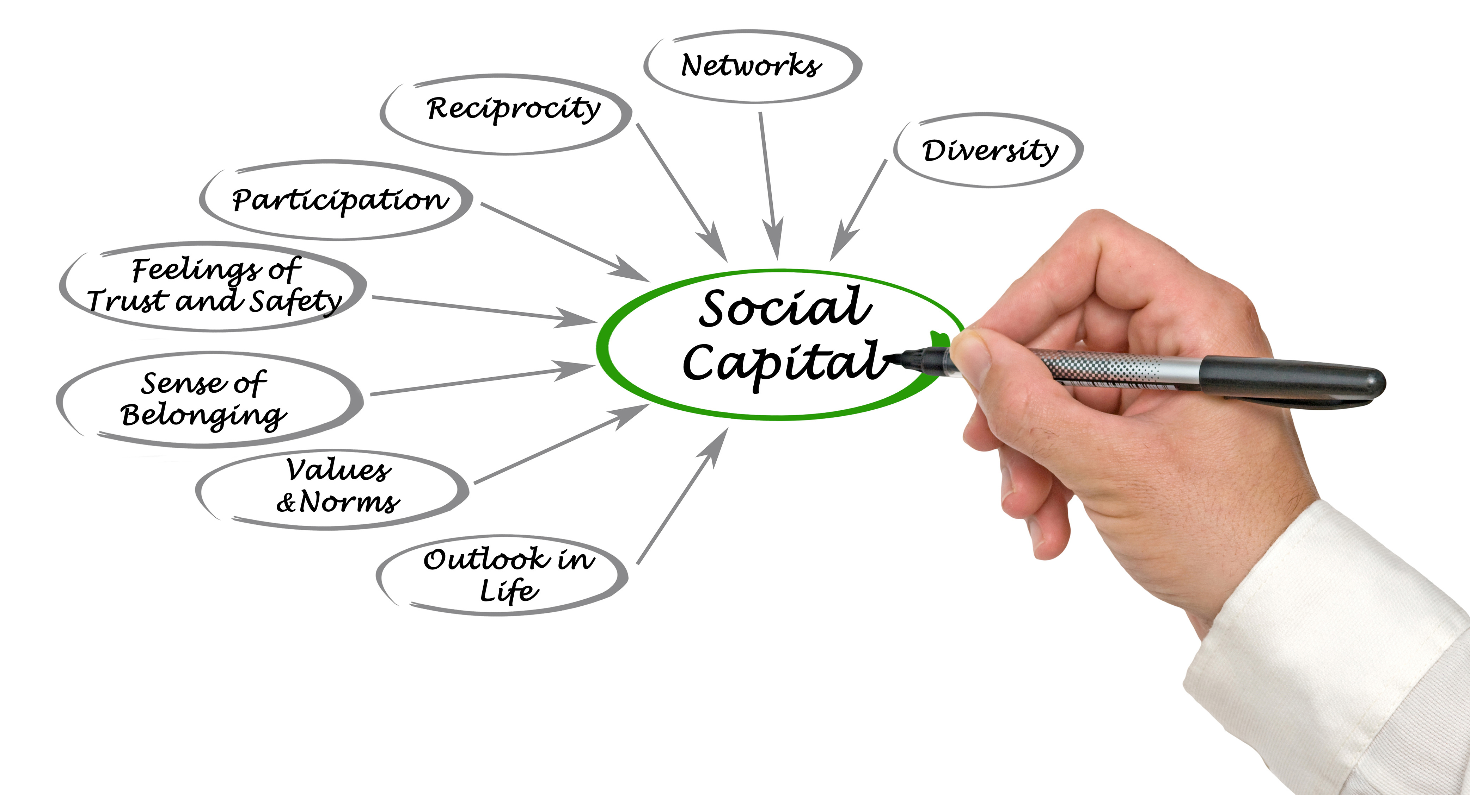
Notes:
Social Capital, much like its counterpart, Human Capital, plays a pivotal role in the desistance journey.
Shadd Maruna's insights into "redemption scripts" aren't limited to personal narratives; they also encompass the social bonds and networks that individuals cultivate over time.
Being rooted in a supportive community or having stable relationships acts as a buffer, aiding individuals in distancing themselves from past criminal behaviors.
Fergus McNeil emphasizes this point when he discusses the role of society in an individual's journey away from crime. It's not solely about the individual's will or determination to change, but also about the opportunities society offers and the support it provides.
Social Capital, therefore, is the bridge between an individual's intentions and societal reception. It's the safety net, the encouragement, and sometimes, the very reason one finds to desist from crime.
Bonta and Andrews also touched upon this, highlighting the value of pro-social modeling and structured community interactions in reinforcing positive behaviors.
They recognized that an individual's environment, relationships, and network can either serve as risk factors or protective factors.
As we delve into Social Capital, let's be reminded that the journey of desistance is both personal and communal.
While Human Capital allows individuals to craft positive narratives, Social Capital provides the external affirmation, support, and opportunities to actualize those narratives in the real world.
The intertwining of these two forms of capital is paramount for true, sustainable transformation.
7:22

Slide 6
Notes:
Identity Transformation is arguably the keystone of the desistance journey.
Delving deep into Desistance theory, Shadd Maruna's groundbreaking research on reformed ex-offenders brought to the forefront the concept of "redemption scripts".
These are the narratives individuals craft about their past, present, and future selves.
A criminal identity evolves into a non-criminal one when individuals see a brighter, better version of themselves taking shape in the horizon.
It's not just about abandoning a criminal identity but adopting and internalizing a pro-social one.
Fergus McNeil's work complements this notion by emphasizing the importance of 'recognition' - the process by which society acknowledges and validates an individual's change.
When society recognizes an individual's efforts to change, it solidifies their new pro-social identity.
Bonta and Andrews also echo this sentiment in their work. They understand that effective rehabilitation isn't just about reducing risk but also about nurturing and endorsing a positive sense of self.
Through pro-social modeling and reinforcement, an individual's self-concept can be molded towards a more positive and constructive identity.
As we explore Identity Transformation, we must recognize that while individuals craft their redemption scripts, society plays the role of the audience.
For desistance to truly take hold, the story of change needs not only to be told……. but also to be heard, acknowledged, and accepted.
In this dance between the individual and society, a new identity, grounded in pro-social values, takes root and thrives.
9:14

Slide 7
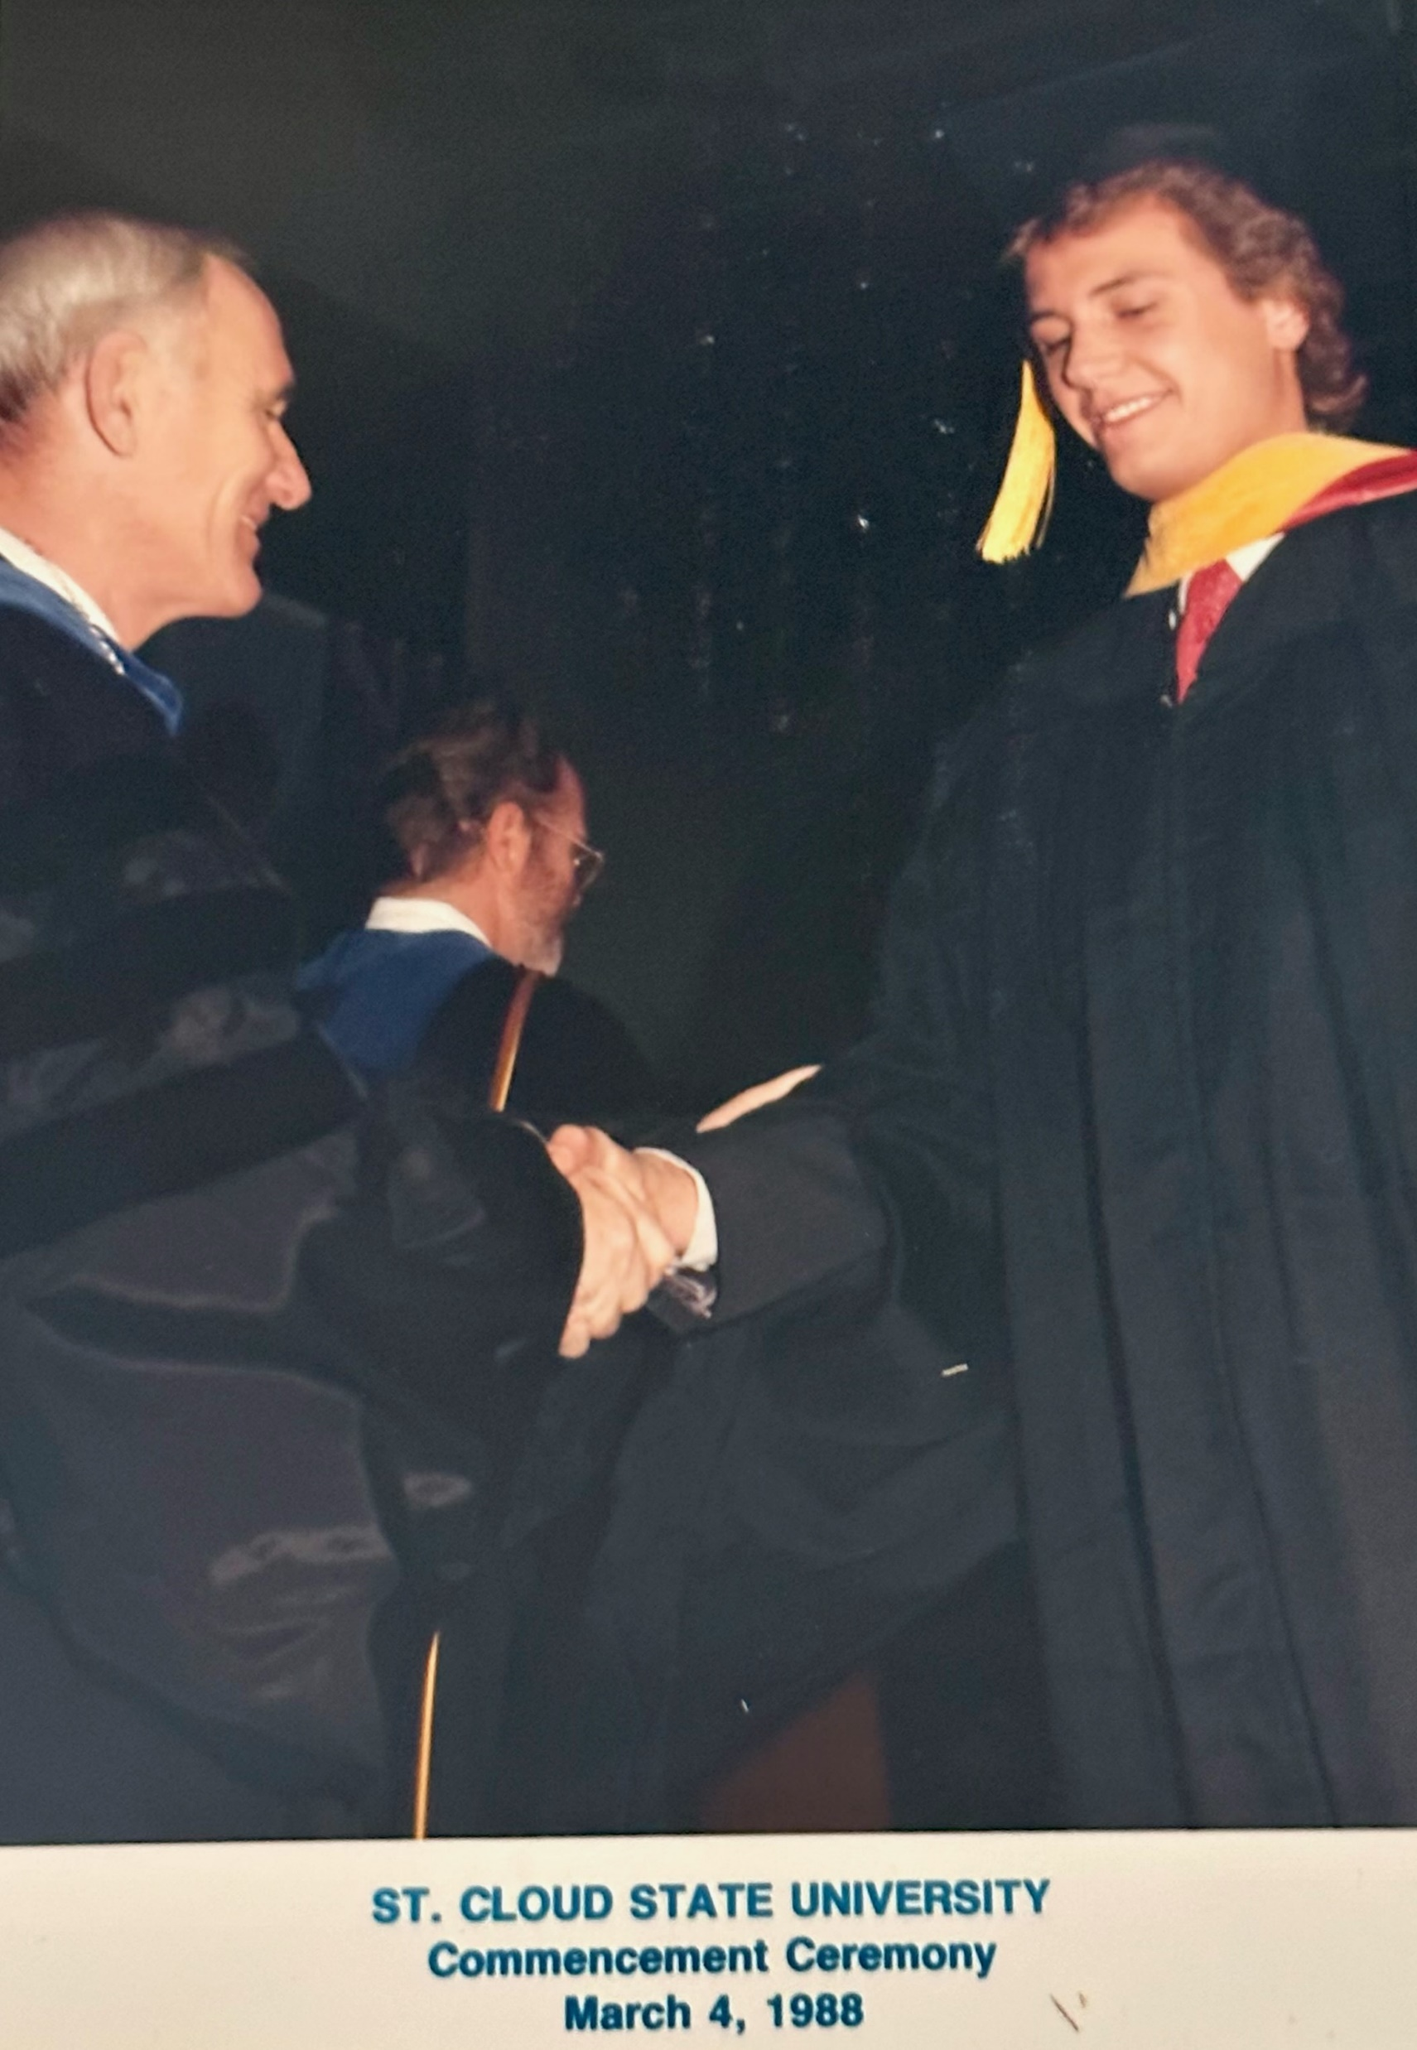
Milestone: 1988 hired by Florida DOC.
Human Capital -> MS in CJ Admin
Social Capital -> Entirely academic focused. Fellow students and faculty.
Identity -> “Aspiring Crime Fighter”
Notes:
In 1988, I graduated from Saint Cloud State University with a Master of Science Degree in Criminal Justice Administration.
This achievement marked a significant step in my Human Capital. With the knowledge, skills, and insights I gained, I felt prepared to contribute profoundly to our justice system.
Yet, if we consider my Social Capital at that time, it was predominantly academic focused. My fellow students and CJ faculty.
But the most telling aspect of that phase of my life was my identity. I perceived myself as a future "Crime Fighter." That was my mission, my purpose, and my narrative. I was molded by, and wholeheartedly believed in, the principle of tackling crime head-on.
Drawing from the insights of Shadd Maruna and Fergus McNeil, we understand that identities are fluid, and the narratives we craft for ourselves can pivot based on experiences, reflections, and growth.
My story, as with many of yours, saw a transformation over the years, much like the probation clients we serve.
The parallel process of change, growth, and evolution is universal. Whether one is on the side of a criminal justice practitioners , or someone under supervision, the recipe for change is rooted in the development of Human and Social Capital and a shift in Identity.
As we journey forward, let's remember that the pathways of growth and change are not linear. They're rich with lessons, challenges, and most importantly, evolution. Let's embrace our experiences, both personal and professional, as they hold the key to empathy, understanding, and innovation in our field.
11:27

Slide 8
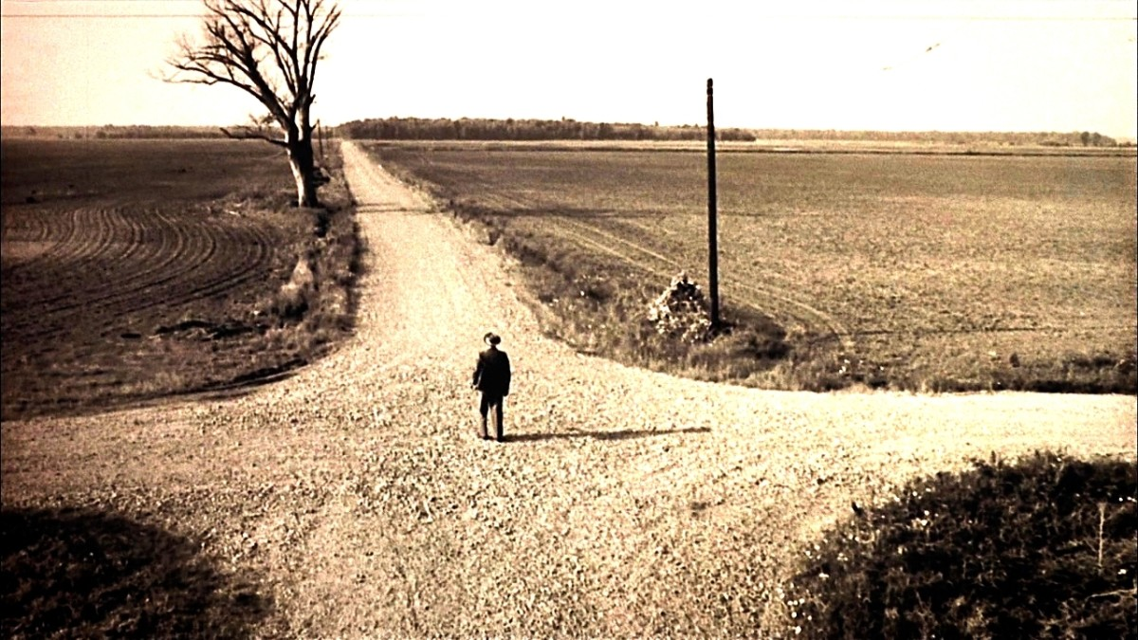
Human Capital + Social Capital +Identity= Behavior
Notes:
Given what we've discussed my Human Capital (HC) as represented by my Master's Degree, my Social Capital (SC) being rooted in traditional justice roles, and my then Identity as a 'Crime Fighter', I'd like you all to reflect on something.
Knowing that these three variables - HC, SC, and Identity - collectively form a potent cocktail that influences behavior, where would you predict my trajectory was headed at that time?
How do you believe these components shaped my early decisions, actions, and interactions in the realm of criminal justice?
We will answer that question after taking a look at that eras Vision and Innovation!
12:24

Slide 9
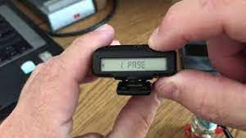
1988’s Vison and Innovation
Notes:
"In 1988, our field was undergoing significant changes.
The Vision and Innovation theme of this conference resonates profoundly with that period.
On the one hand, the field of probation was entering a new era, embracing the nascent technology of electronic monitoring.
This was a groundbreaking step, allowing us to supervise probationers more effectively.
Alongside, the introduction of digital pagers streamlined our communications and response times.
Parallelly, I was embarking on my own professional journey.
Freshly equipped with my Master’s from Saint Cloud State University and a mindset of a 'Crime Fighter,' I was eager to dive into this evolving world and make a difference.
The convergence of my personal trajectory and the innovations of the time shaped my initial years in probation.
But as we know, both personal and professional landscapes evolve, and so did mine.
As we proceed, we'll delve deeper into the parallel journey of the advancements in probation and my own professional evolution.
Together, they offer a holistic perspective on how vision and innovation, both personal and systemic, can drive growth and change in our field.
14:00

Slide 10
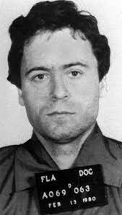
My Behavior?
“Community Control Officer”
Notes:
To answer the question posed earlier and provide clarity on the behavioral outcomes driven by the amalgamation of my Social Capital, Human Capital, and then-prevailing Identity, we need to delve into my days with the Florida Department of Corrections.
As a 'Community Control Officer,' my role encompassed several responsibilities, but a significant part of it was collecting 'Cost of Supervision' fees.
I took on this role with fervor, and the results spoke for themselves. I had the highest collection rate in the Okeechobee branch office.
In fact, our office led the district, and our district, in turn, topped the entire state of Florida. I was, to put it plainly, a COS collection machine.
Now, you may wonder, why this fervent approach? Why this relentless pursuit?
The answer lies in understanding the profound impact of my human capital - the education and training I had, my social capital - the network and environment I was part of, and most significantly, my identity at the time - that of an ardent 'Crime Fighter.’
Each of these elements steered my behavior, my decisions, and my outcomes.
The environment and the standards set by our office, the tools and knowledge at my disposal, and the identity I had embraced converged, resulting in my particular professional approach at the time.
And this isn't unique to just me. It’s a testament to how these crucial variables - our Social Capital, Human Capital, and Identity - can shape, mold, and influence our behavior.
They shape our perceptions, guide our decisions, and ultimately determine our paths.
16:00

Slide 11
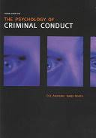
1994’s Vision and Innovation
Notes:
In 1994, the field of Corrections and Probation witnessed a landmark shift.
A monumental innovation was presented to us in the form of Bonta and Andrews' seminal text, 'The Psychology of Criminal Conduct'. If there ever was a transformative moment in our field, this was it.
The text brought forth the principles of evidence-based practices in corrections, leading us away from mere intuition or outdated practices and steering us towards strategies founded on research and proven methodologies. It wasn’t just a book; it was a blueprint for the future of corrections and probation.
The cornerstone of this transformation was the Risk-Need-Responsivity framework. Many of you are familiar with it and, indeed, work within its parameters daily. For the uninitiated, it's a framework that focuses on the three core principles: Assessing the Risk of re-offending, understanding the Needs that must be addressed to reduce this risk, and tailoring the intervention based on the individual's unique Responsivity factors.
This framework revolutionized our approach and is now a staple in most corrections and probation agencies around the globe.
As we talk about innovation, progression, and transformation, there's an intriguing element of foreshadowing I'd like to share. While we’re discussing the 1st edition of this groundbreaking text, know that its journey continued, evolving with the field. And as a small hint towards where our story is headed: the most recent, 7th edition of 'The Psychology of Criminal Conduct', holds some familiar names within its pages. But more on that later."
18:00

Slide 12
Milestone: 1995 anointed the “Gang PO”
Notes:
Returning to the picturesque landscapes of Minnesota marked not only a homecoming for me but a significant shift in my professional journey.
At Ramsey County Community Corrections, I stepped into a freshly minted position tailored for supervising high-risk gang members.
A new challenge, a new role, and an evolution of my HC, SC, and Identity.
Let's dissect this evolution:
In terms of Human Capital, I was uniquely positioned. I was the sole probation officer in Minnesota to be sworn into the prestigious statewide Gang Strike Force.
This affiliation propelled my journey into deeper waters of gang awareness, from merely attending trainings to actively facilitating them. I was shaping minds and strategies.
My Social Capital underwent a noticeable shift. My network, once dominated by traditional criminal justice professionals, morphed to prominently feature law enforcement officials. From the proactive Minnesota Gang Strike Force to the dedicated teams at the Ramsey County Attorney's Office and Saint Paul Police Gang Unit, my interactions and collaborations were primed towards a targeted mission.
And as for Identity, my role evolved dramatically. I was no longer just a 'Crime Fighter' or a 'Probation Officer'. I was a 'Gang Investigator', a title that wasn't merely honorary.
I was deemed qualified enough to provide expert testimony on gang-related matters. Within the corridors of Ramsey County Community Corrections and beyond, I was colloquially known, and perhaps somewhat affectionately, as the 'Gang PO.'
But remember, these shifts weren't just about titles or affiliations. They were reflective of a deeper change - in mindset, approach, and objectives.
They were emblematic of the continuous evolution we all undergo, both personally and professionally. 20:20

Slide 13
Human Capital + Social Capital +Identity= Behavior
Notes:
"We've journeyed through significant waypoints in my career, each marked by distinct evolutions in my Human Capital, Social Capital, and Identity. Just as we did earlier, I invite you now to reflect and analyze.
Given my unique role in the statewide Gang Strike Force, my extensive engagement in gang awareness trainings, the pronounced shift in my social networks towards a law enforcement-centric orientation, and my emerging identity as a 'Gang Investigator'—I pose to you this question:
What do you envisage my behaviors would have been during this period, based on this updated matrix of HC, SC, and Identity?
I want you to take a moment and truly think about it. How do these factors, when combined, direct or influence actions and decisions?
Let's engage in this equation of change and growth. 21:12

Slide 14
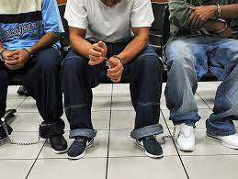
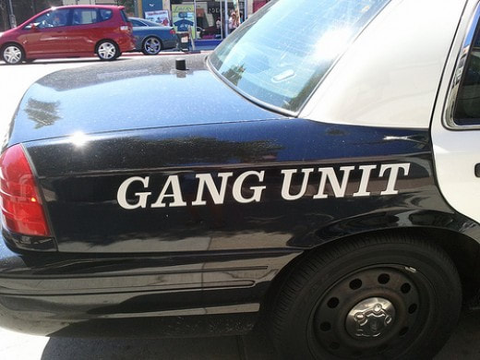
Late 1990’s, Vision and Innovation
1. Admits gang membership or association.
2. Is observed to associate on a regular basis with known gang members.
3. Has tattoos indicating gang membership.
4. Wears gang symbols to identify with a specific gang.
5. Is in a photograph with known gang members and/or using gang-related hand signs.
6. Name is on a gang document, hit list, or gang related graffiti.
7. Is identified as a gang member by a reliable source.
8. Arrested in the company of identified gang members or associates.
9. Corresponds with known gang members or writes and/or receives correspondence about gang activities.
10. Writes about gang (graffiti) on walls, books and paper.
Notes:
The late 20th century saw our cities grappling with an escalating challenge: the rise of street gang violence.
Our serene cityscapes were overshadowed by a growing menace that threatened the very fabric of our communities.
However, this era was not just defined by the challenges but by our response to them.
The vision and innovation of that time were rooted in a fundamental belief: collaboration. The realization dawned that the conventional methods, when applied in silos, were insufficient.
A multi-agency approach was the way forward.
The strategy? Form a cohesive unit between probation and law enforcement agencies. This wasn't just about pooling resources but merging our expertise, intelligence, and community reach.
The belief was that by working in tandem, we could strike at the heart of the problem and pave the way for a safer tomorrow.
This was innovation in its truest sense – adapting to the pressing needs of the time and devising strategies that went beyond traditional boundaries.
While the challenge was immense, so was our collective resolve to tackle it.

Slide 15
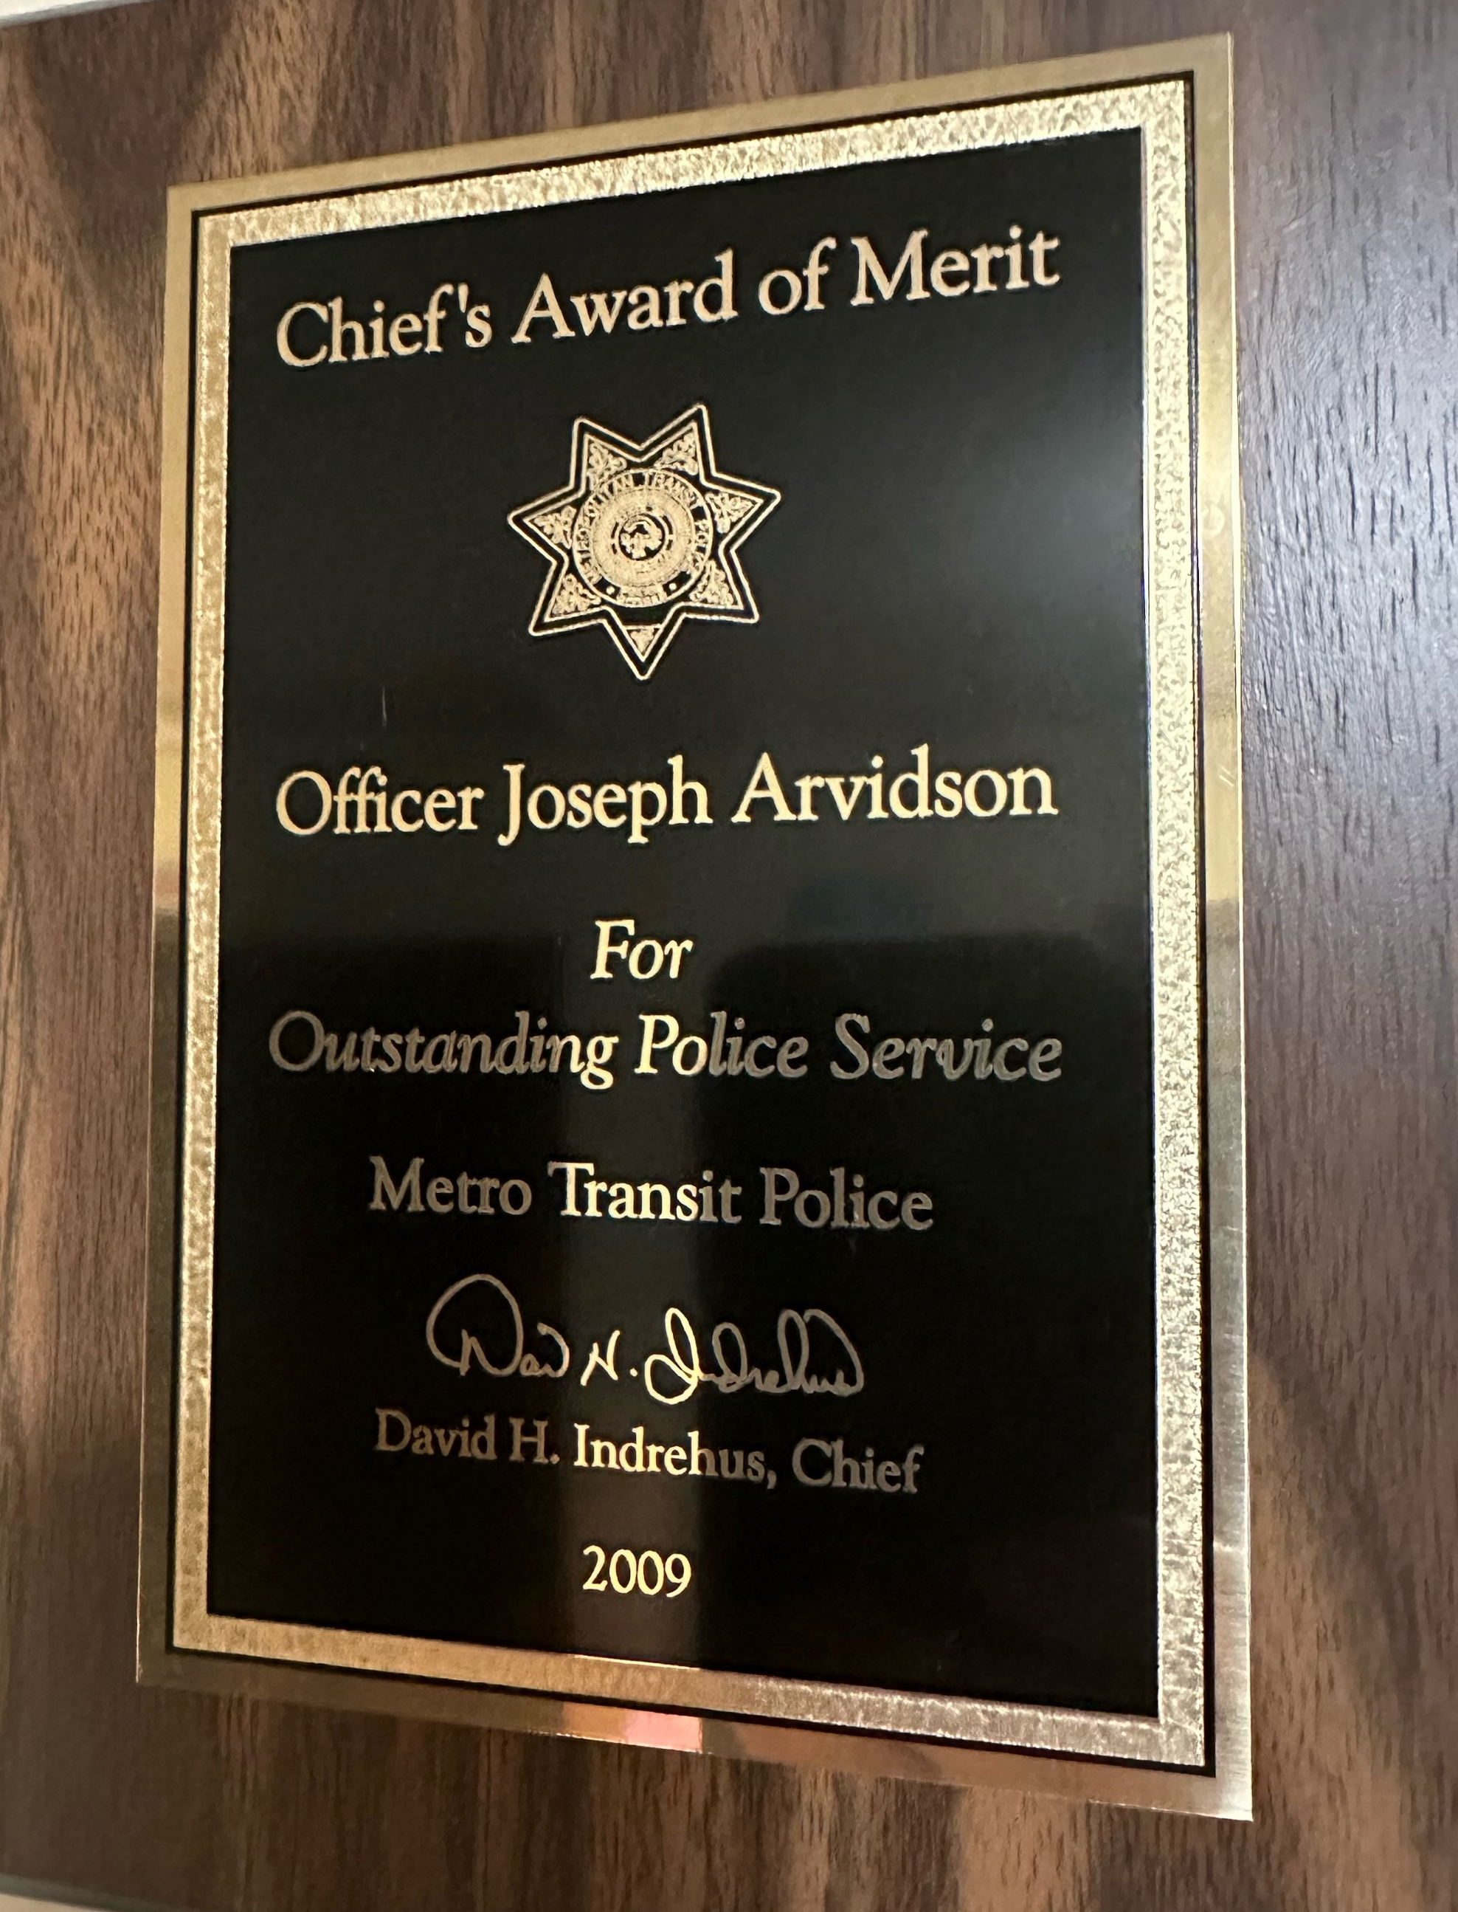
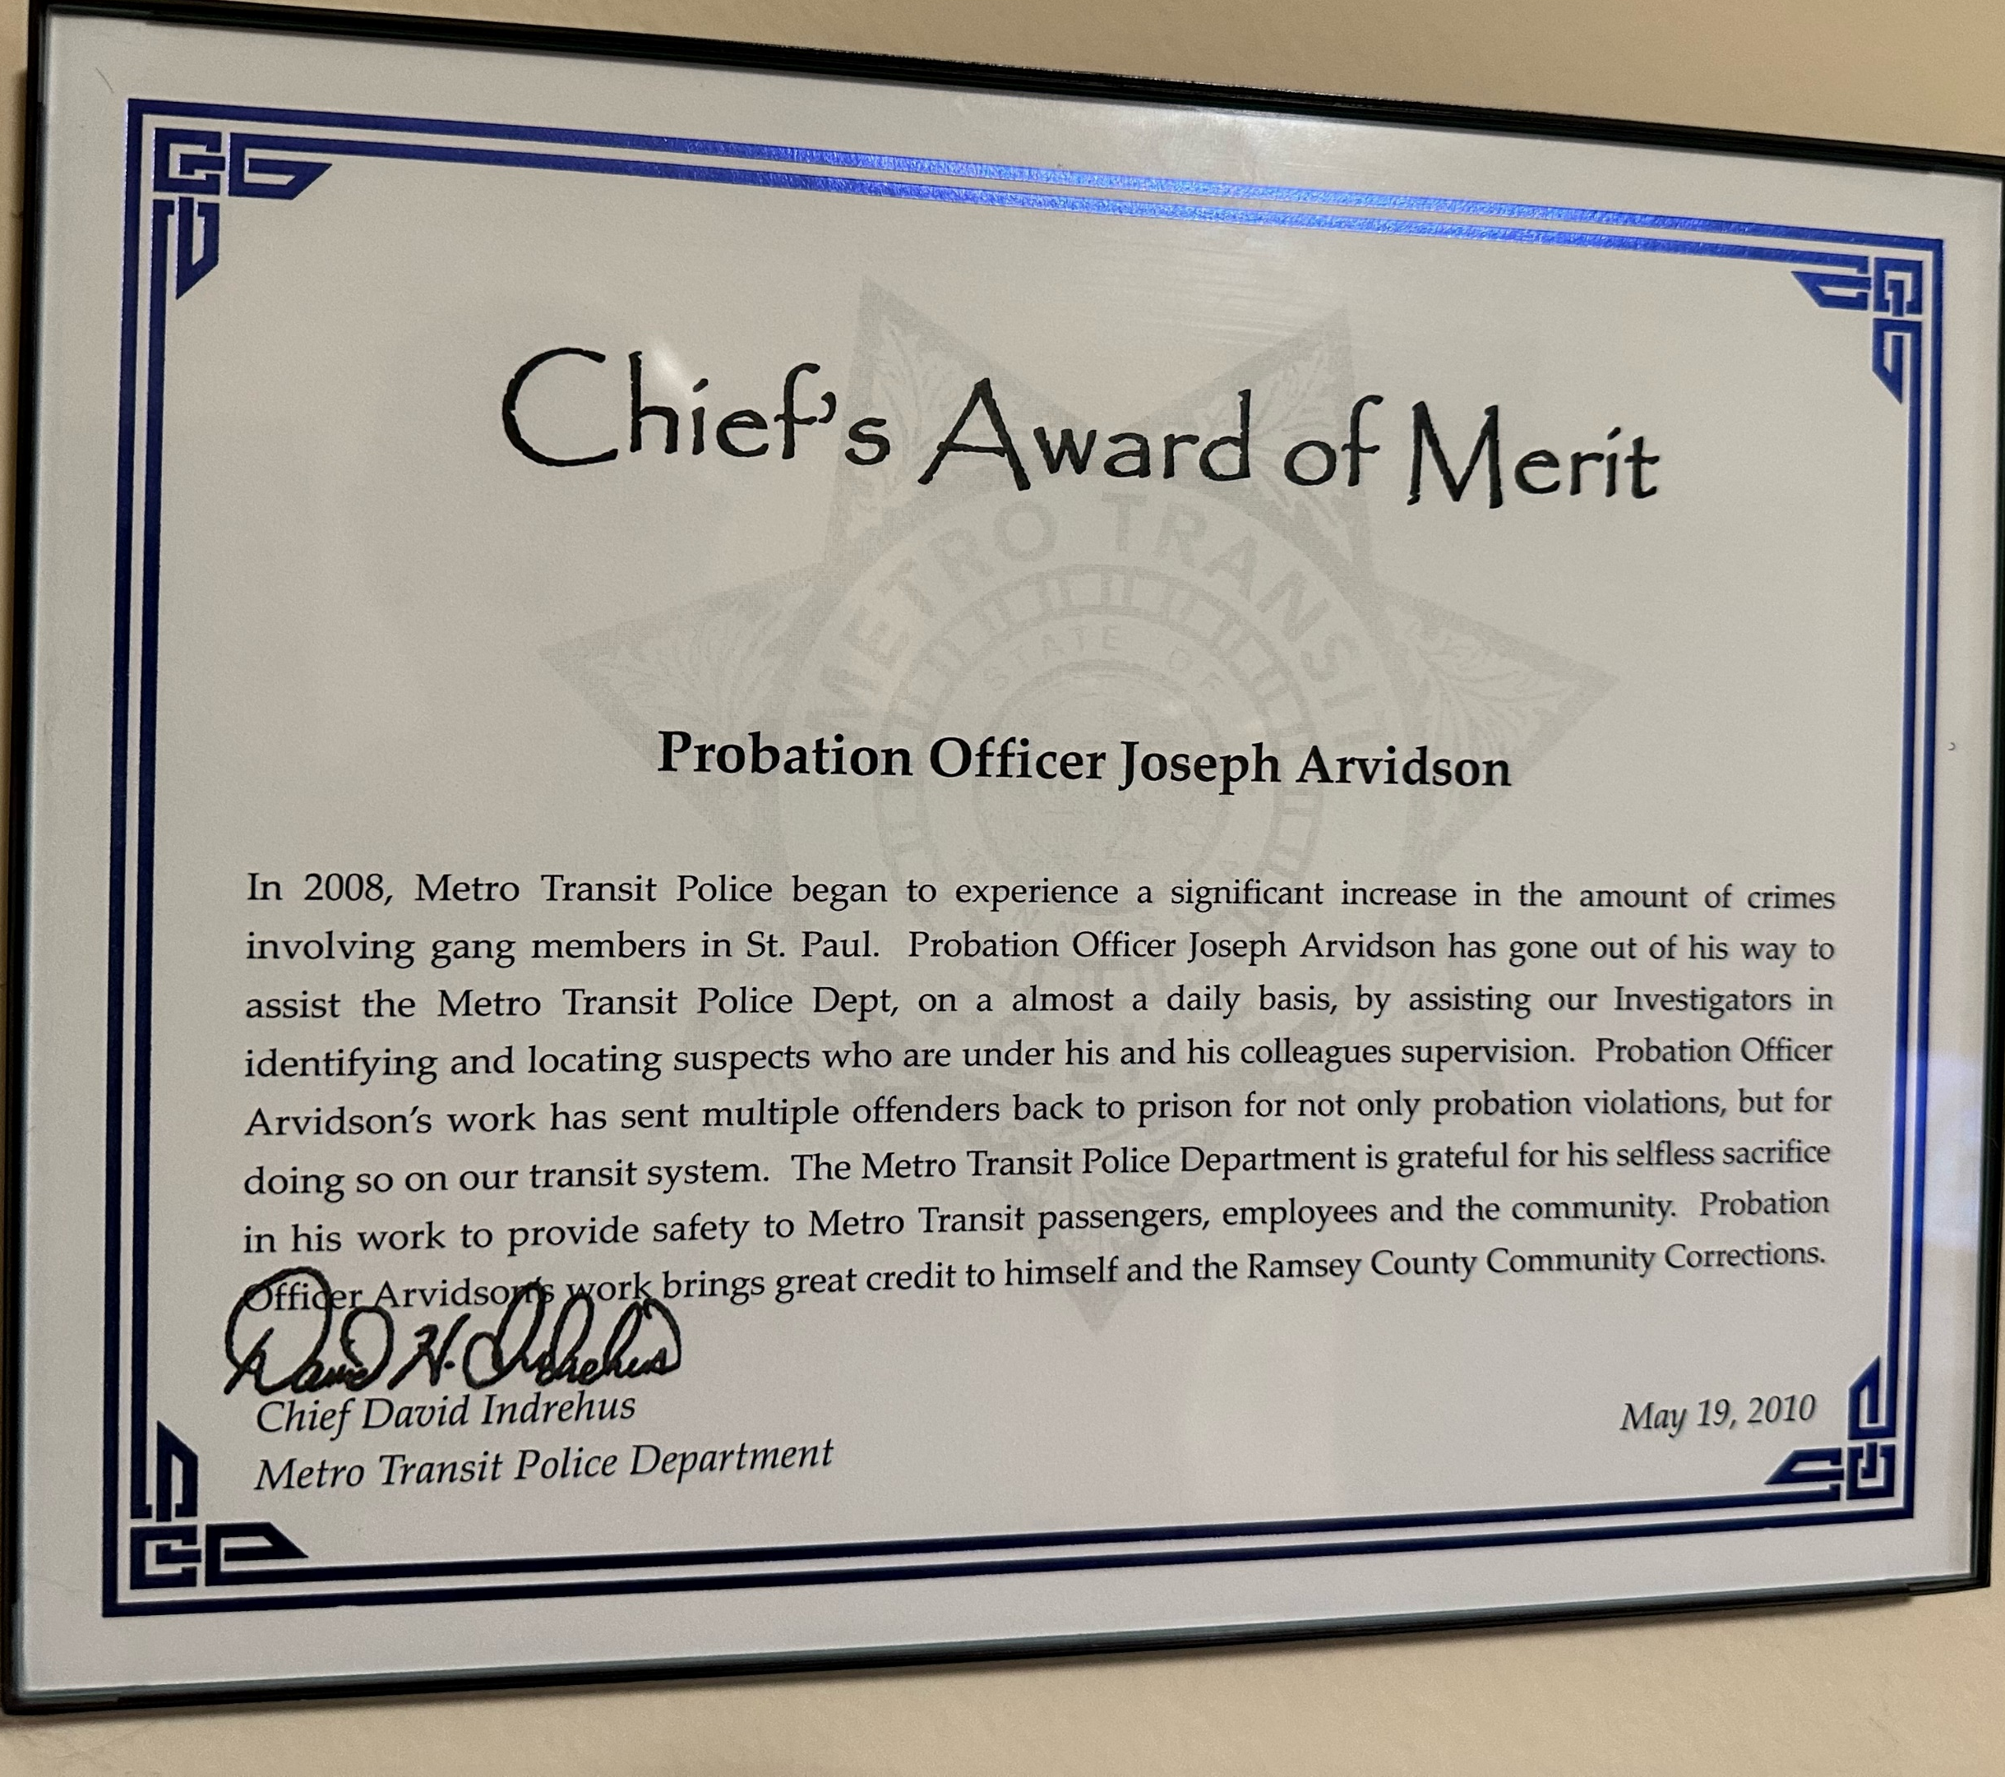
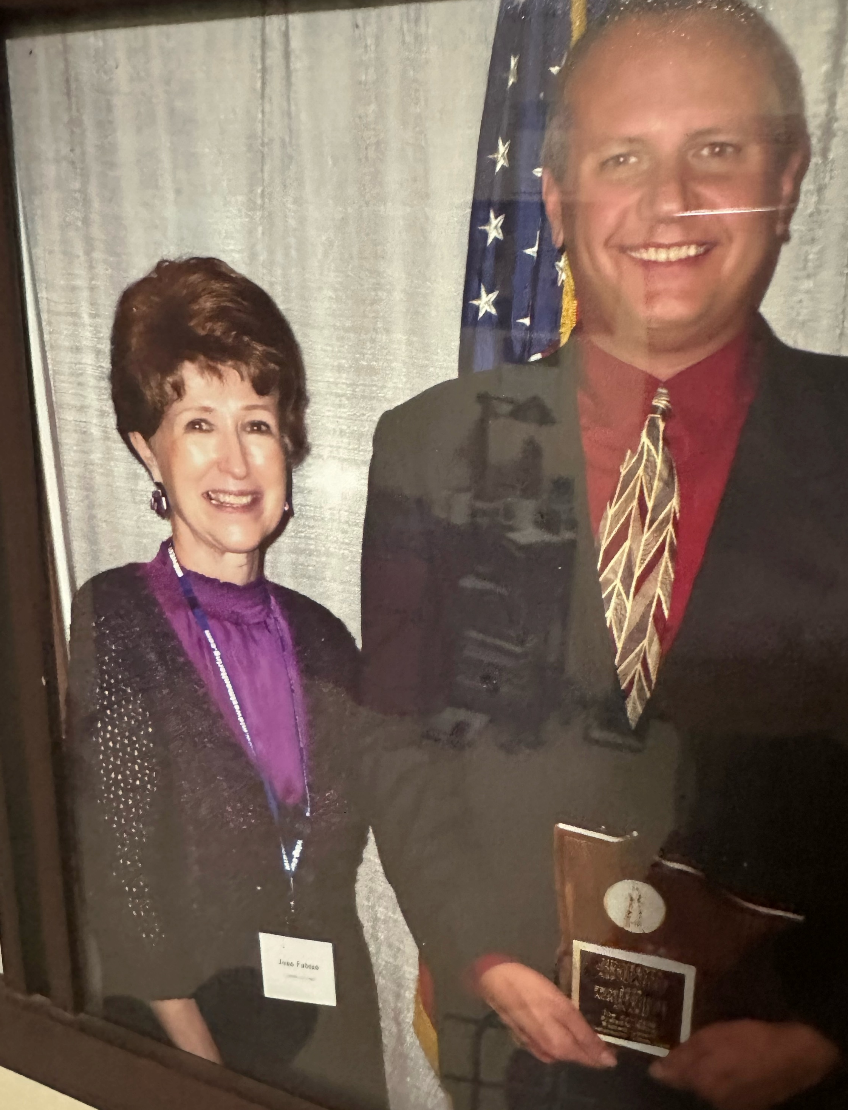
Behavior= Awards
Notes:
"Our journey through the pages of history and the evolution of vision brings us to a very personal chapter of my narrative.
While it's essential to understand the dynamics of Human Capital, Social Capital, and Identity in shaping behaviors, it's equally crucial to see the outcomes of such behaviors.
As a direct consequence of my engagement, collaboration, and dedicated role as a 'Gang Investigator,' I was honored with multiple accolades recognizing the efforts to quell the tide of gang violence.
These awards, are not just metals, ribbons, or certificates.
They represent the countless hours spent on the streets, the sleepless nights, the danger faced, and more importantly, the lives impacted and saved.
But I share these not to trumpet my achievements.
Instead, they serve as a testament to what's possible when one's HC, SC, and Identity converge towards a singular goal.
Each recognition signifies that when passion aligns with purpose and is fueled by the right resources and networks, impactful change is not just a dream but a tangible reality.“ 24:00

Slide 16
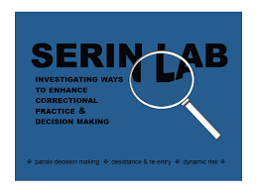
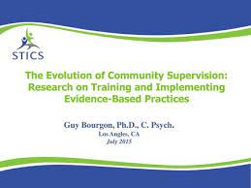
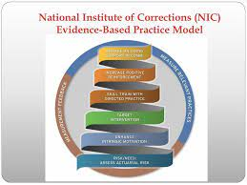
Milestone: 1998 Diving Deep into EBP
Notes:
"The journey of personal and professional evolution brought me to yet another pivotal crossroads: The Evidence Based Practices Training Unit. This wasn't just a promotion—it was a revelation.
Here, I found myself not just learning but immersing, almost to the point of obsession, into the vast ocean of Evidence-Based Practices in Corrections. It felt like I was being handed the keys to truly impactful change.
These names you see here became my guiding lights. The insights from Bonta, Andrews, Bourgon, Serin, and the late, great Ed Latessa were not just academic readings—they felt like epiphanies at every page turn.
Their works provided tools and frameworks that went beyond traditional methods, laying the foundation for truly transformative correctional strategies.
But knowledge alone was not the endgame. I had an insatiable appetite for EBP trainings. Every seminar, every workshop became an opportunity to hone my understanding and skills. And soon, this voracious learning led to collaboration.
Brad Bogue and I began to envision a Practice Model of Supervision. A model that not only revolutionized our agency's approach but would soon serve as an inspiration for agencies worldwide.“25:35
"We will delve deeper into the ramifications of this collaboration shortly. But at this juncture, the essence is clear: When passion meets purpose, and when dedication is powered by knowledge, transformative visions are born.“

Slide 17
Evolving Variables…What's the Outcome? HC + SC + Identity=???
Notes:
"Let's embark on another introspective journey. As we've seen, my trajectory has been marked by significant shifts and growth.
Each phase has been punctuated by new learnings, connections, and a renewed sense of purpose.
So now, with this newfound focus on Evidence-Based Practices and Core Correctional Skills, how have these three pivotal variables evolved?"
My Human Capital has seen a rapid ascent, fueled by an insatiable quest for knowledge. The literature, the ever-expanding body of evidence-based practices, and the mastery of core correctional skills have become the cornerstones of my expertise.
The circles of influence have now expanded to include fellow EBP trainers and subject matter experts.
These are individuals as committed, if not more, to ushering in change, to transforming how we think about corrections.
And my Identity? It has evolved from the crime fighter, the gang investigator, to now... a change agent, a torchbearer.
I've become an evangelist of what truly works, eager to share, train, and bring light to the intricate maze of corrections."
Given this evolution, I pose a question to all of you: Considering the enriched Human Capital, the robust Social Capital, and the refreshed Identity, what do you believe my resultant behavior would be in this phase?
27

Slide 18
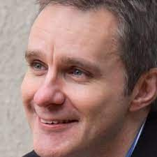
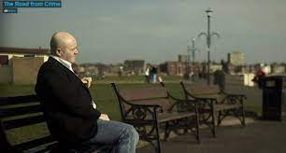
2012’s Vision and Innovation The Road From Crime
Notes:
2012 marked not just another year, but a watershed moment in my journey of understanding the intricacies of crime and rehabilitation.
Fergus McNeil and Shadd Maruna’s documentary, 'The Road from Crime,' was a revelation."
Through this poignant exploration, I was introduced to the concept of Desistance from Crime. This wasn’t just another theory. It was a profound perspective that delved deep into the psyche of those involved in crime and charted their journeys out of it.
As I delved into this new realm, I became familiar with the layered nuances of desistance: The primary cessation of offending; the secondary transformation of self-identity away from crime; and the tertiary acknowledgment by society of this change."
But what struck me the most was the alignment of these concepts with the foundation stones of Human Capital, Social Capital, and Identity transformation. It was like fitting the last pieces of a complex puzzle, shedding light on the holistic approach towards rehabilitating clients and ensuring their successful reintegration into society."
"The Road from Crime wasn’t just a documentary; it was a roadmap. A roadmap that would significantly influence my approach and understanding in the years to come.“ 29

Slide 19
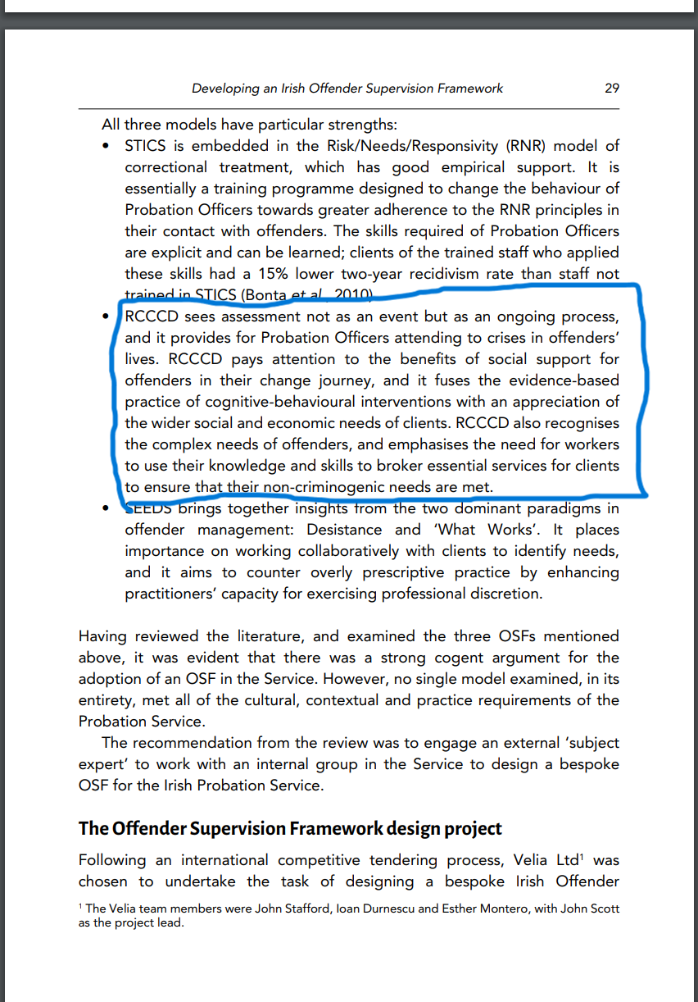
Behavior= The Culmination of Evolution->The ESP Model.
Our ESP Practice model!!!
Notes:
By 2012, my immersion into evidence-based practices had manifested in a tangible creation - The Effective Supervision Practice Model, or ESP for short.
Co-developed with Brad Bogue of J-Sat, ESP became a beacon, guiding practitioners in the field."
The progression wasn't overnight. Every workshop, every paper, every book I read laid the foundation for ESP.
But ESP was more than just a model. It was a framework, a structure, that was given its due recognition. We developed a rubric to measure its application, earning us copyright protection from the patent office in Washington DC."
And the global recognition followed. Professor Durnescu's literature review for Irish Probation Services captured the essence of our work, situating it amidst the prominent frameworks.
He acknowledged the value of skilled interventions, emphasizing the principles of evidence-informed practice."
Our aim with ESP wasn’t to merely introduce a new system but to translate core principles into actionable, effective interventions in real-world settings. Knowing that it’s making a difference, and being cited internationally, is a testament to our collective efforts.“
30:30

Slide 20
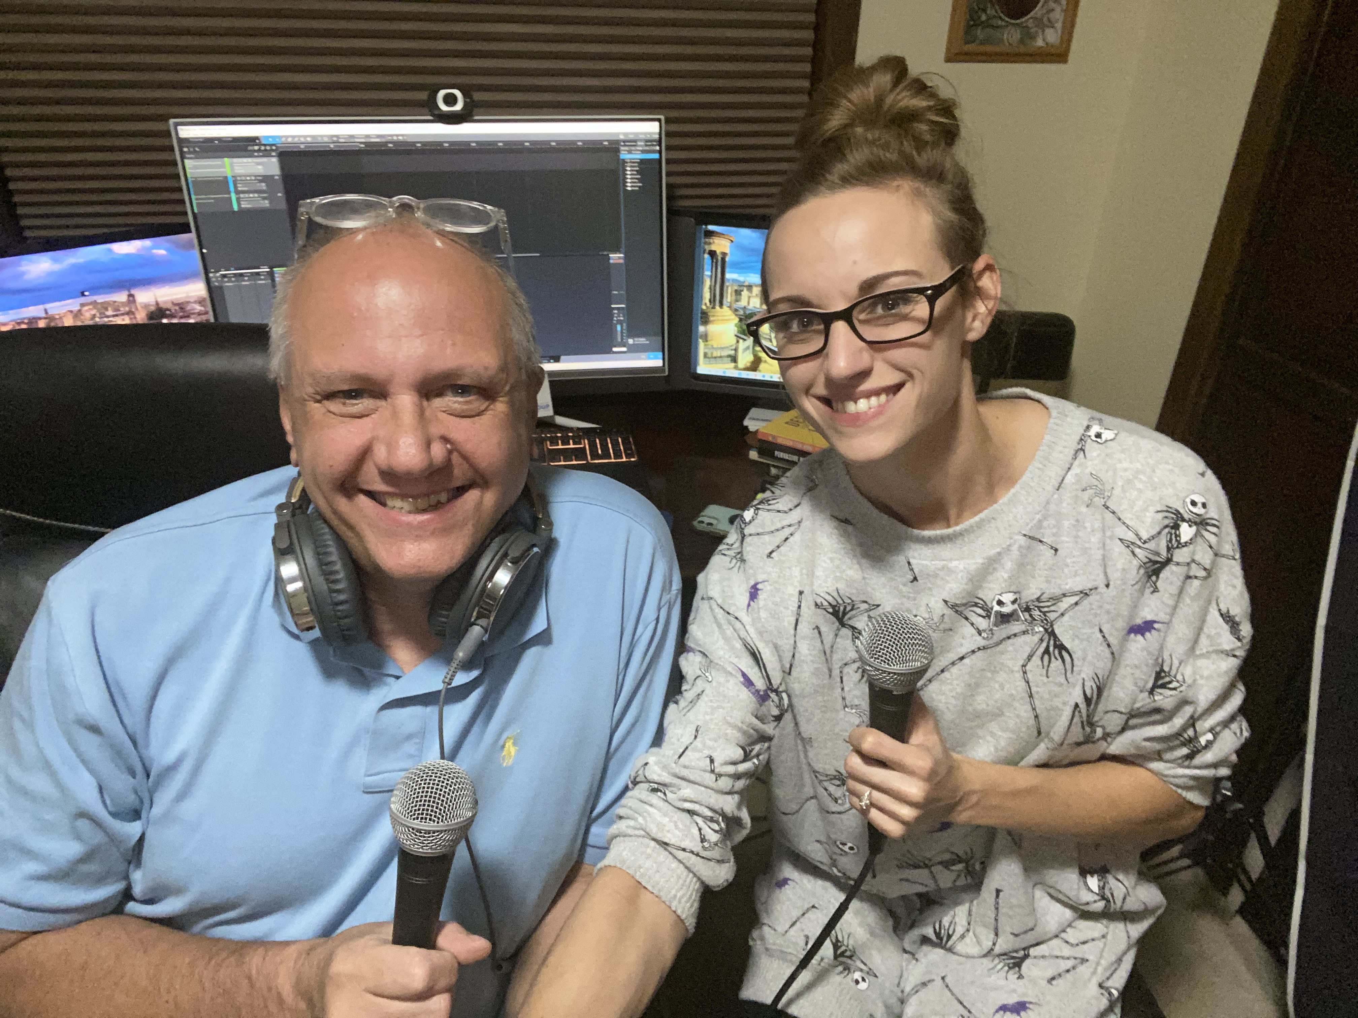
Milestone February of 2020: The Criminologist podcast launch
Notes:
As we stepped into a new decade, I embraced the digital age in a way I'd never imagined.
In February of 2020, I ventured into the world of podcasting, launching 'The Criminologist'. The aim was clear - to shed light on the concepts of desistance from crime, and the essence of core correctional skills."
Podcasting was just the beginning. I diversified into video content with a YouTube channel.
Our growing digital footprint meant using social media not just to connect, but to amplify our message. The best part? I wasn’t alone in this journey. My social capital expanded, drawing in thought leaders from across the globe.
But amid this digital evolution, the core remained unchanged. 'The Criminologist' wasn’t just a name; it became my identity. A trainer, a facilitator, a voice that yearned to make a difference."
And well, it did come with its perks.
With worldwide connections and seminars, I evolved into something of a jet-setting professional!“ 31:44

Slide 21
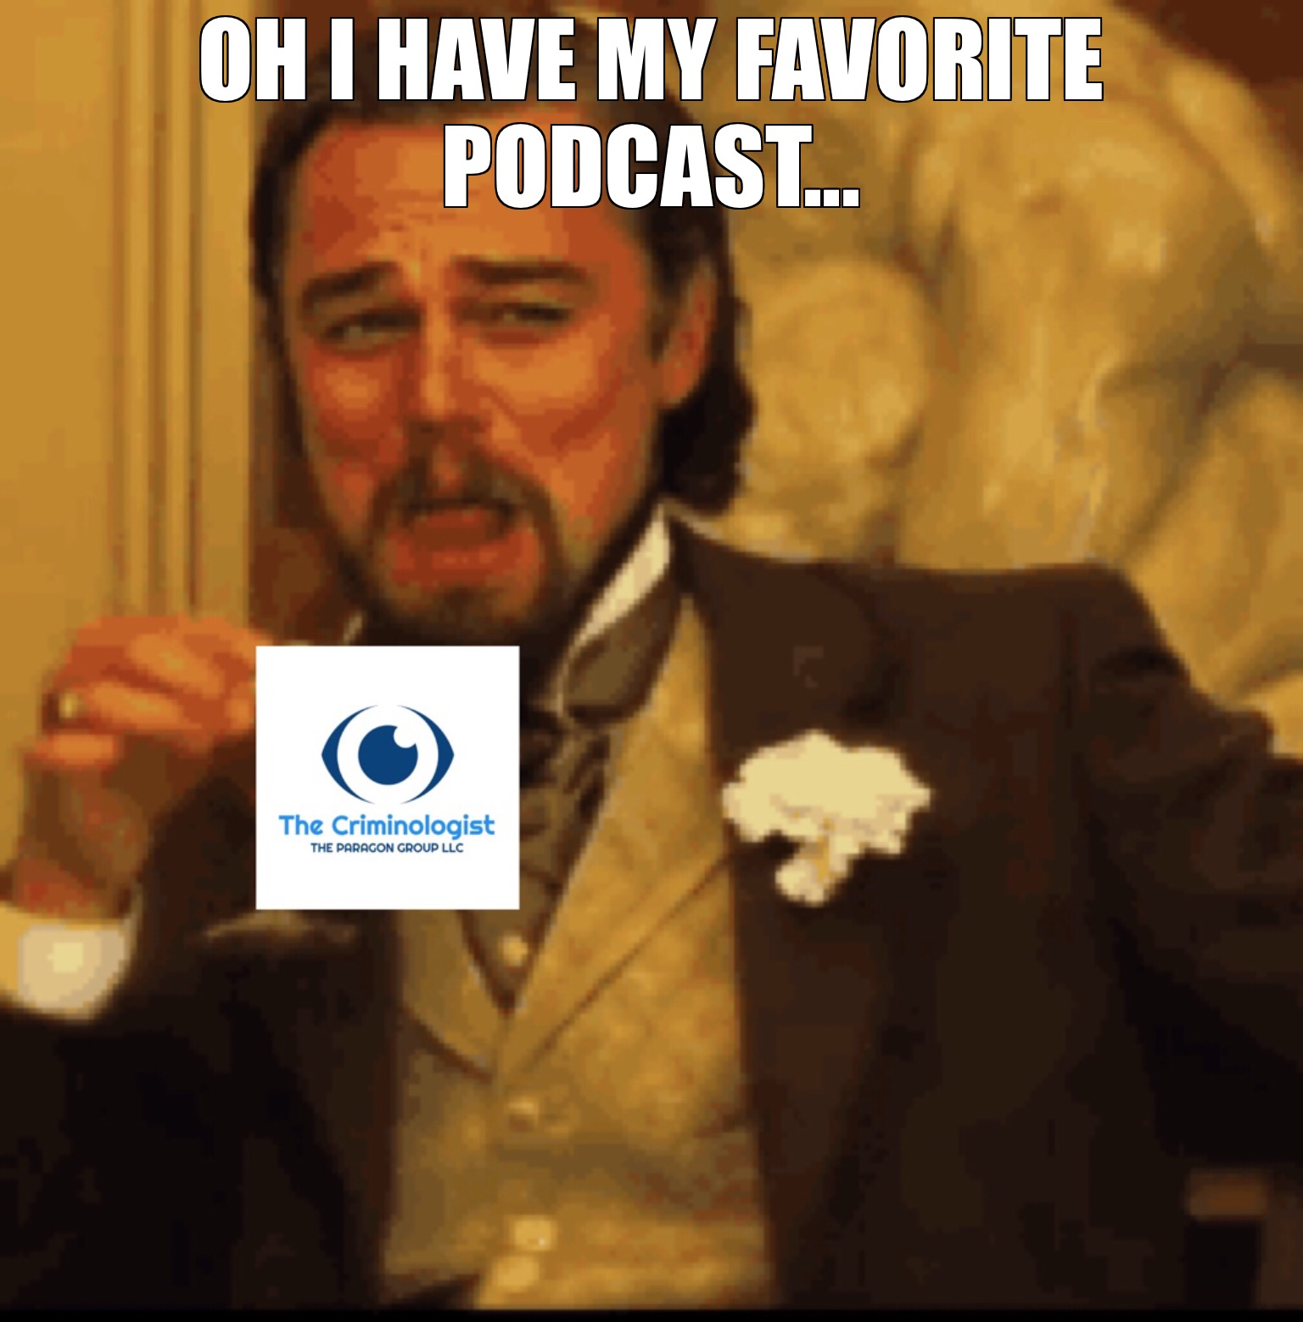
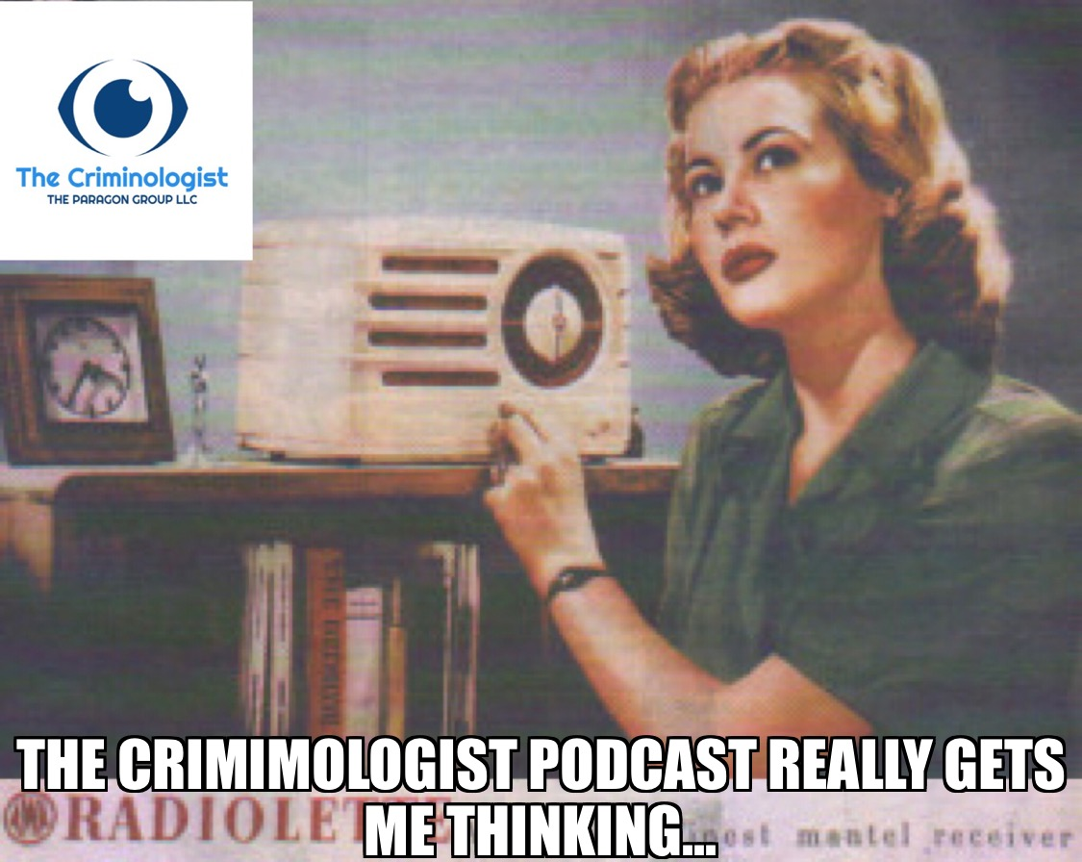
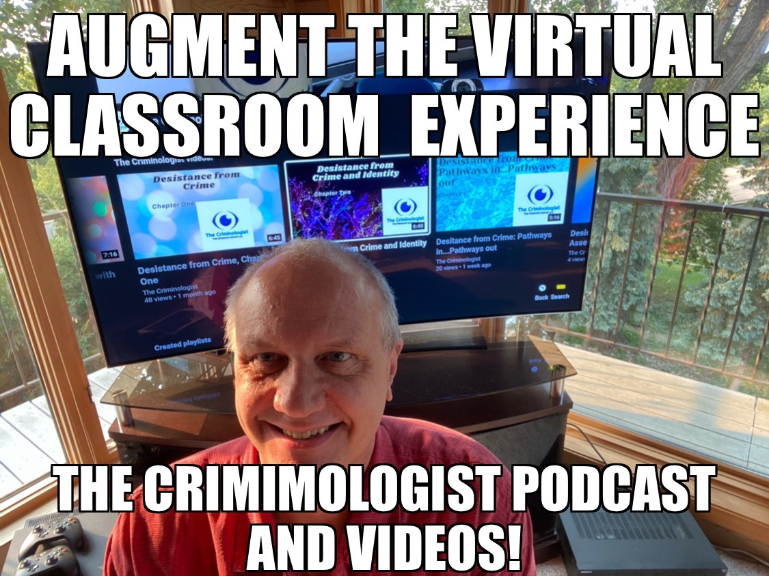
2020’s Vision and Innovation Embracing the Digital Revolution
Notes:
2020 was not just a new decade; for me, it marked a bold leap into uncharted territories. Podcasting, content creation on YouTube, and harnessing the power of LinkedIn became the forefront of my mission.
The digital revolution wasn't just about technology; it was also about leveraging it to connect, educate, and inspire."
This... this was a game-changer. The podcast medium offered a unique way to share insights, stories, and foster meaningful conversations.
And LinkedIn, oh! It wasn't just a platform for professional connections. It was, and continues to be, a space for shared learnings, dialogues, and innovation.
Each of these episodes, each of these videos, represents a story, a lesson, an insight.
Together, they symbolize my journey in 2020, a journey filled with vision and ceaseless innovation. 33

Slide 22
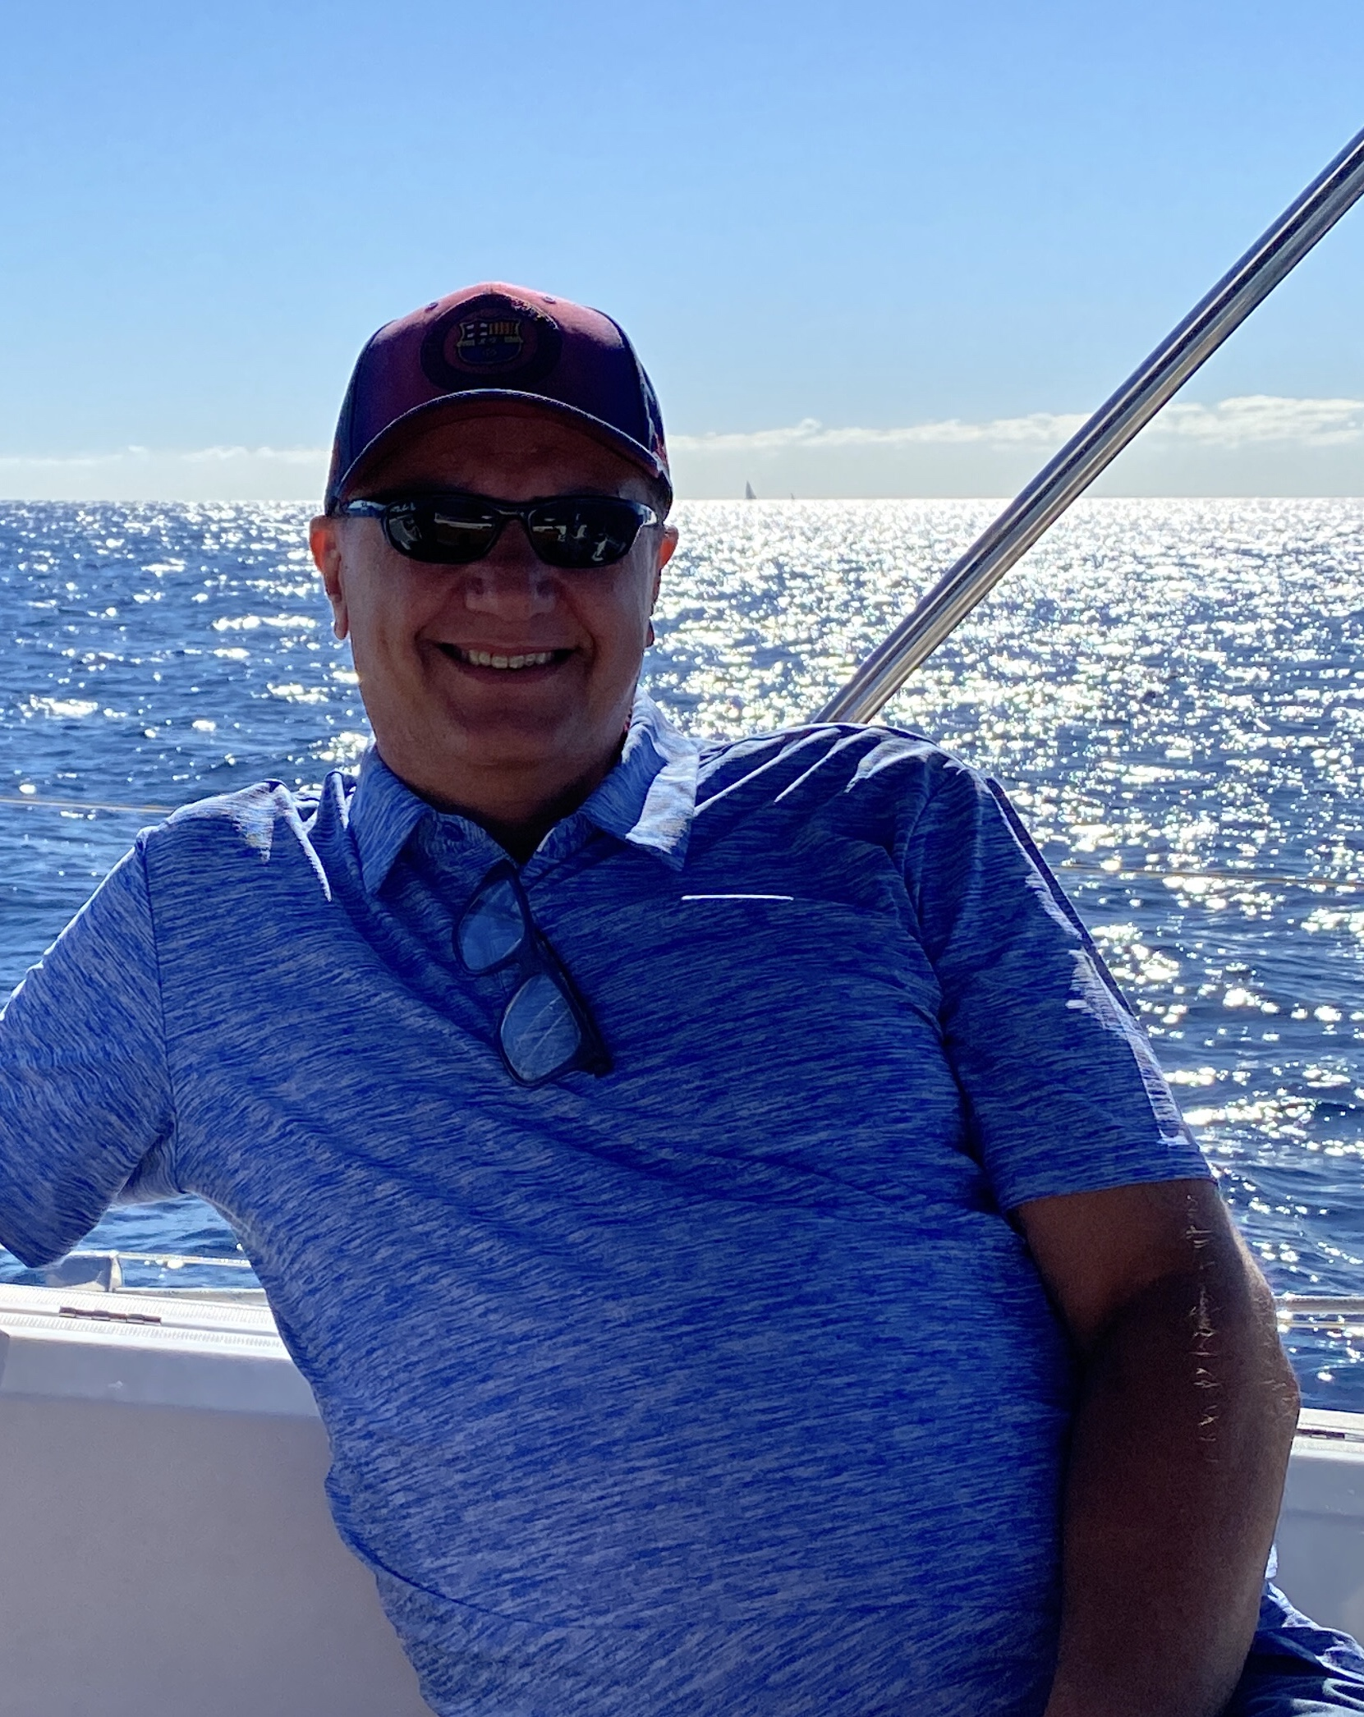
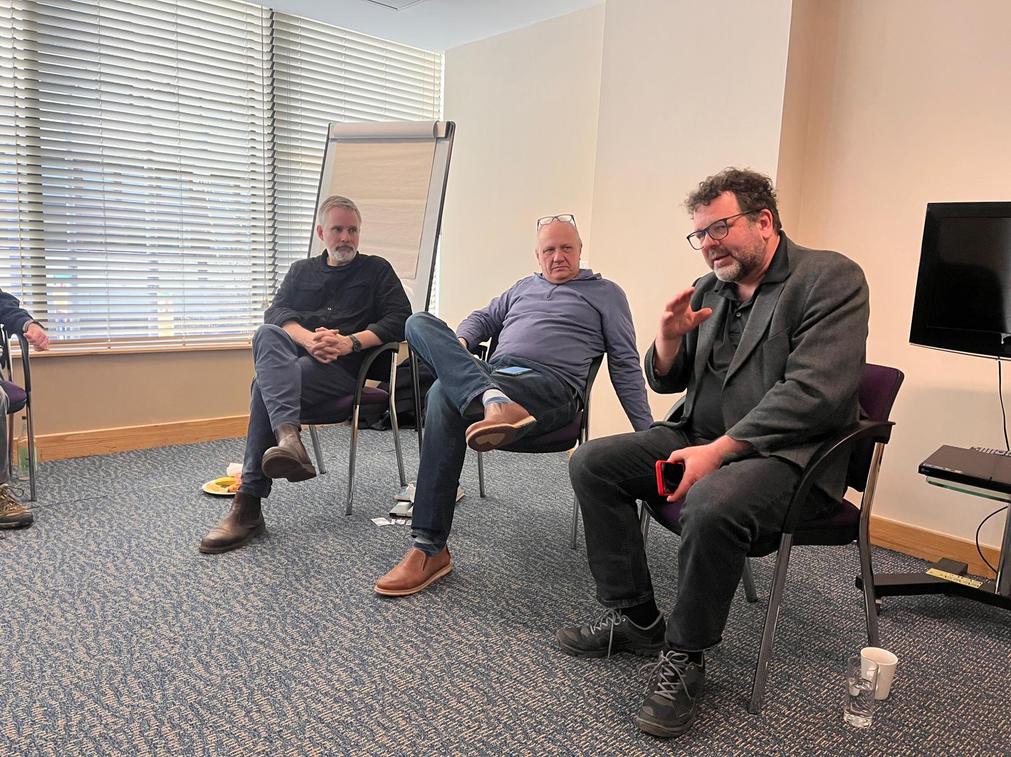
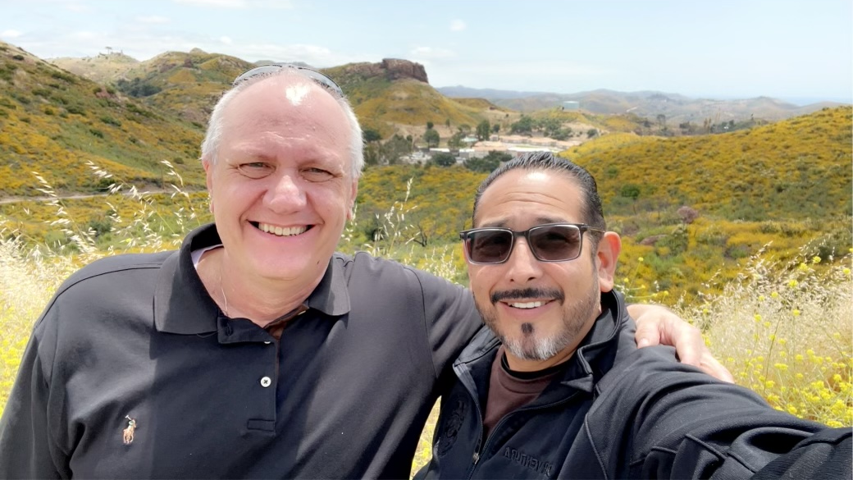
Behavior: A Journey of Growth and Global Impact
Add map?
Notes:
These dots, these paths on the map, they aren’t just about the miles I’ve traveled. They represent the milestones of my journey – milestones made possible by continually nourishing my human and social capital, and evolving my identity."
"When I set foot in Scotland, presenting alongside my idols, it was surreal. Each trip to Barcelona felt like coming home to a community of global learners.
The Middle East exposed me to a rich tapestry of cultures and teaching experiences. And then the bustling energy of cities like New York, the glamour of LA, the southern charm of Atlanta, and the beauty of Australia... each of these trips added a chapter to my story."
But the essence isn't just in the places I've been or the accolades. It's about transformation. Look where dedication to growth can lead. Look at the doors it can open. It's tangible proof for anyone - we can shape our destinies! 34

Slide 23
Milestone: A Journey Down Under. An Honor and a Partnership
Notes:
It's truly surreal for me to be standing here today, addressing such a dynamic and dedicated audience. I'm deeply honored to be invited as the keynote speaker for the esteemed Probation & Community Corrections Officer's Association. It’s a testament to the universal journey we all share in the world of corrections."
I'd like to express my heartfelt appreciation to the organizers of this incredible event. Your commitment to advancing our field is palpable in every detail and every conversation.
And a special shoutout to Tammy Lewis. Tammy, your invitation to travel to the beautiful city of Sydney and help shape the vision for the future of probation has been an opportunity I will always treasure."
I've also heard that Tammy is a fan of 'The Criminologist' podcast! And for that, Tammy, you have my eternal gratitude. Your support, and the support of so many others here, only fortifies my belief in the importance of what we do and the stories we share."
To all of you, let’s embark on this journey together, charting the path for the next chapter in probation, with evidence-based practices and transformative stories at its heart. 35:18

Slide 24
“Our potential unfolds not just by looking within, but by harmoniously merging our individual journey with the collective wisdom of our time."
Notes:
Our paths in life, both personal and professional, are intertwined with the fabric of our times. As I reflect on a 35-year journey in probation, I see not only my own growth but the metamorphosis of our field. Each innovation, every piece of research, and all the collective wisdom has left an indelible mark."
However, beyond tools and techniques, my journey was deeply influenced by my evolving Human Capital, Social Capital, and Identity transformation, and how these synchronized with the field's ever-changing vision and innovation.
It's crucial for our probation leaders to remain aware of these shifts and ensure that we are always aligning ourselves with what works best."
"And herein lies the beauty – the secret, if you will. This formula is universally applicable. It aids us in our personal growth, propels our teams, guides our leadership, and most importantly, becomes the beacon for the clients we serve."
Pausing as the slide reveals a quote.
Quote: "Our potential unfolds not just by looking within, but by harmoniously merging our individual journey with the collective wisdom of our time." - [Author's Name or can be left Anonymous]
"As we stand at the cusp of a new era, let's draw from our rich past and always strive for a future that's innovative, inclusive, and impactful.“ 36:49

Slide 25
FASD and R-N-R: A Call for a New Direction in Criminal Justice
Notes:
As we delve deeper into this discourse, we will navigate through visionary examples of what the future might hold for probation officials, beginning with the intersection of FASD and the RNR model. Together, we'll illuminate the potential pathways of innovation that beckon us forward. Let's embark on this exploration together. In a world where labels often define us, it's essential to understand the stories and struggles that lie beneath the surface. One such label, often misunderstood and underestimated, is FASD. But what is FASD beyond its acronym? How does it intersect with the criminal justice realm, and more importantly, how do we approach it with both empathy and effectiveness?
FASD is not merely a label. It encapsulates the myriad challenges and narratives of individuals profoundly impacted by prenatal alcohol exposure. Our criminal justice domain confronts an immediate imperative. We are aware of the profound impact of this condition, yet we grapple with a dearth of methodologies to holistically support these individuals.
My envisioned trajectory pivots towards leveraging the well-established Risk-Need-Responsivity (RNR) model to curate interventions tailor-made for these individuals."
By marrying the understanding of FASD prevalence with the structured RNR approach, we chart a course for groundbreaking reforms in our justice paradigm. This isn't merely about resource allocation; it's about bestowing a tangible opportunity for reintegration and minimizing recidivism."
I invite you all to further delve into this subject, to glean deeper insights and potential pathways for intervention through my article published in in Frontiers in Psychology."
As visionaries in probation, we are tasked with continually refining our lens, ensuring it encompasses even the most marginalized of our societal members.
In unity, we have the power to evolve the probation and criminal justice narrative, steering it towards inclusivity and efficacy.
38:22

Slide 26
Becoming Neuro Criminology Informed: A Paradigm Shift in Probation
Notes:
As we transition into the next frontier of probation, it's essential we delve deep into the nexus of criminal behavior and its neurological underpinnings.
This leads us to an emerging realm that I firmly advocate for: That of Neurocriminology."
Neurocriminology goes beyond the facade of behavior, seeking to understand the 'why' by peering into the 'how' – that is, how neural mechanisms influence behaviors that bring individuals into our justice system.
By grounding our interventions in neurocriminological insights, we can better comprehend the genesis of behaviors. It's akin to viewing a complex mosaic - every neurological facet is a piece that, when understood, gives a clearer picture of the whole.
When the broader justice system views individuals not merely as offenders but as humans with unique neural landscapes, it engenders a culture of empathy, understanding, and holistic rehabilitation.
The invitation today is for us all to embark on a journey towards becoming neurocriminology-informed professionals. The convergence of neural science and criminology offers a reservoir of untapped potential, promising a revolution in our approach to probation.
By anchoring our strategies in the deep waters of neurocriminology, we fortify the bridge between understanding and intervention, creating a probation system that's both informed and transformative.
Neurocriminology isn't just another branch of study. It's a game-changing interdisciplinary approach, blending neuroscience, physiology, genetics, biology, and psychology to redefine our understanding of criminal behavior.
As professionals, by immersing ourselves in this knowledge, we can revolutionize our methods - from interviews to treatments - ensuring a more informed, holistic, and effective probation system."
"Embracing neurocriminology is not merely about evolving our practice; it's about ushering in a new era of probation that's grounded in science, empathy, and transformation.“ 41:23

Slide 27
Notes:
Now TIDES isn't just an acronym; it's a testament to years of experience, research, and innovation.
It represents a convergence of trauma-informed care, desistance theory, neuro criminology, and core correctional skills. A blend that promises to redefine the essence of probation supervision.
Let’s take a quick look at the Components of TIDES:
Self-Regulation: Harness the power of emotional intelligence. Move from reactive to proactive.
Resilience: Overcome adversities with a fortified spirit. Transform setbacks into setups.
Identity: Rewrite personal narratives. Be the author of change.
Social Support: Relationships as the bedrock of transformation. Find strength in community.
TIDES offers a revolutionary approach. It aligns with the modern understanding of the brain, behavior, trauma, and healing, ensuring that we, as probation professionals, are equipped with the most potent tools to effect lasting change.
Dear esteemed colleagues, TIDES isn't merely another method—it's a transformational journey. As we face the challenges of an ever-evolving landscape in probation, let us embrace TIDES as our compass.
It's a synthesis of vision, innovation, science, and practice.
Together, let us set sail towards a brighter, more informed future for probation, ensuring that each individual we work with has the best chance to transform, grow, and thrive."
Are you ready to ride the TIDES of change? 43:25

Slide 28
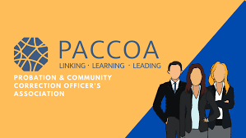
The Journey Ahead
Notes:
"As we've journeyed together through this keynote, navigating through the vast expanse of probation services, neuro criminology, the integral components of Human and Social Capital, and the dynamic Identity Transformation - we've been drawn closer to the heart of the matter. We've touched upon the ever-evolving innovations and the compelling visions shaping our world.
And just like Australia's vast landscapes, from its bustling cities to the serene outback, our professional realm is diverse, vibrant, and awaiting further exploration.
This land, with its rich tapestry of history, culture, and innovation, from the rhythmic beats of INXS to the compelling tales of 'Mad Max', mirrors the kaleidoscope of our endeavors.
We're constantly adapting, evolving, and seeking pathways to progress.
It's my genuine hope that as we've delve into the TIDES model, we've found a convergence – a meeting point – of understanding trauma, championing desistance, and foreseeing a more cohesive, informed approach to probation services.
Just as Australia's landscapes are interwoven with narratives and dreams, our professional tapestry is interlaced with challenges, achievements, and aspirations.
Now, it's our call to action. We stand at the precipice of change, armed with knowledge and shared goals.
Let's continue to challenge, to question, and above all, to innovate. Remember, the fusion of our collective energies can drive unprecedented transformation.
For those ignited with curiosity and the pioneering spirit, I invite you to delve deeper into the TIDES model at our breakout sessions later in the conference.
Together, we'll chart the waters of this transformative approach, and I hope to see many of you there.
As we embark on our respective paths, may we carry the spirit of mateship, the drive for innovation, and the determination to make a difference.
Here's to shaping a future that does justice to our shared mission and to the enduring spirit of Australia!
46

Slide 29
Joseph Arvidson, Executive Director->
Visit us at www.TheParagonGroupLLC.com
Podcast -> “The Criminologist”
Available on iTunes, Spotify, Stitcher, Overcast, etc.
channel-> “The Criminologist”
Follow The Criminologist Podcast on
joearvidson7@gmail.com

