Slide 1


Advancing Community Corrections: Innovation & Vision
CONVERSATIONS WITH EMPLOYERS
Crafting a narrative that showcases employability appeal
PACCOA CONFERENCE | 19 – 20 October 2023 | Sydney, Australia
Dr Suzanne Reich
Discipline Lead | Senior Lecturer
Criminology & Criminal Justice
Suzanne.Reich@unisq.edu.au @ReichSuz

Slide 3
PRESENTATION OVERVIEW
OBJECTIVE 1
showcase an idea for advancing community corrections through collaborative practice;
OBJECTIVE 2
present an innovative blueprint to help people in their reintegration endeavours; and
OBJECTIVE 3
hopefully inspire your vision for advancing community corrections in innovative ways!
TOPICS
Research background
First Impressions
Impression formation
Belief in Redeemability
Desistance signals
Desistance signalling

Slide 4
RESEARCH BACKGROUND
Having a job protects against reoffending
✦ ✦ ✦
Employers perceive job applicants with a criminal record pose a risk
✦ ✦ ✦
Therefore, employers are reluctant to hire
✦ ✦ ✦
How can job applicants with a criminal record accentuate their desistance from crime and overshadow their criminal record?
“Beyond the criminal record: An examination of how and why redeemability beliefs and desistance signals matter for employers’ willingness to hire a job applicant with a criminal record.”

Slide 5
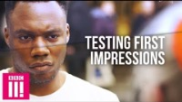

First impressions…
“BBC three has conducted a social experiment. Strangers can ask each other any question after five minutes eye to eye”

Slide 6
In the words of Mary Poppins…
A cover is not the book
So open it up and take a look
'Cause under the covers one discovers
That the king may be a crook
Chapter titles are like signs
And if you read between the lines
You'll find your first impression was mistook
For a cover is nice
But a cover is not the book
Emily Blunt | Lin-Manuel Miranda
Company – Mary Poppins Returns
But what if the cover is a criminal record?

Slide 7
IMPRESSION FORMATION
Individuating Information
Stereotype
Impression formed

Slide 8
IMPRESSION FORMATION
Desistance Signals
Belief in Redeemability
Willingness to hire

Slide 9
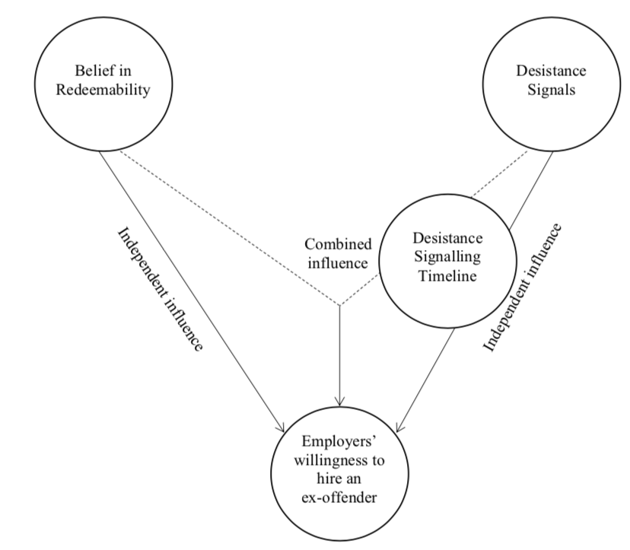
WILLINGNESS TO HIRE MODEL
Employers pre-conceived beliefs about capacity for desistance from crime
AND
Job applicants clearly and effectively signalling their desistance from crime
INFLUENCE
Hiring outcomes
How can desistance be signalled?
(Reich, 2019)

Slide 10
Desistance signalling timeline
(Reich, 2019)

Slide 11
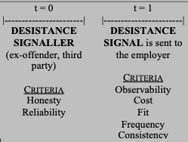
DESISTANCE SIGNALLING TIMELINE
By addressing the criteria, ex-offender job applicants can design their own desistance signalling strategy and make their desistance from crime recognisable

Slide 12
The Desistance Signaller - Honesty

Slide 13
The Desistance Signaller - Reliability

Slide 14
EMPLOYMENT WORKSHOPS
Getting a job with a criminal record
Understand desistance signalling
Hard and soft skills brainstorming
Desistance signalling design template

Slide 15
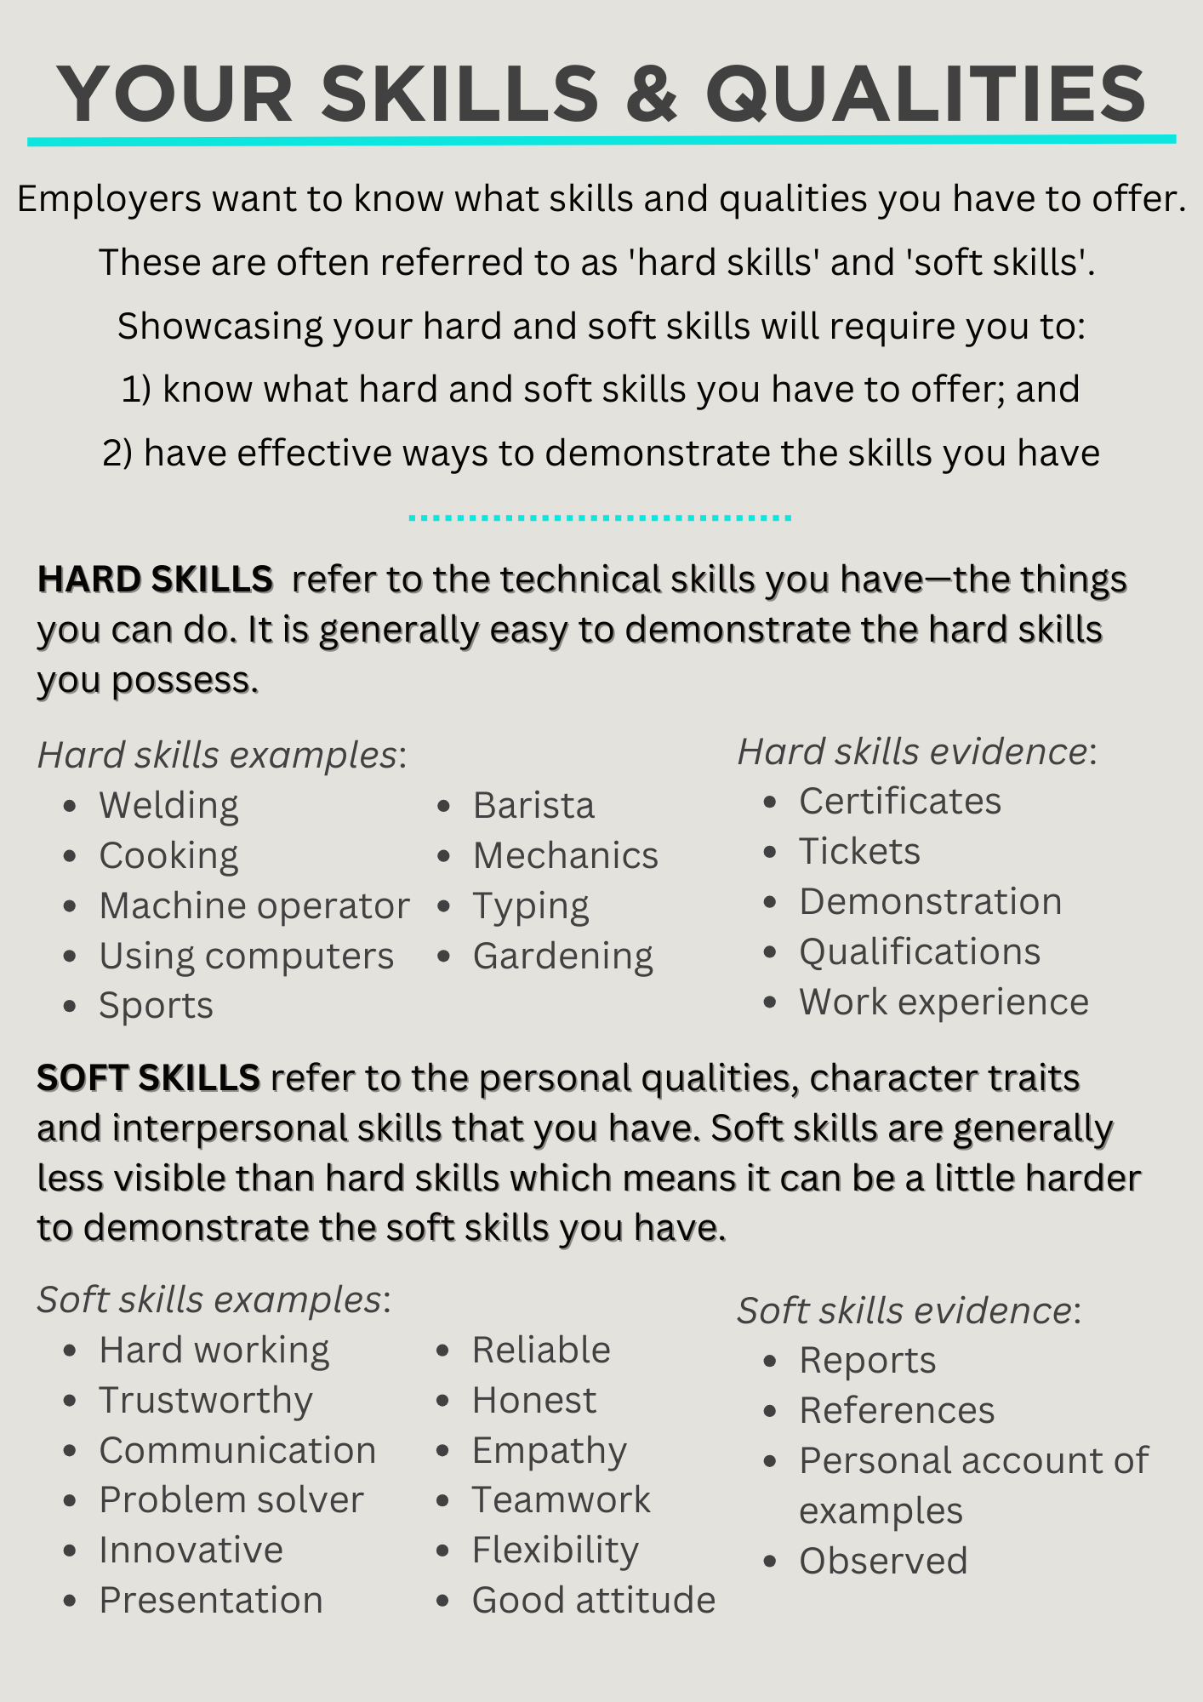

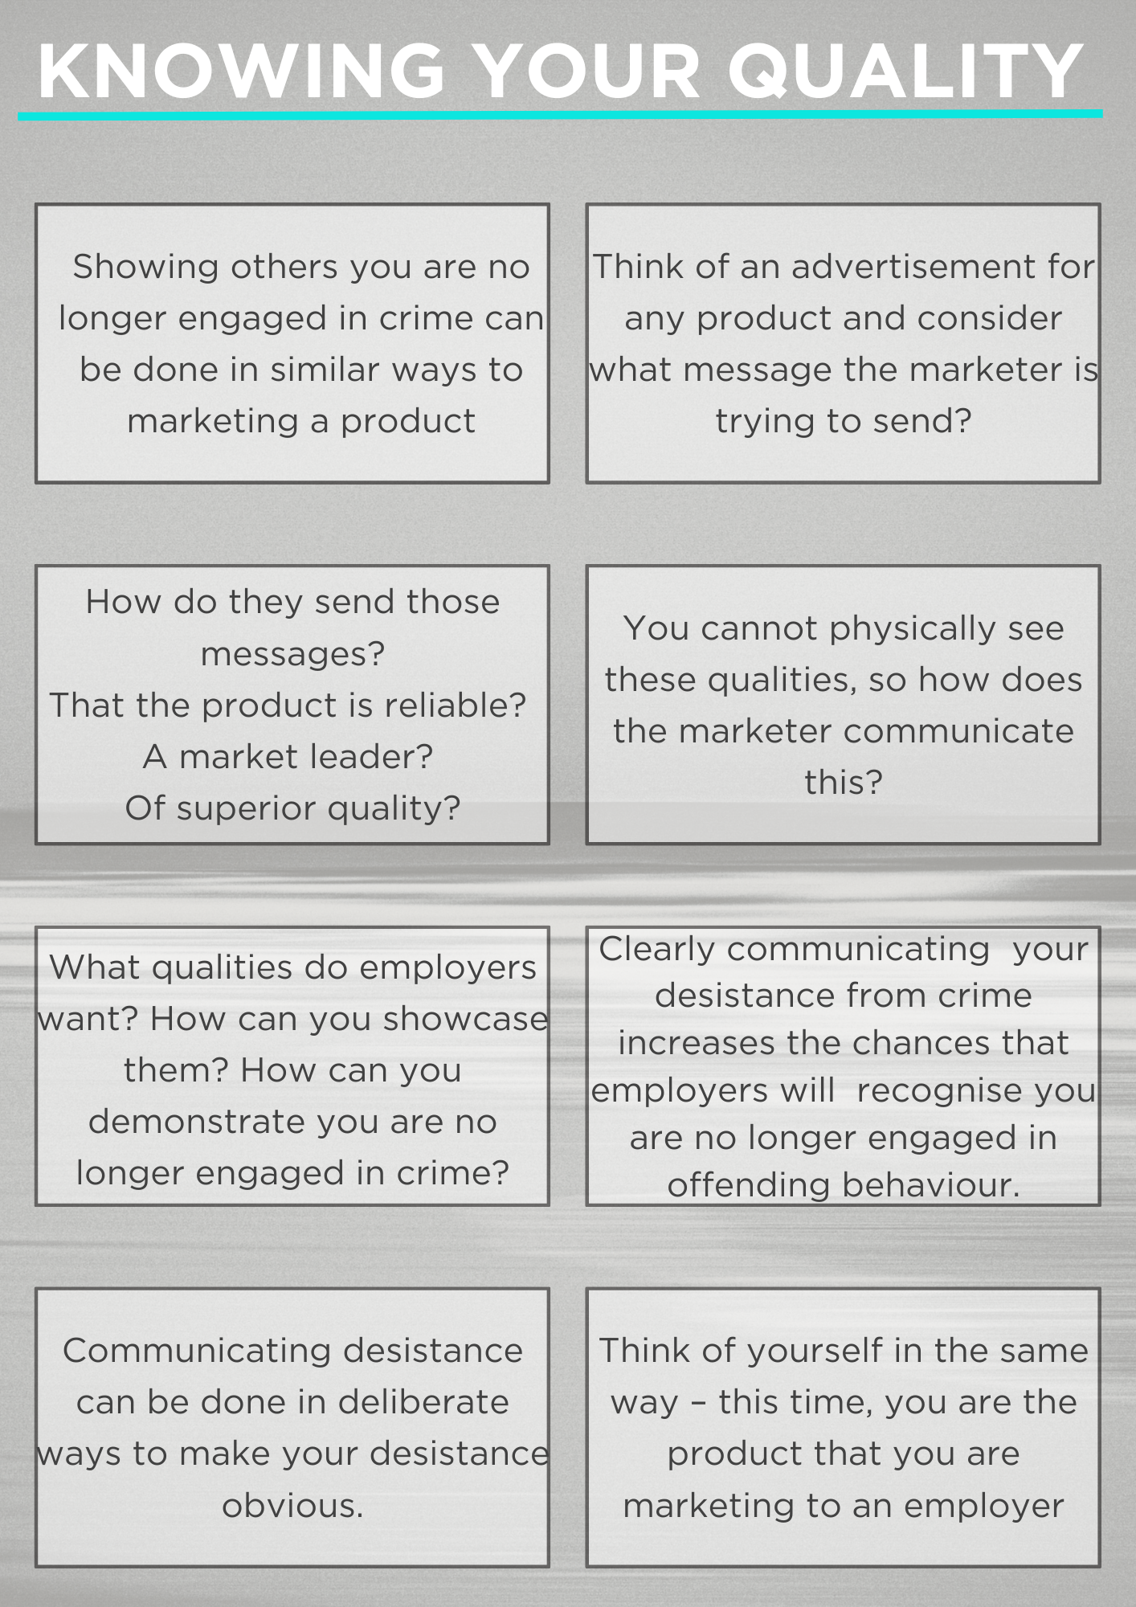
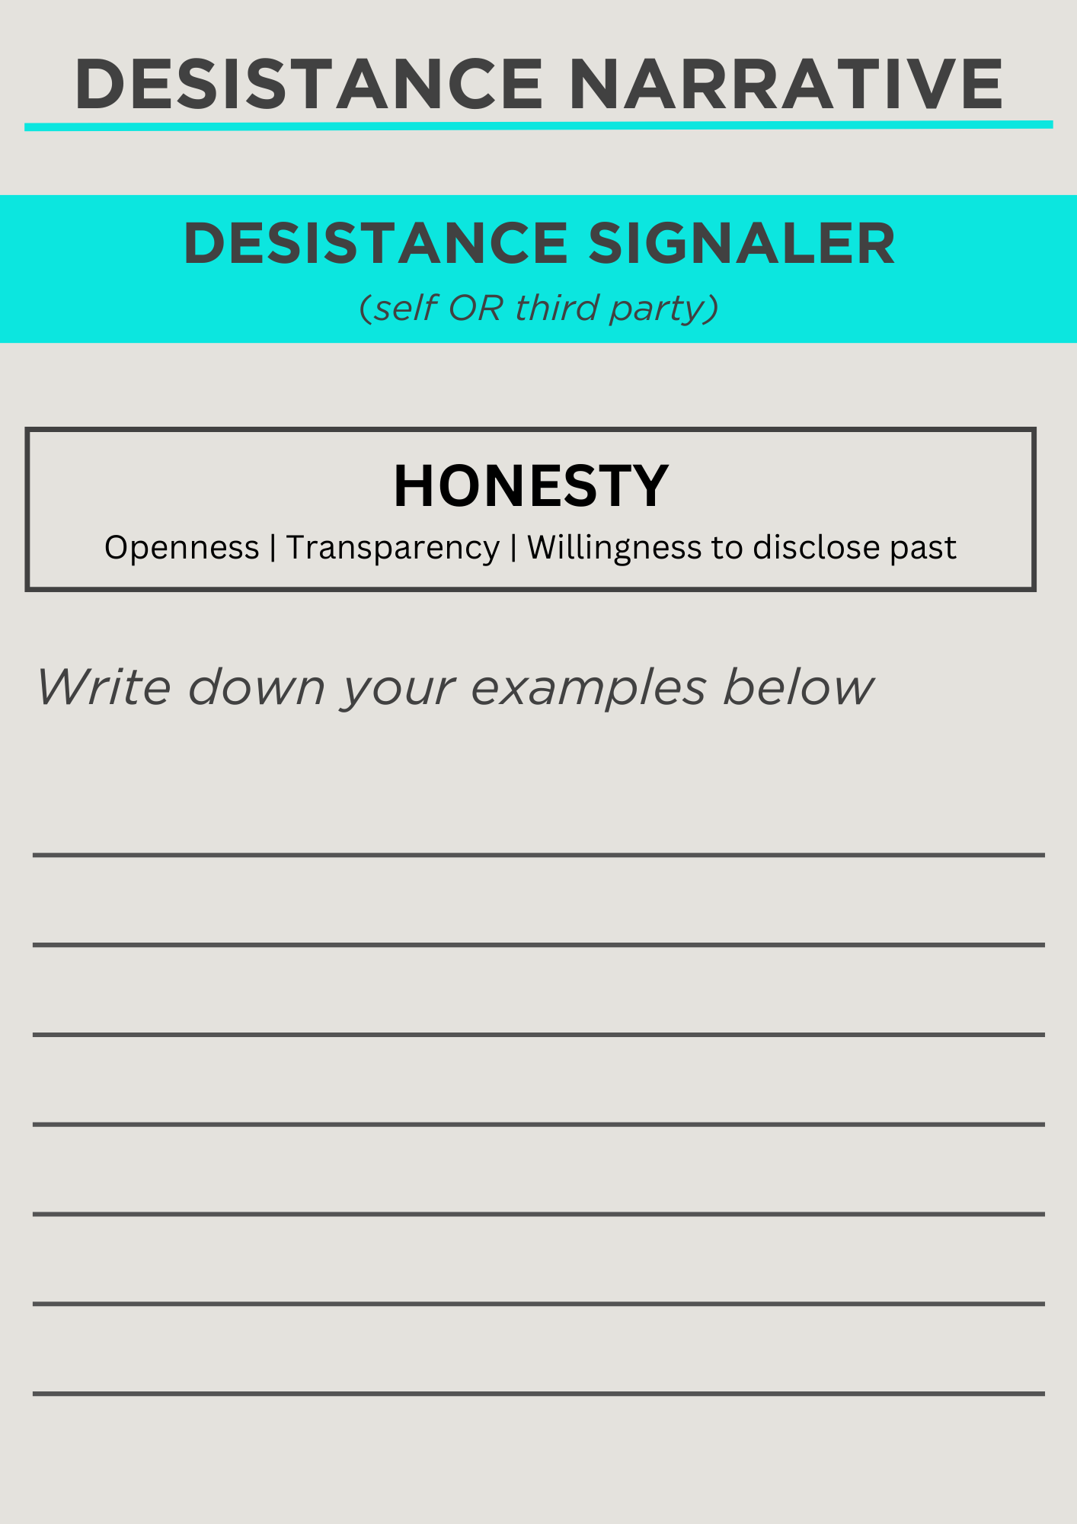
DESISTANCE SIGNALLING BY DESIGN

Slide 16
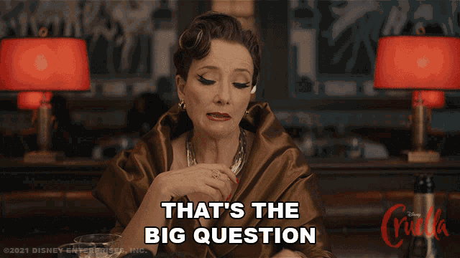
Perhaps you’re thinking….
3 THINGS
Attend tomorrow’s desistance signalling workshop
✦ ✦ ✦
Host a workshop for your service users - I’ll come to you
✦ ✦ ✦
Act as a job coach for those under your supervision
What can we do from day to day in our work with those under supervision to help them signal their desistance?

Slide 17
QUESTIONS or COMMENTS?
Thank you !

