Slide 1
Master of Education and Professional Studies Research
Griffith University 2023
Custodial Correctional Officers’
Perceptions of Offender Rehabilitation
- A Snapshot from Lived Experience
(& Implications for Community Corrections)
Christopher French
BEd, MEd (with Distinction), MPM, MEdProfSt
Dr Mark Tyler – Co Supervisor
Dr Stephen Hay – Co Supervisor
Notes:
Presenting as a Griffith University Researcher, not a QCS employer
Reducing 31k words to 20 minutes and reshaped presentation for this audience – I am willing to share my paper
Read title of Research and highlight Perceptions/ Lived experience
My Journey – Education – CCO – PDO

Slide 2
Perceptions & Lived Experience
Perceptions
Perceptions reflect an individual’s sensory insights which they base their future rehabilitation engagement and behavior upon (Zacks et al., 2007)
Lived Experience
Lived Experience is something that is not simply ‘experienced’ but becomes meaningful and leaves a lasting impression
(Frechette et al., 2020; Mertens, 2018)

Slide 3
My Perceptions & Lived Experience
CCO
CCO training was of a high standard, but minimal attention given towards rehabilitation programs
Some CCOs’ enthusiasm for rehabilitation appeared to diminish when exposed to their work environment
PDO
A holistic approach to rehabilitation was absent – departments seemed to work in silos
No pathway of communication with Community Correction officers for PDOs
Notes:
Care Bears versus Toastie Cookers
I wanted to find out what was going on and see if there was a research gap worth exploring
The Community Corrections Pathway was not part of my initial perception but became one upon research completion
For my literature review, read 150 National/ International journal articles
For this audience, I am very briefly highlighting some literature findings

Slide 4
Literature Review
Defining Rehabilitation:
“Interactions with the offenders aimed at motivating, guiding, and supporting constructive change in whatever characteristics or circumstances engender their criminal behaviour or subvert their prosocial behaviour” (Lipsey & Cullen, 2007)
Notes:
* The primary definition I used for my research was from Lipsey and Cullen

Slide 5
Literature Review
International & National Rehabilitation expectations:
Prisoners must be supported to change their behaviours and attitudes
All correctional staff play a role in rehabilitation
International Covenant on Civil and Political Rights (United Nations General Assembly, 1976);
Guiding Principles for Corrections in Australia (CSAC, 2018)

Slide 6
Literature Review
Impact on Rehabilitation:
CCOs exerted the strongest influence upon the behaviour of prisoners because of daily exposure with them, which increases opportunities to counsel prisoners (Schaefer, 2018)
CCOs with positive approaches contributed to effective rehabilitation, but negative approaches generated barriers (Antonio et al., 2009; Ferdik & Hill,s, 2018; Gul, 2018)
Notes:
I expect the positive and negative approaches in Community Corrections would be similar for effective rehabilitation

Slide 7
Literature Review
Challenges to Rehabilitate :
CCOs’ perceived adversity contributes to job dissatisfaction and decreases motivation to perform rehabilitation responsibilities (Trounson, Pfeifer, & Skues, 2019)
CCOs often combat a cultural workplace rejection of rehabilitation (Ferdik & Hill, 2018)
Notes:
Perceived adversity and job dissatisfaction was not a finding of mine
Reflect of your workplace and culture for effective/ positive rehabilitation approaches

Slide 8
Literature Review
Barriers to support Rehabilitation:
The ‘Deprivation Model’ - positive beliefs CCOs have will be worn down through prison events (Halsey & Deegan, 2017)
‘Just World Theory’ - individuals believe, ‘people get what they deserve’ (van Prooijen & van den Bos, 2009)
Benefits of Rehabilitation training:
CCOs improve their officer–prisoner relationships and increase their ability to change prisoner behaviour (Antonio et al., 2009; Canada et al., 2020; DeHart & Lachini, 2019)
Notes:
Highlight Sex Offenders
From review, I found a research gap that led to four Research Sub Questions

Slide 9
Research Questions
What were the rehabilitation perspectives of CCOs upon appointment?
What are the perspectives of CCOs held presently?
What has influenced any changes of CCOs’ perspectives?
How can these perspectives be used to inform correctional training program design?
As Community Corrections Officers, reflect on your perspectives?
Notes:
As Community Corrections officers, reflect on your perspective throughout this presentation from employment to practice
This afternoon’s workshop will explore your perceptions – what works, what may need considering in your workplace

Slide 10
Research Design
Method:
Qualitative research using NVivo software – Thematic Map
90-minute anonymous interviews
Participant criteria: Certificate 3 in Custodial Corrections, Unit Officer experience for at least 12 months, permanent employee of QCS
Demographics: 37 – 64 age range, 4 males/ 2 females, 54 years total experience with QCS

Slide 11
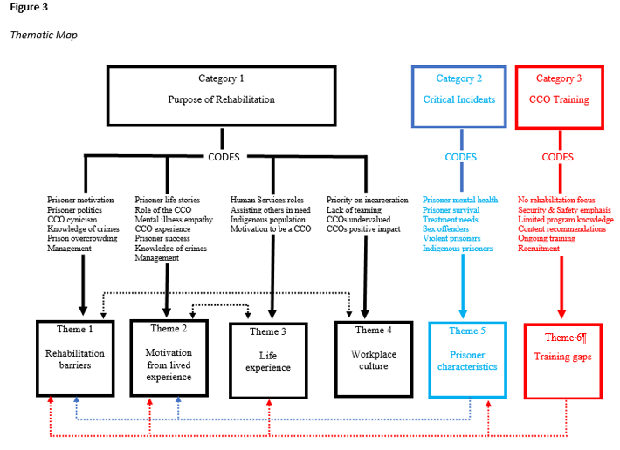
Notes:
Highlight categories
Some highlighted findings are presented under this structure
Qualitative research – findings are in the form of participant quotations

Slide 12
Findings Purpose of Rehabilitation
Theme 1 – Rehabilitation Barriers:
“Unless you can run them out with a future, or give them a trade, or qualify them as an electrician or a plumber or something, rehabilitation attempts are wasted”.
“It is a tick-the-box exercise for prisoners to get parole and some CCOs will use parole as a motivator for prisoners to participate in intervention programs because it will look good for parole”.
Notes:
* How do you view your role – Tick-the-box V rehabilitation?

Slide 13
Findings Purpose of Rehabilitation
Theme 2 – Motivation from Lived Experience:
“Basically, it’s age and maturity. I’m not the same person now that I was when I was in my twenties…I now believe in rehabilitation and providing prisoners with tools to assist their growth”.
“It’s why I do my job. I still use every opportunity to put my Mum hat on and talk to them and get them to see things from a different perspective”.
Notes:
Professional responsibility

Slide 14
Findings Purpose of Rehabilitation
Theme 3 – Life Experience:
“I’m a mother of young adults, the oldest is 30 and the youngest is 23. So, of course, I’ve got experience caring for people and that made a huge difference starting the work at the prison”.
“I like to know what makes people tick. I always find myself doing that in my personal life as well. Why would someone do what they’ve done, or what’s got them to that point? It is just how I am as a person”.
Notes:
What is your background – did that motivate you to join Community Corrections?
Interestingly, participants came from human service fields of police, hotel management, team leader in mines, case worker, youth justice

Slide 15
Findings Purpose of Rehabilitation
Theme 4 – Workplace Culture:
“A lot of CCOs only see their job as incarceration. We lock up other human beings for a living so there’s part of us that tells us that they’re animals”.
“We always see the ones that come back. So, our idea of rehabilitation is skewed by the fact that we’re in the prison environment, but the ones who go and rehabilitate never come back”.
Notes:
How does recidivism impact your rehabilitation perception?

Slide 16
Findings Critical Incidents
Theme 5 – Prisoner Characteristics:
“Paedophiles get off on hurting the helpless, so no, I don’t think there’s any chance in rehabilitating them, and we shouldn’t waste our time”.
“I think about 40 percent of our officers are now females. I don’t know if that goes down well with the Indigenous population. It’s a traditional thing. The elder female CCOs have some respect because they have that persona of ‘Aunty’. However, middle-aged Indigenous men being told what to do by young females can, at times, cause problems”.

Slide 17
Findings CCO Training
Theme 6 – Training Gaps:
“My thoughts on rehabilitation since studying criminology have changed. It made me look for answers and highlighted the difficulty individuals face”.
“We spend a lot of time with prisoners and reinforcing any teachings might be advantageous; prisoners come to us for advice and if we had a greater knowledge of what they were learning, it would helpful”.
Notes:
Discussion obviously compared the findings to the literature and the following are again some focus points for this audience
Structured under the research sub-questions

Slide 18
Research Question 1: Key Points Perspectives on Rehabilitation upon Appointment
All participants believed the main goal of rehabilitation was to reduce recidivism, provide employment skills, and keep the community safe
All participants entered corrections motivated to support rehabilitation because of their life experience

Slide 19
Research Question 2: Key Points Perspectives after experience
All participants actively approached rehabilitation as an individual responsibility when feeling disempowered or unworthy to rehabilitate
The harsh and unforgiving prison environment motivated some participants to assist prisoners
Notes:
Elaborate on point 1 and contrast with point 2

Slide 20
Research Question 3: Key Points Influences on changing perspectives
All participants believed life/role experience was important for rehabilitation
All participants believed the ‘punitive’ CCOs negatively influenced other CCOs to support rehabilitation
Prisoner overcrowding, lack of resources and being ‘time poor’ impacted CCOs’ ability to rehabilitate
Notes:
* Point 2 is referring to sub-cultures – especially officer stations where clusters assemble – liken to your office areas!

Slide 21
Research Question 3: Key Points Influences on changing perspectives
Some line-managers encouraged prisoner rehabilitation which motivated participants
Some participants found sex offenders as not worthy of rehabilitation or not possible
Prisoners with embedded criminal lifestyles were too difficult to rehabilitate

Slide 22
Research Question 4: Key Points Perspectives informing CCO Training
Ongoing training is important to maintain/ extend rehabilitation knowledge
‘On the job’ training/ mentor programs with experienced officers are required
Personal characteristics, life experience, a rehabilitative mindset and appropriate education should be recruitment criteria

Slide 23
Recommendations
Design a training module for officers on the purpose of rehabilitation that highlights the influence all officers have upon rehabilitation success. This module should use evidence-based research and include prisoner rehabilitation success stories
Notes:
There were 8 recommendations – I am sharing four, other four relate specifically to CCO training/ operations
Rec 1 – highlight ALL officers!

Slide 24
Recommendations
The inclusion of detailed overviews on rehabilitation intervention programs. For each program, underlying principles that facilitate officer support for program success should be reinforced and practised
Notes:
REC 2 - What is your understanding of the concepts/ language of Centre programs? Thorough, limited, not required?

Slide 25
Recommendations
A research-informed overview be developed and delivered on the different prisoner characteristics, and how rehabilitation can assist them. There should be an emphasis on sex offenders, violent prisoners, those with an intellectual disability, and prisoners from Aboriginal and Torres Strait Islander populations
Notes:
REC 3

Slide 26
Recommendations
Where applicable and practicable, rehabilitation training and refresher courses should be instructed by the Offender Development Team (programs, education, cultural liaison, psychologists, and counsellors) to impart their knowledge and promote a holistic team approach to rehabilitation
Notes:
REC 4

Slide 27
Considerations for Community Corrections Teams
What are your perspectives on Rehabilitation and what are their impacts? How have they developed/changed since appointment?
What strategies could be used to promote a holistic approach to rehabilitation across your agencies? Is it required?
What nurtures your ability to rehabilitate and are there barriers? – can they be overcome?
Notes:
* Workshop this afternoon will explore some of this

