Slide 1
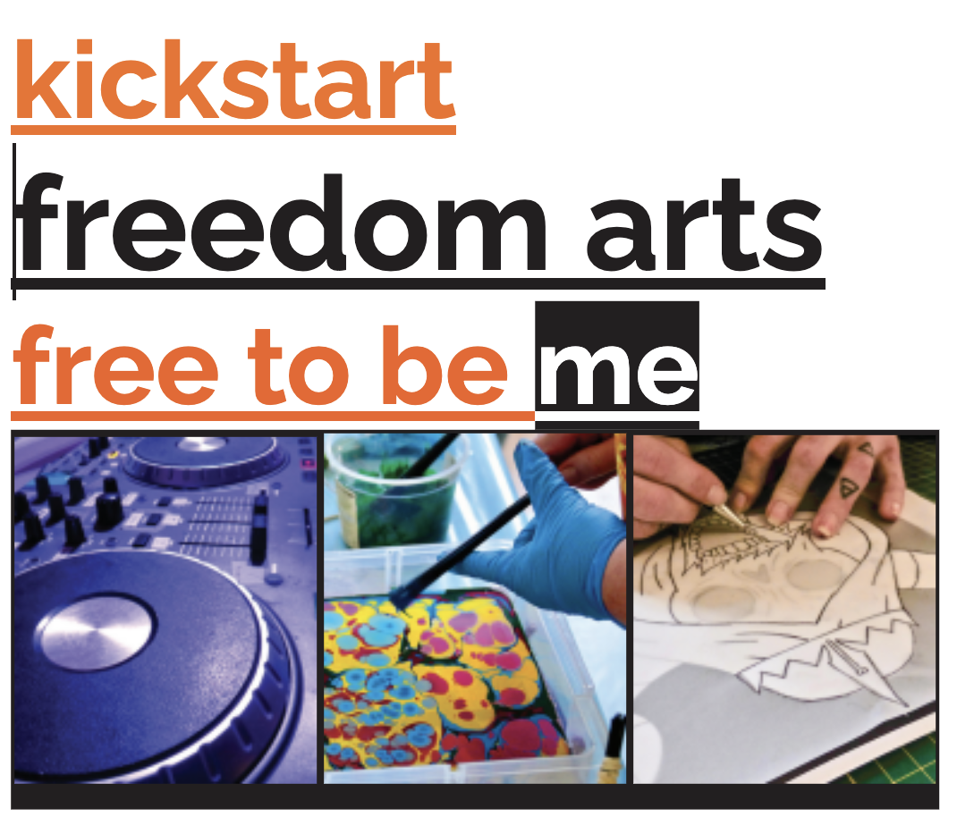

Slide 2
The Freedom Project
Pilot Program

Slide 3
Overall Project Aims:
Gain an improved understanding of themselves and the world around them.
Learn and practice new skills in creative thinking, creative arts and making techniques in a safe space
Gain opportunities to experience positive feelings of success and achievement leading to improved self-esteem, self-confidence and greater self-efficacy
Improve the ability to form and maintain positive relationships.
Learn strategies for dealing with stress and recovery from addictive behaviours
Form pathways to engagement with the broader community, lifelong learning and social programs bringing new opportunities for positive social engagement and forming new friendship groups

Slide 4
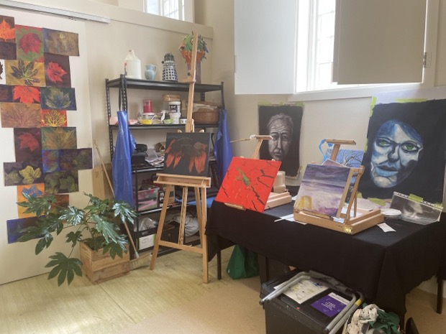
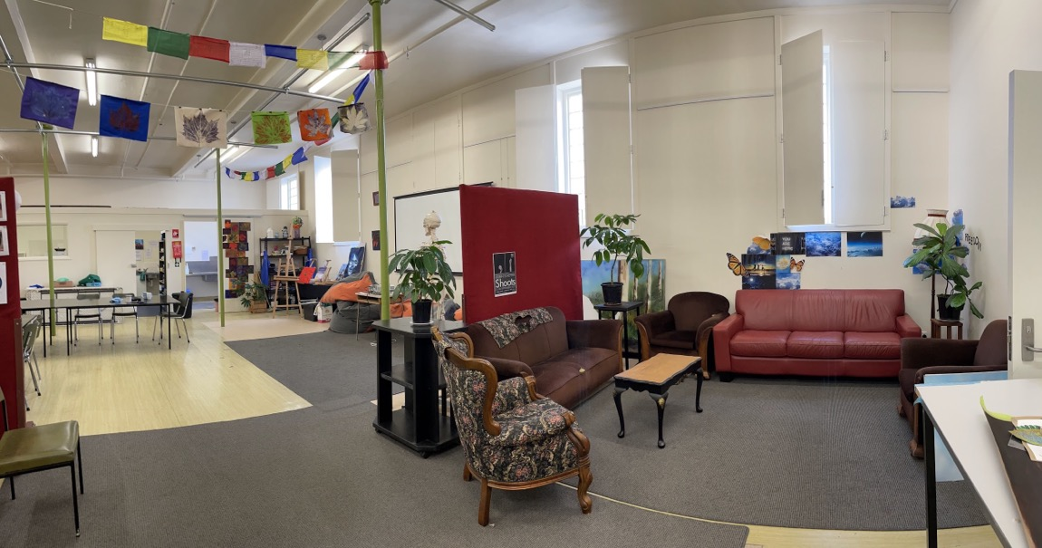
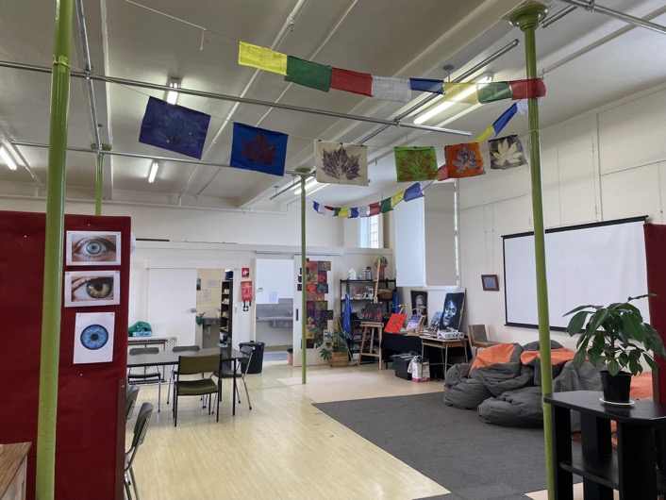
The Art Room
A safe and welcoming space

Slide 5
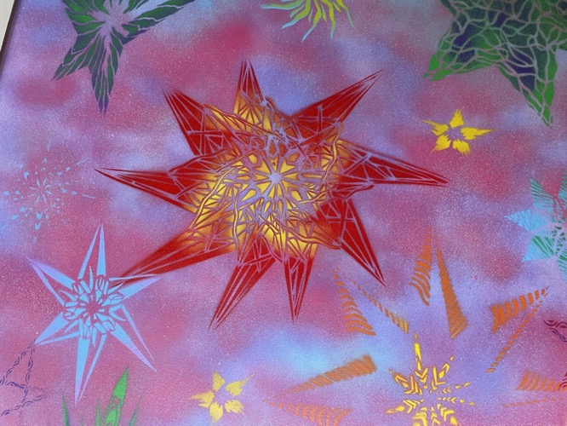
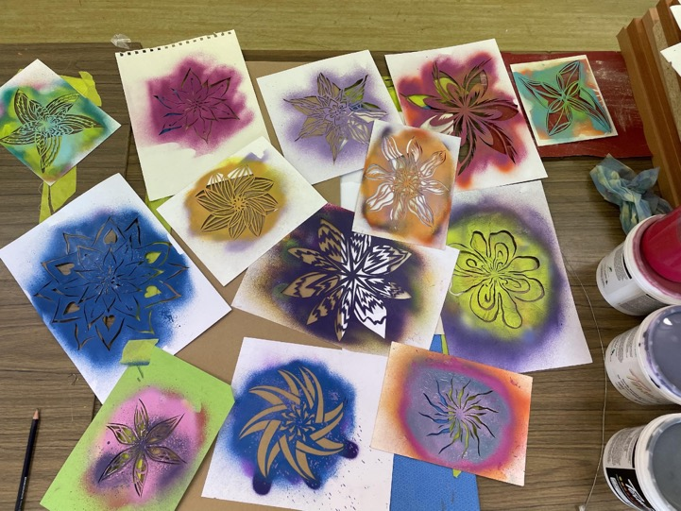
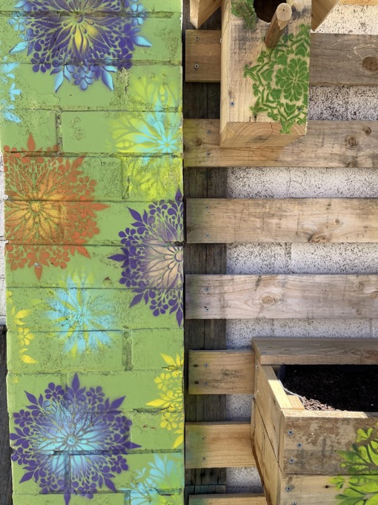
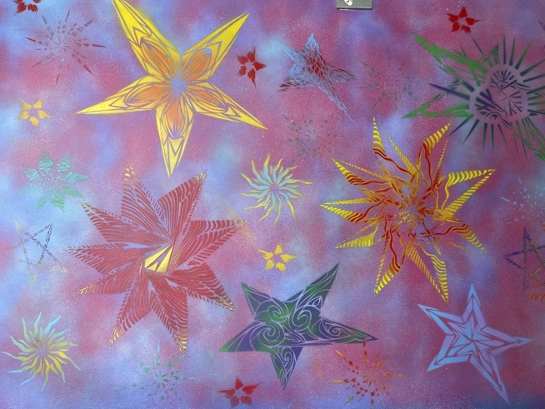
Stencil Art

Slide 6
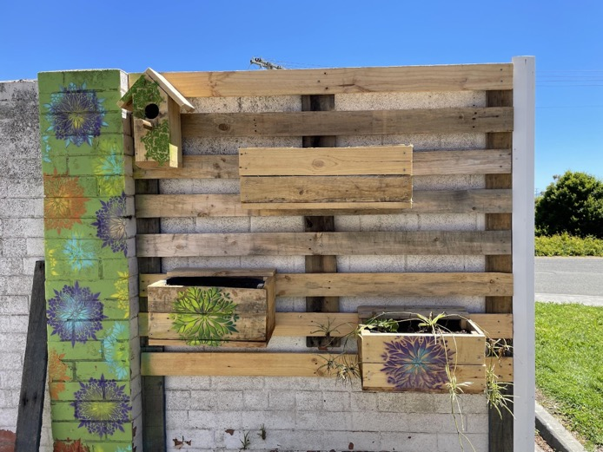
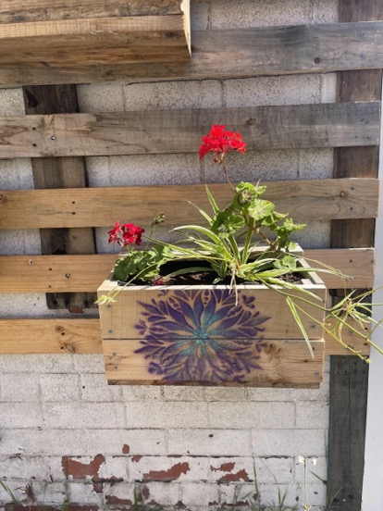
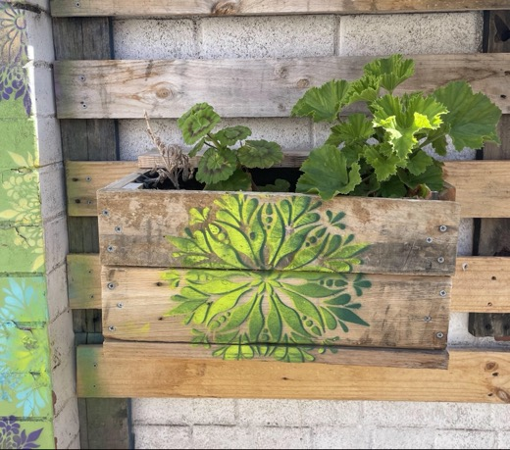
Pallet recycling

Slide 7
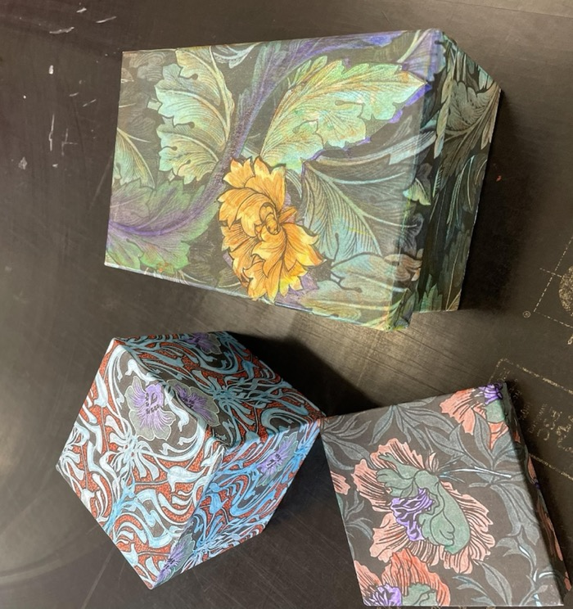
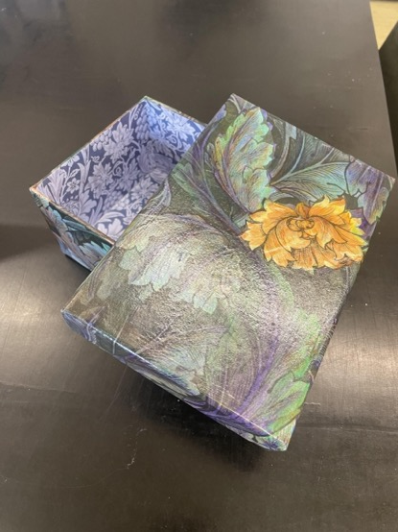
Collage Boxes

Slide 8
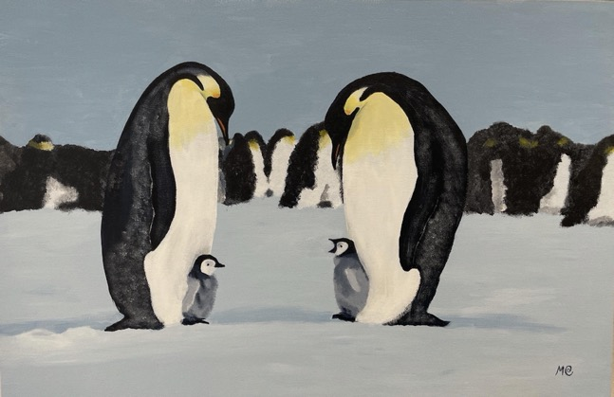
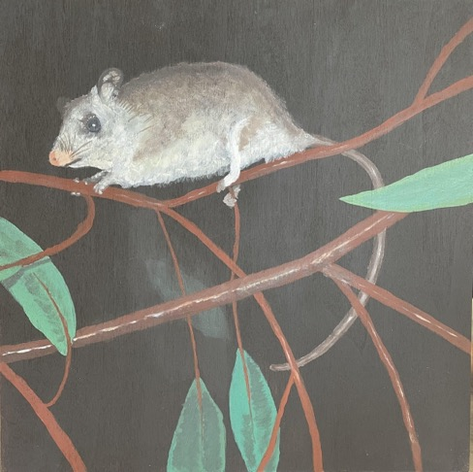
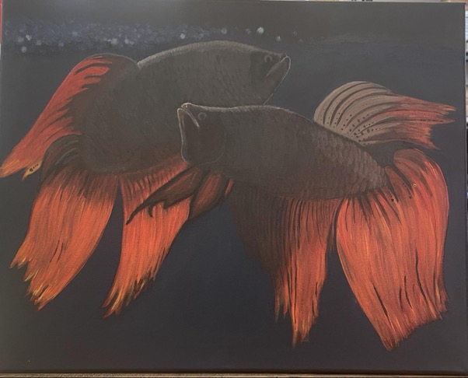
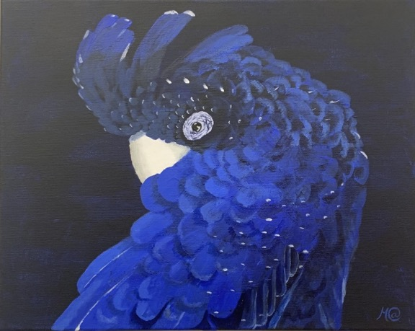
Painting - from beginners to experienced
Second attempt at painting by a client under a Home Supervision Order who used to keep tropical fish, working with something familiar is a great way to start.
This participant had only worked with watercolour before.
Notes:
It’s even helped back home. I now know the importance of showing my daughters how much they are valued so they can have good self-esteem. It boosted my confidence. I wouldn’t have known I could paint like that beforehand, so it’s certainly done a lot for me.

Slide 9
Indigenous woman’s work, (currently re-incarcerated but waiting to come back to Freedom Arts)
Framing - using recycled palettes

Slide 10
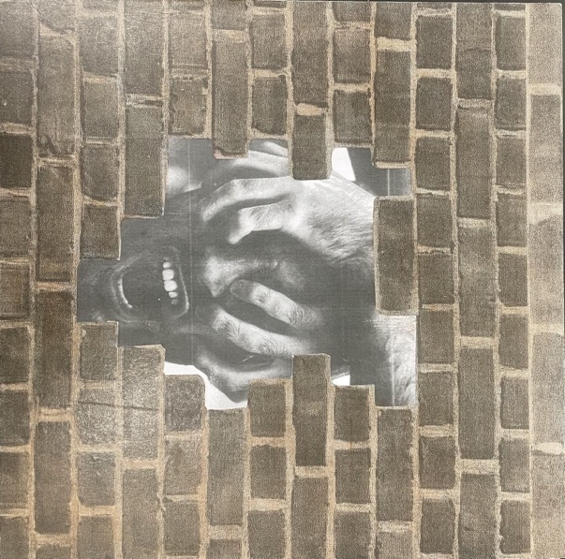
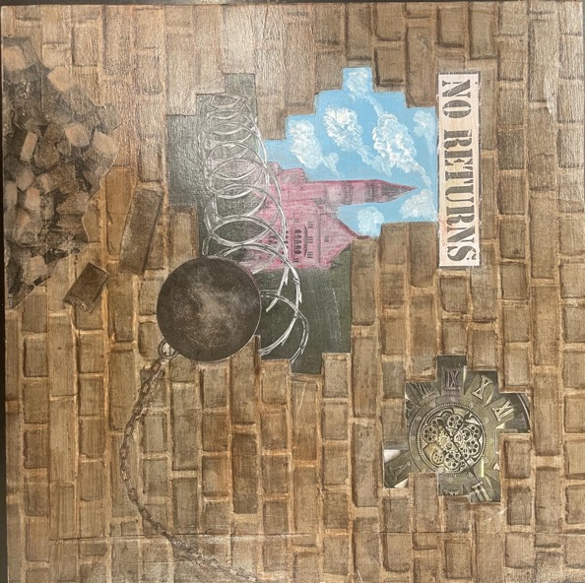
Collage works for Artists with Conviction Exhibition 2021
Theme:Unbuilding the Walls
Notes:
For the first time non incarcerated offenders were offered the opportunity to participated in the Artist with Conviction art exhibition run by Risdon Prison for artworks relating to the theme ‘ Unbuilding the Walls

Slide 11
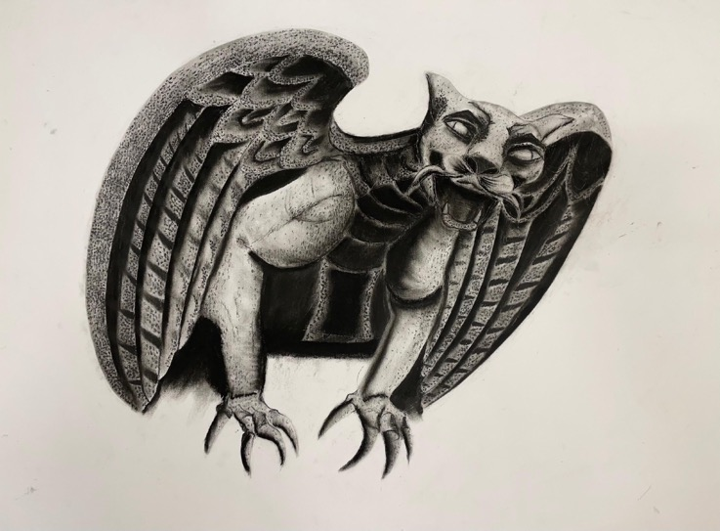
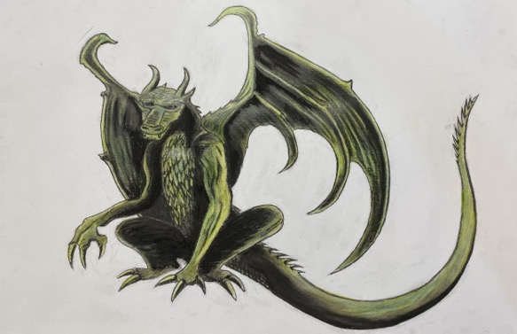
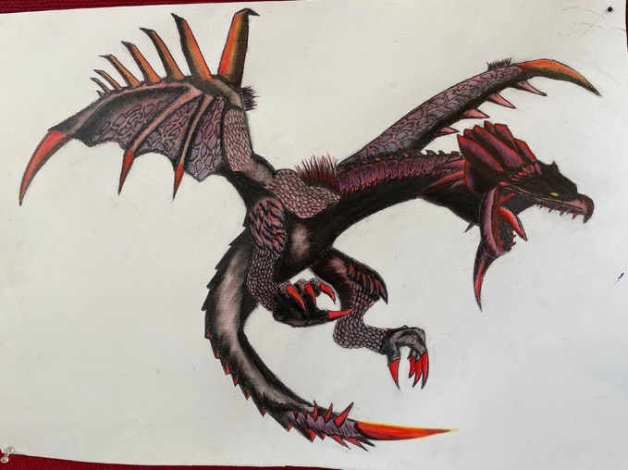
Charcoal and Acrylic
First time using this method of drawing!
Notes:
Andre
‘Freedom has just been 100% life changing for me. It really, really has worked for me. You just have to put in the time, put in the effort. I would be back using, definitely. I would be back living the life I was. Coming here in myself, it gives me a reason to be here. I am learning to deal with more people, my anxiety level is not so high, it's slowly coming down. I plan everything else around Freedom. I feel like I’m a whole new person, a new leaf, started a new chapter in the book. I would recommend this program to anybody who wants to escape the same life that I had.’
I would of felt lost not having a workshop and something to do. I would of more than likely be back in jail by now.
I would be back using definitely. I would be back living the life I was. Coming here gives me a reason to be here. I would recommend this program to anybody who wants to escape the same life I had, to get involved in programs like this. Its been life changing. It really, really has worked for me. I need this not to go and use again and fall back into the rut I was in before.
It definitely helps improve our lives. It works. It has given me so much opportunity.

Slide 12
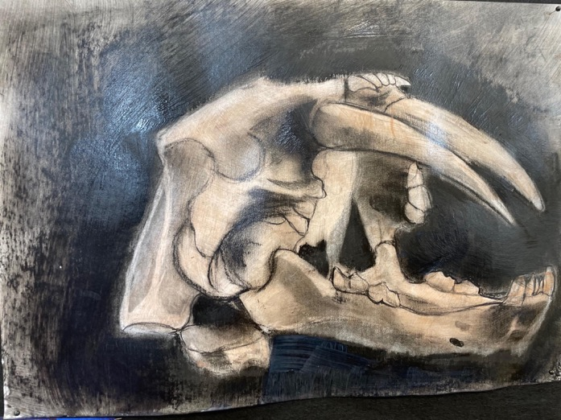
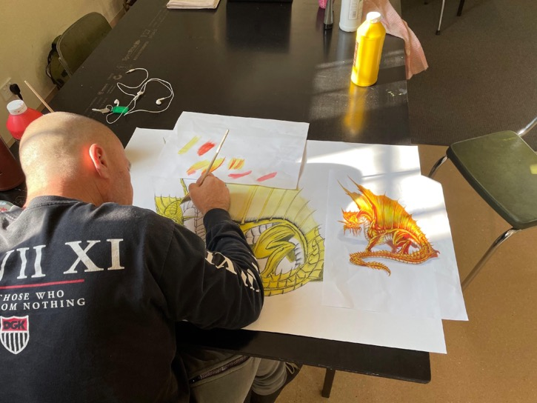
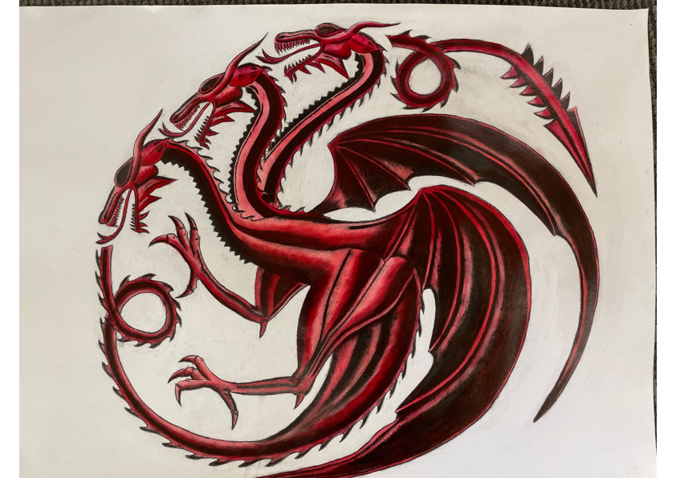
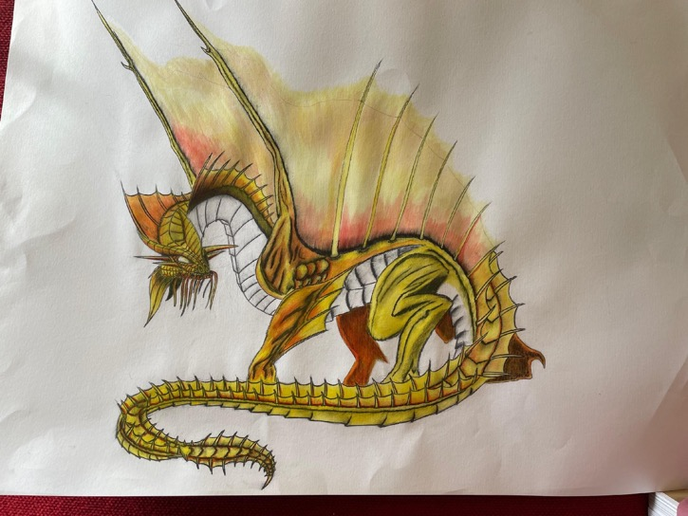
Notes:
Due to other matters, this participant was sentenced to 12 months in jail. He related that if he hadn’t been to Freedom Arts and learned that he could make art, he would have been suicidal at the thought of being inside.

Slide 13
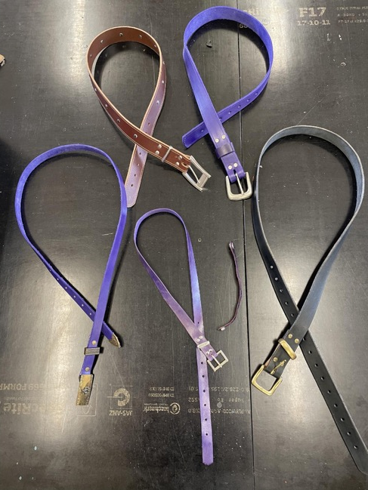
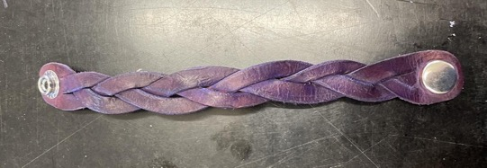
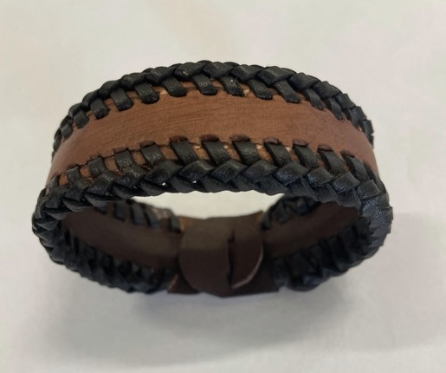
Leatherwork one participant mentoring others

Slide 14
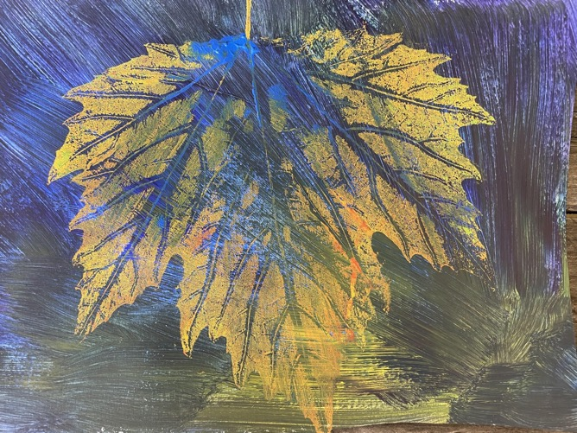
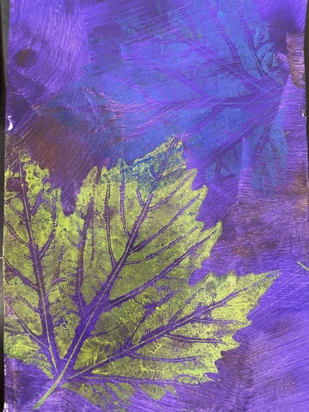
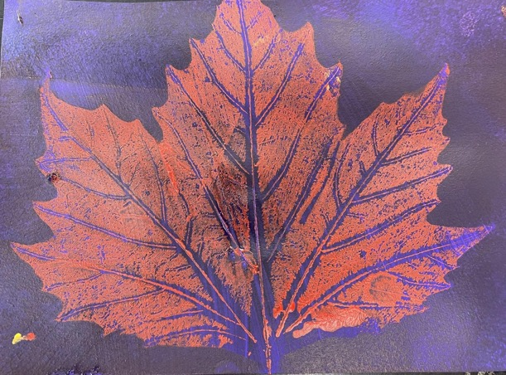
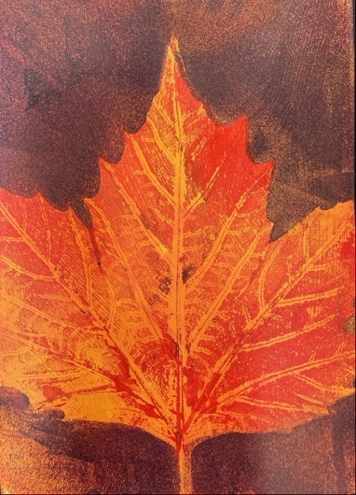
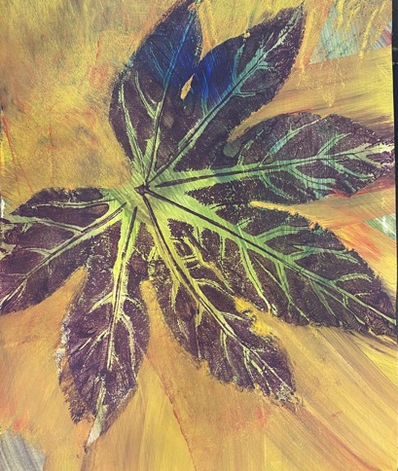
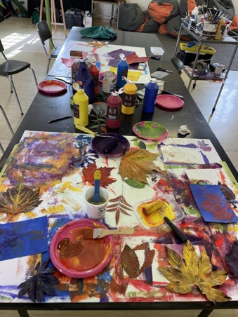
Leaf Printing
Notes:
Being here, painting and working with Caroline has made my stress level go from there to
there. I know it’s a place that don’t judge you. It removes you from the life outside that I did
know and puts you in a whole other world which is what I need at the moment. Some days I
get bad anxiety and bad stress and I just get on the phone or talk to Caroline about it. No
medication, no nothing. The anxiety is slowly coming down. I can slowly interact with more
people and stuff like that. I am a lot more confident.
I know there is a support network that understands.
It reduced my stress. Before this all I could do is be at home depressed. I had nothing to do
but think about what’s happening back home. But coming here gave me something else to
think about.

Slide 15
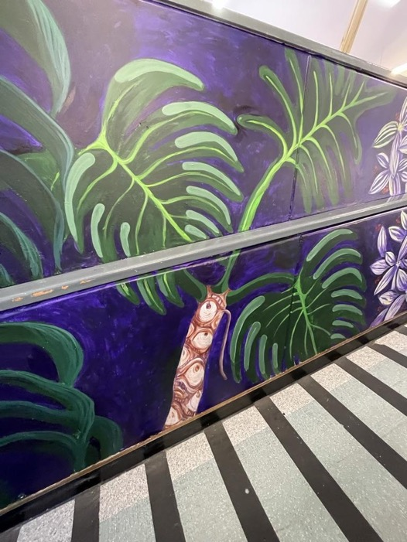
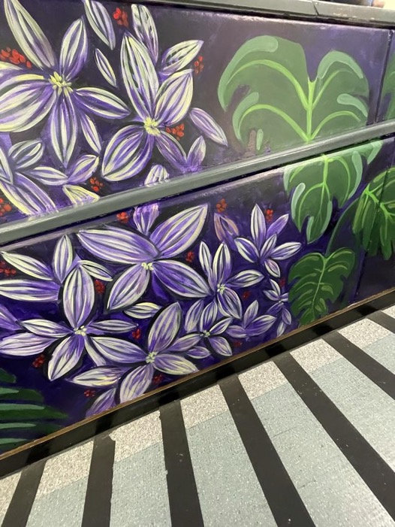
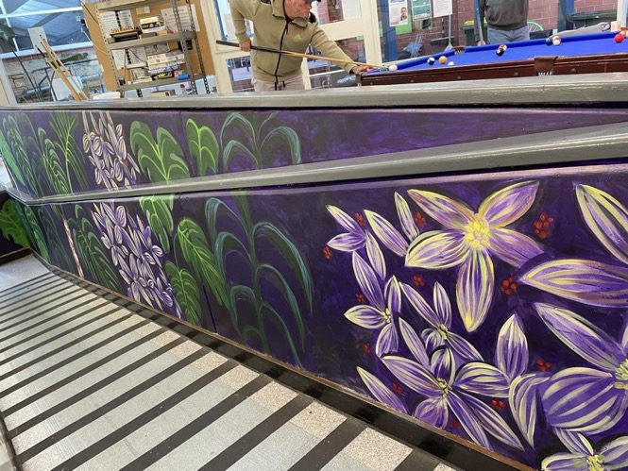
Bethlehem House Mural
Notes:
Working with residents at Bethlehem House to engage them and encourage referral to Freedom Arts.

Slide 16
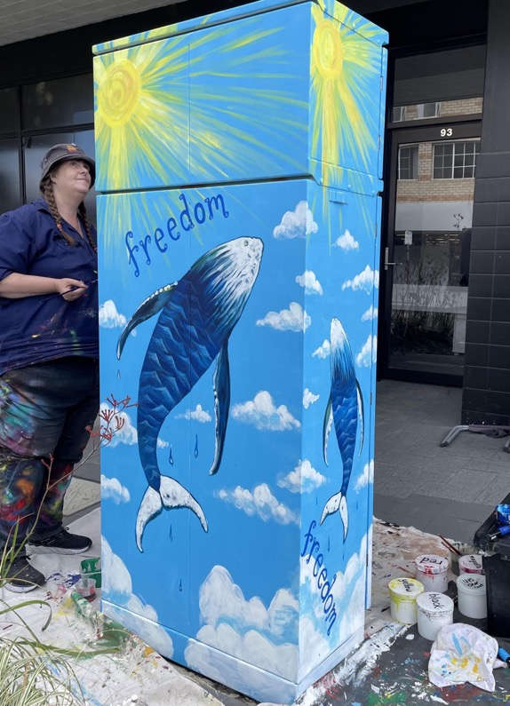
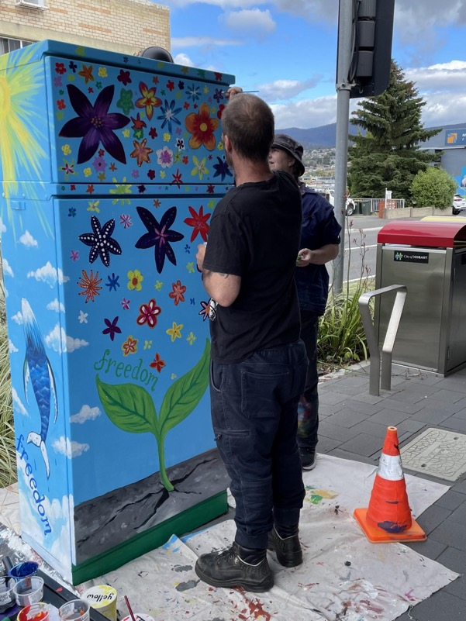
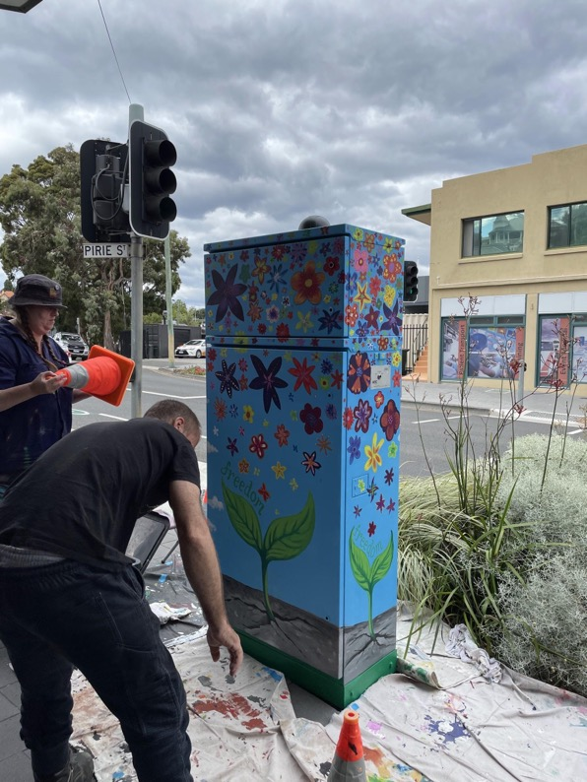
Urban Smart Signal Box Project - Pirie St New Town
Notes:
We applied for a Signal Box project which ignited great excitement for the participants to be part of a project that everyone could see, and positive interaction with passers by.

Slide 17
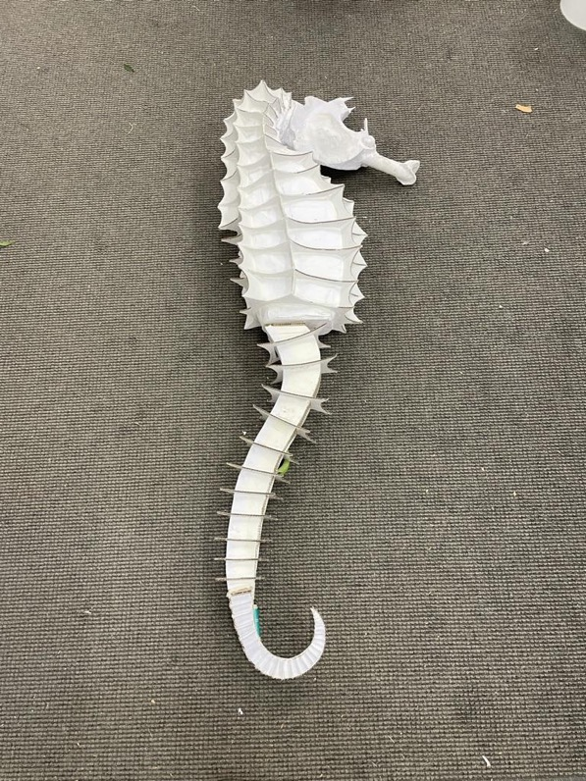
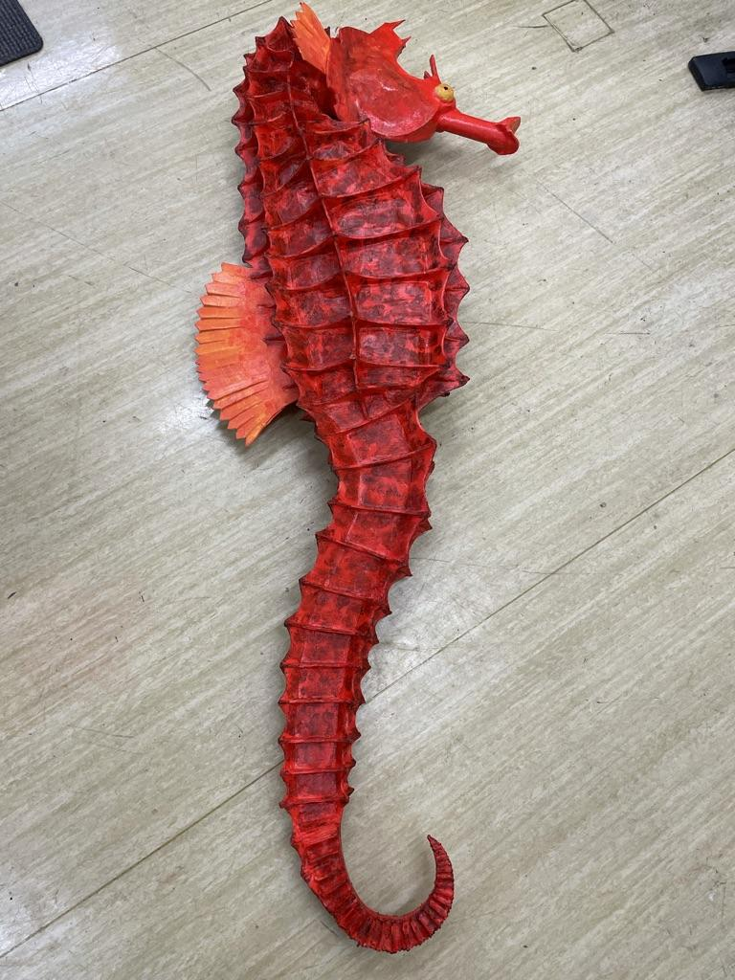
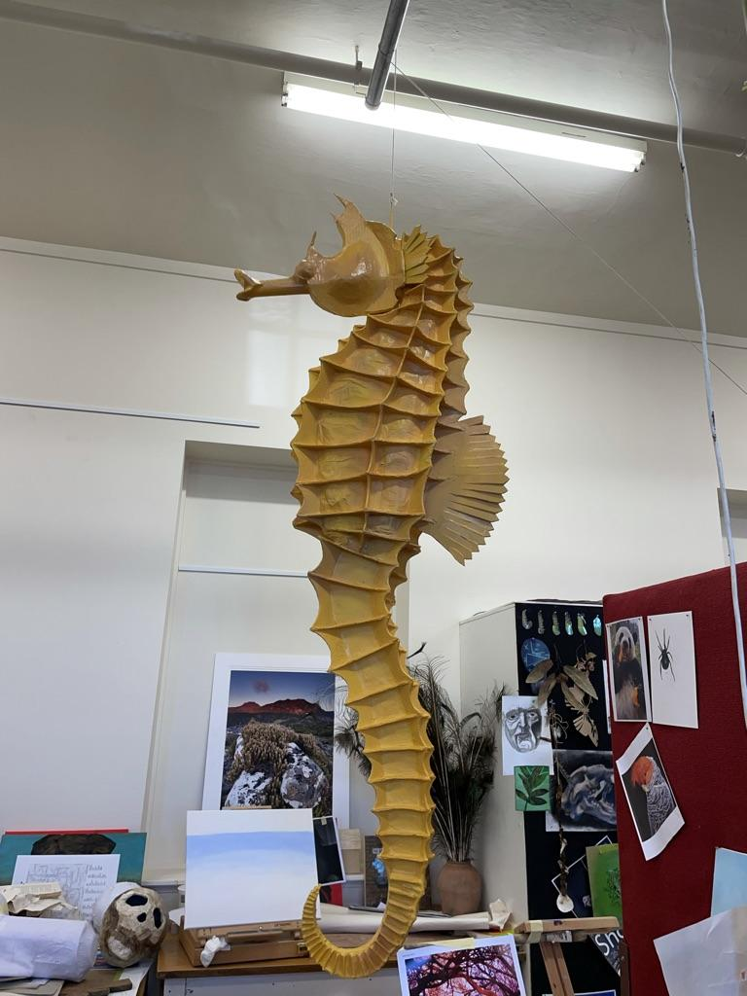
Paper Machier and Cardboard

Slide 18
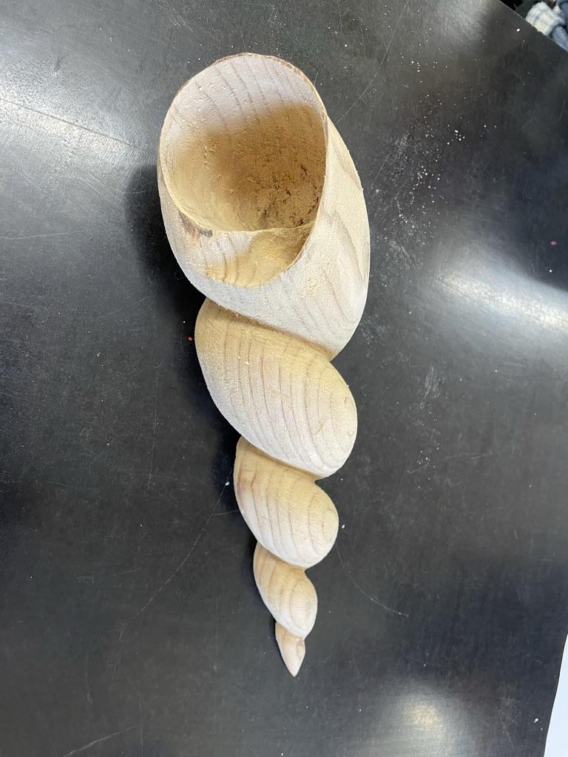
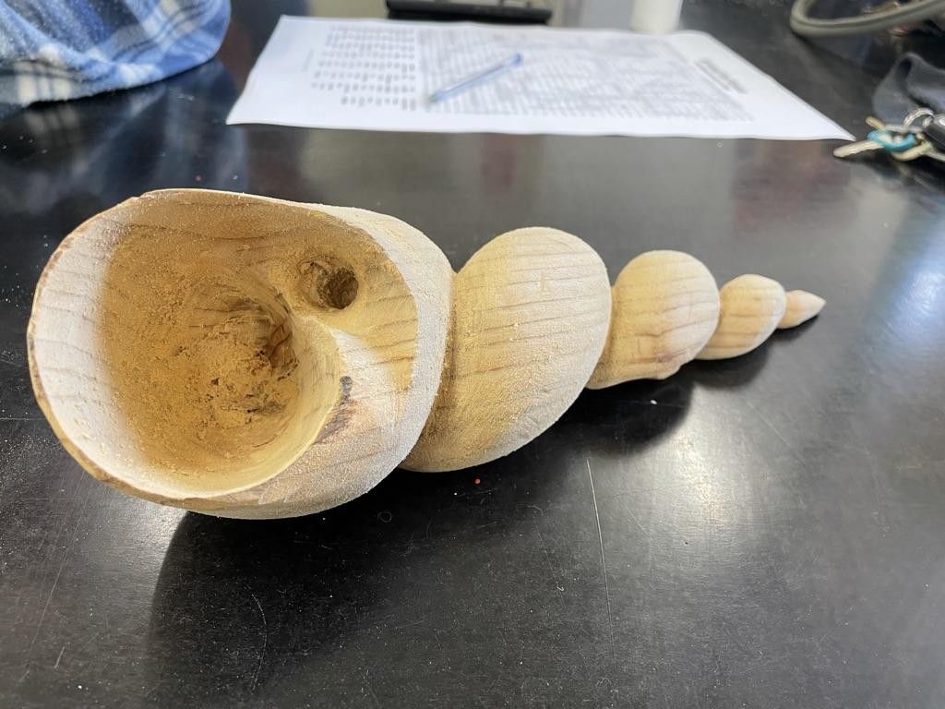
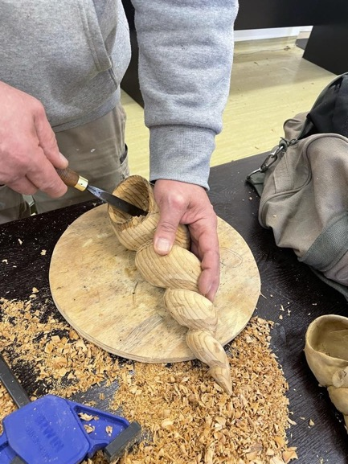
Woodwork with Marcus Tatton
Notes:
I was a bit nervous to start with because I’m a sort of hermit person. I stay at home and don’t socialize. But since I’ve been coming here it’s opened up a whole new world for me, it’s been amazing. It gave you a sense of welcome and warmth, a feeling that you could be in a place where you were comfortable.
I had low expectations but was quickly and pleasantly surprised. It gives me a distraction to lengthen my episodes of drinking. If I wasn’t here I would be drinking.
I had already recovered but it has helped maintain my sobriety.
I was an addict. Cold turkey is the end of that story. I don’t want to go back to that life style. Being here, because a lot of them are in the same boat as me. That has been amazing too. It gives me a reason to be somewhere, to feel wanted because I have no family or friends. Being here really helps and you can talk about all different things.

Slide 19
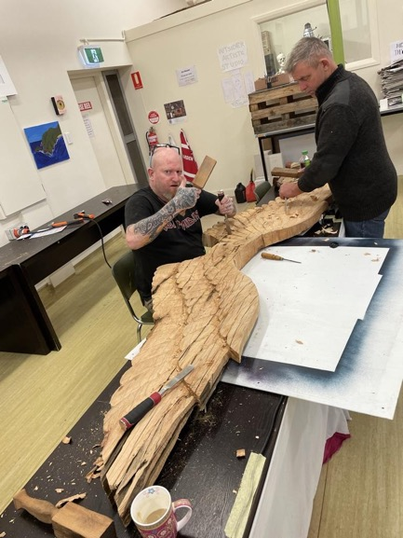
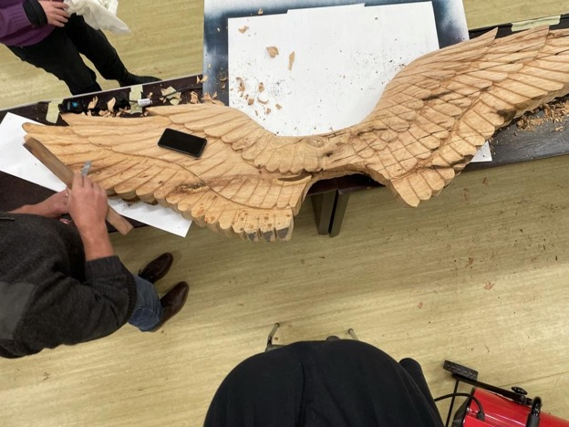
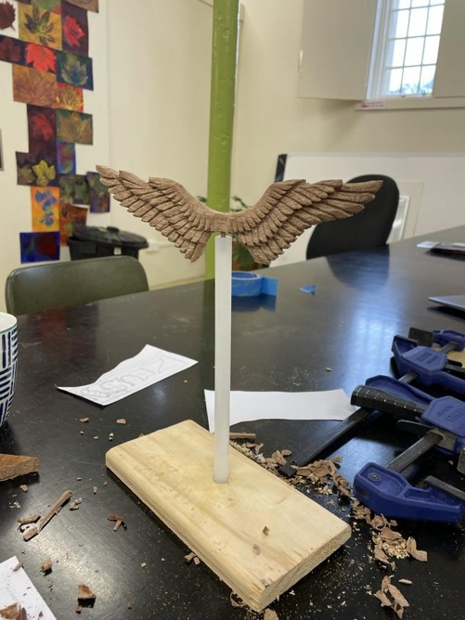
Freedom Wings - A work in progress
An artwork developed with sculptor Marcus Tatton and Nick Maxwell, was erected out the front of the Old Orphanage circa 1831
Notes:
Working with positive male role models who have had no connection to the justice system had a very positive impact on the participants. Some of the soft skills that were passed on were patience, resilience and learning to control outbursts of anger when something went wrong.

Slide 20
Installed
Notes:
Installing the Wings at Kickstart Arts, St Johns Park. This was a great moment. One of the guys said he realized that he’d been smiling all morning, something that he had not done for a long time.

Slide 21
Wood carving with Marcus Tatton
Notes:
This was a client who had never made any art ever. He was very proud of his garage plaques.

Slide 22
Fabric Printing
Notes:
A local artist came in to do some stencilling with the participants. I am very choosy about who works with the clients. It takes a particular personality to work with this cohort. As she worked with children alot, sadly she was too patronising and ruffled the feathers of our group, but we learned some new skills and moved on to do our own version of stencilling.

Slide 23
Free to Fly Acrylic on Canvas
This participant benefited greatly from out program and referred to it as his ‘therapy’.
Notes:
Tim
Tim's painting of Bruny Island he also got into some papier mache, he made a massive planet Mars that he gifted to his son. Tim found Freedom Arts to be a great help to him, it was something that he looked forward to every week. He often talked about how much it supported his emotional wellbeing and gives his life stability. ‘It’s a big plus for my mental health, they are the only days I feel content with myself. Without it I think I would be ‘off the rails’. It has really helped big time with my depression and anxiety.

Slide 24
Paper Machier Jack Jumper – in progress

Slide 25
The creator of this Jack Jumper Ant won the Premier’s award at the Artists with Conviction Exhibition 2022
Notes:
Nigel G
‘Before I went to jail, I used to carve wood, and was hoping I could do that in jail. That was not possible so I had to make use of what I could find. Toilet rolls, old request forms and cardboard boxes was all I could use. Freedom Arts has given me a focus, and something to do. Having somewhere to go and something to do is good for my mental health and wellbeing. If it wasn’t for Freedom Arts the boredom and lack of focus would probably have led me back to jail.’
This piece won the Premier's Award at AWC

Slide 26
Even the toilet doors got a makeover at Freedom Arts

Slide 27
Working with wood assemblage
Notes:
These works are a progression from the plaques, working with professional artist Nick
Working with positive male role models assisted participants to engage in non violence or drug related conversations and problem solving skills.

Slide 28
Moto jigsaws – an enterprise initiative that is being explored by the participant, excited by the potential.

Slide 29
Important partners and associations developed in the Freedom program include:
Salvation Army - Beyond the Wire - Ian Wilkinson
Bethlehem House Accommodation (Parolees)
Sexual Assault Support Services - (Women on Justice orders in supported accommodation) Yvona Nouzova
Prison Redress Counsellor Ignacio Rodriguez
Red Cross Support Services and their networks
Max Employment - Georgina Price - (Regional Manager supporting clients on orders)
Artist with Conviction team at Risdon Prison Kylie Chomatek, Wendy Aboud
Literacy Coordinator - Community Corrections Susan Buggy
Risdon Prison Reintegration Team - Katherine Dent - Programs Manager John Pickering
Justice Reform Initiative
Youth Justice Support
Notes:
Connections play an important role in building bridges between services and a flow on effect for clients. The Freedom Art room became a great place to meet with support workers and clients together and a chance for workers to see their clients in a creative and positive light.

Slide 30
CMD first workshop for staff for AWC Client won award – went on to TAFE

Slide 31
Building relationships with Corrections Staff to improve program referrals– workshop for staff as part of Artists with Conviction Exhibition to be held at Kickstart Arts November 2022

Slide 32
Client Testimonials – drawn from Anglicare evaluation
The anxiety is slowly coming down…I’m a lot more confident
It reduced my depression
.
Coming to Freedom Arts has built up my confidence to be around people.
I feel like I’m a whole new person, turned a new leaf, started a new chapter in the
book.
.
Notes:
Providing occupation and a safe and welcoming environment had improved anxiety levels and
resilience:
Being here, painting and working with Caroline has made my stress level go from there to
there. I know it’s a place that don’t judge you. It removes you from the life outside that I did
know and puts you in a whole other world which is what I need at the moment. Some days I
get bad anxiety and bad stress and I just get on the phone or talk to Caroline about it. No
medication, no nothing. The anxiety is slowly coming down. I can slowly interact with more
people and stuff like that. I am a lot more confident.
I know there is a support network that understands.
It reduced my stress. Before this all I could do is be at home depressed. I had nothing to do
but think about what’s happening back home. But coming here gave me something else to
think about.
Participants described increasing feelings of self-worth and communicating better with others.
I think more of myself and feel more confident in the things I do and reacting with different
types of people.

Slide 33
What would happen if you didn’t have Freedom Arts?
I would be back ‘using’ back living the life I was.. to escape the same life I had, get involved in programs like this.
I would of felt lost …more than likely be back in jail by now.
Its been life changing
It works. It has given me so much opportunity.
It definitely helps improve our lives.

Slide 34
Corrections Staff Testimonials
He felt at ease and welcomed when he attended the program
·
My client has advised me it gives him a boost of confidence as he feels appreciated by others as well as the staff in the project
The program was a large contributor towards the client’s positive mental health, it gave him a sense of purpose and ultimately pride in being able to complete artwork
An amazing and inspiring program

